Slide 1
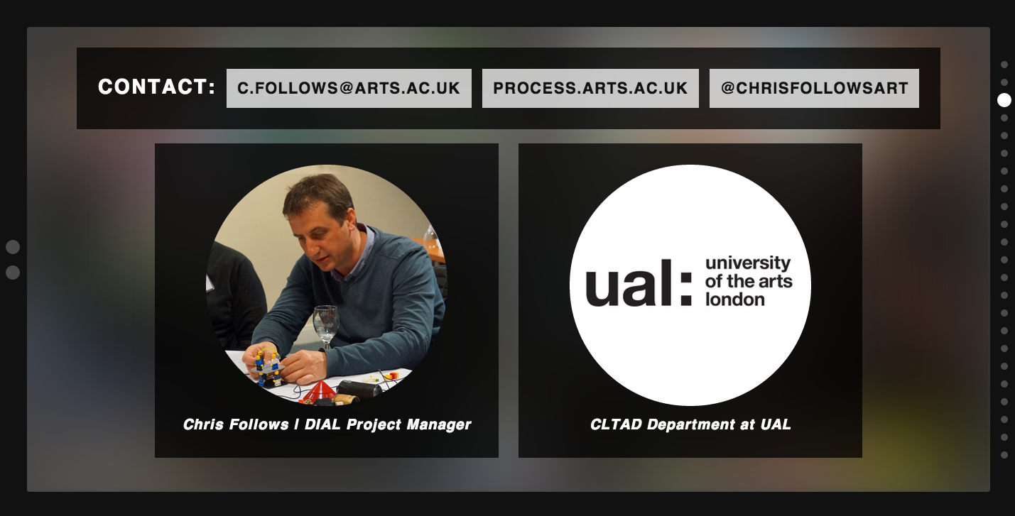
Introduction to developing
online educational resources
University Academic Support Forum 2
1 July 2014 Chelsea College of Arts

Slide 2
MY BACKGROUND
DIAL (2011 to Date)
Digital Integration into arts learning
SCORE (2011 - 2012)
Support Centre for Open Resources in Education (Open University)
ALTO (2009 - 2012)
Arts Learning & Teaching Online
PROCESS.ARTS (2006 – to Date)
Sharing Open Educational resources OERs

Slide 3
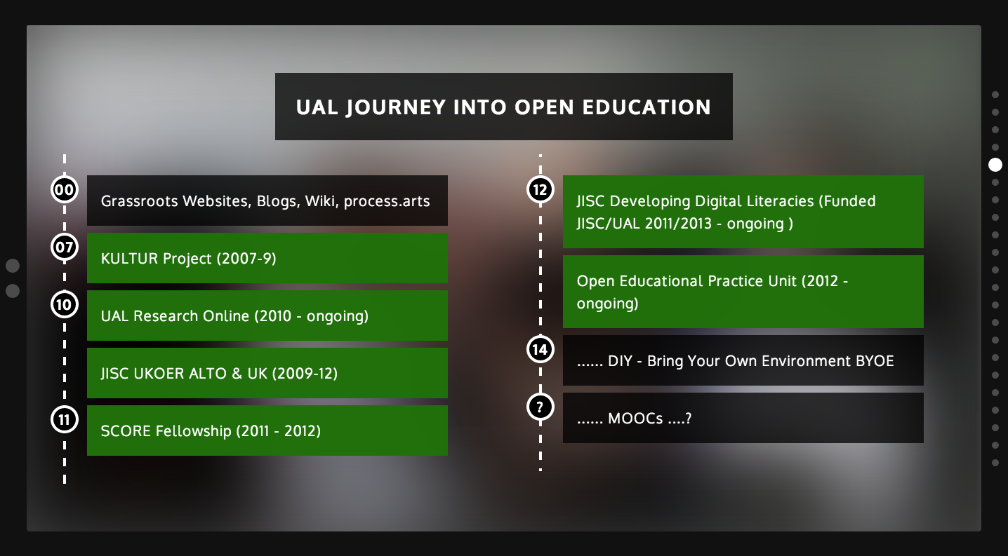

Slide 4
ENVIRONMENT
CLOSED (Login)
OPEN (Sharing, download and reuse)
INSTITUTIONAL (Top down)
GRASSROOTS (Individual/group)
IN-HOUSE (VLE)
COMMERCIAL (Easy, Contract and Fees)
FREE (Specialist, Open Source)

Slide 5
CONTEXT
ACADEMIC (Research)
TECHNICAL (Instructional)
PRACTICE (Personal)
FORMAL (Learning Design, e-learning)
INFORMAL (Experimental, agile)
RICH MEDIA (Technical skills)
DATA (Metadata)
LICENCE (CC)
IDENTITY (Presence)
ONLINE COMMUNITIES (People sharing)
SUPPORT (Stewarding)

Slide 6
MOTIVATIONS TIME & SUPPORT
WHO
Individual (who supports me?)
Group (CoP)
Course (MOODLE)
College (OER)
University (OER)
Sector (OER)
Unknown (OER)
WHY
Personal sharing motivations (Own Time – Specialist in the field)
Required to by line manager or project (Work Time)

Slide 7
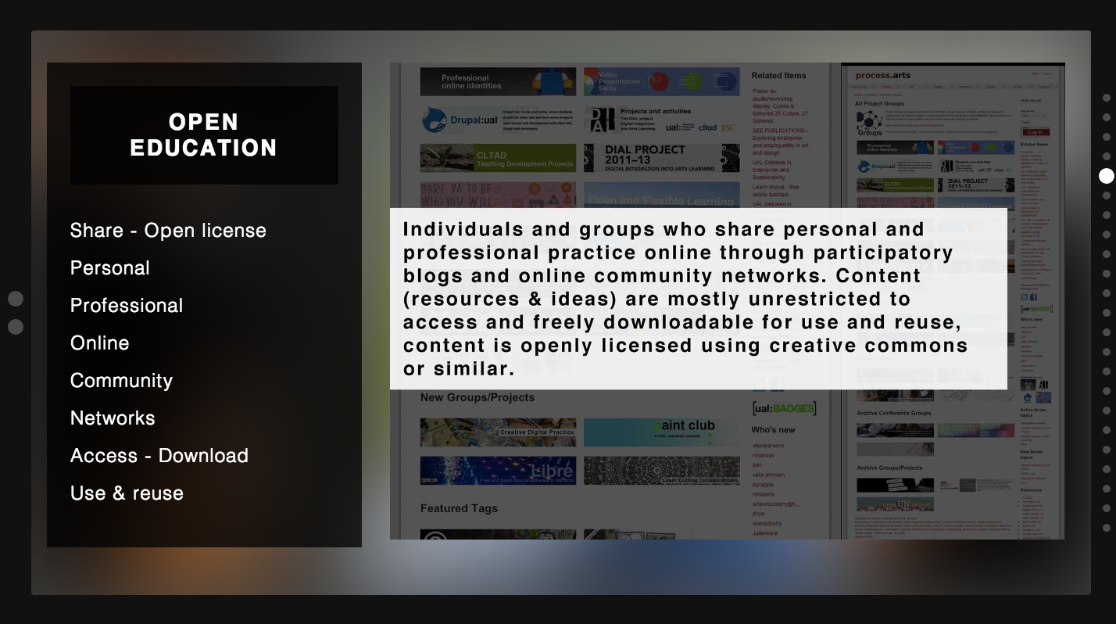
DEFINITIONS DIAL

Slide 8
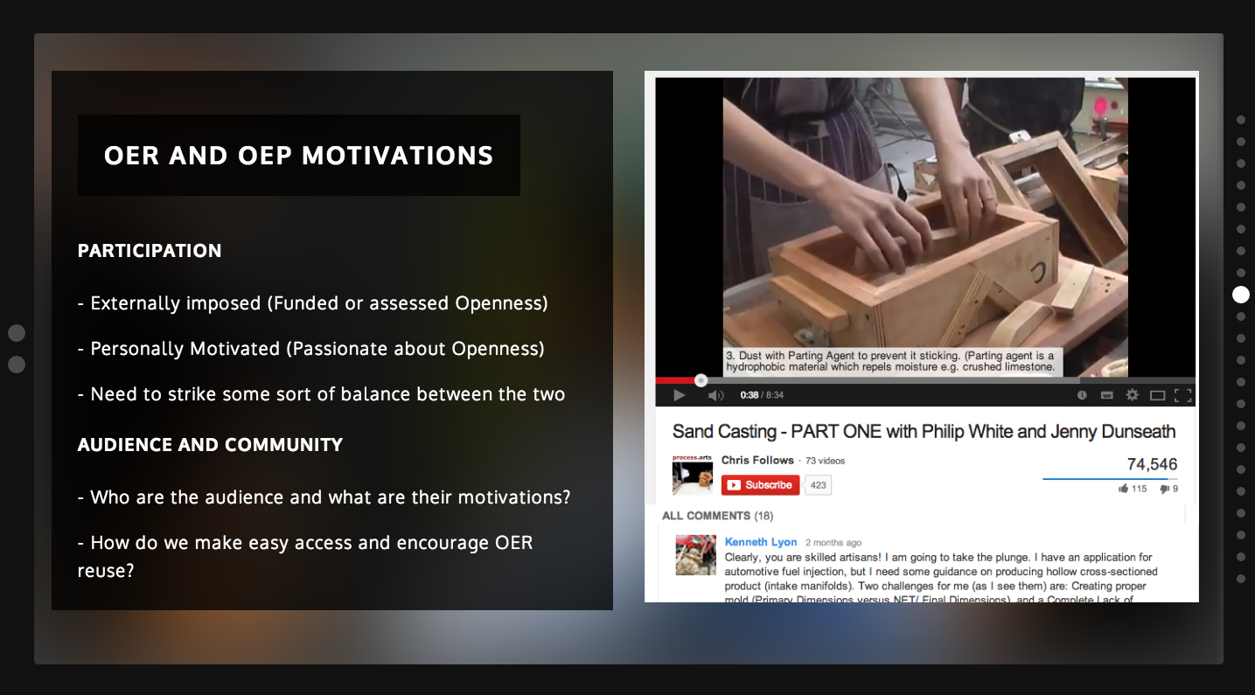

Slide 9
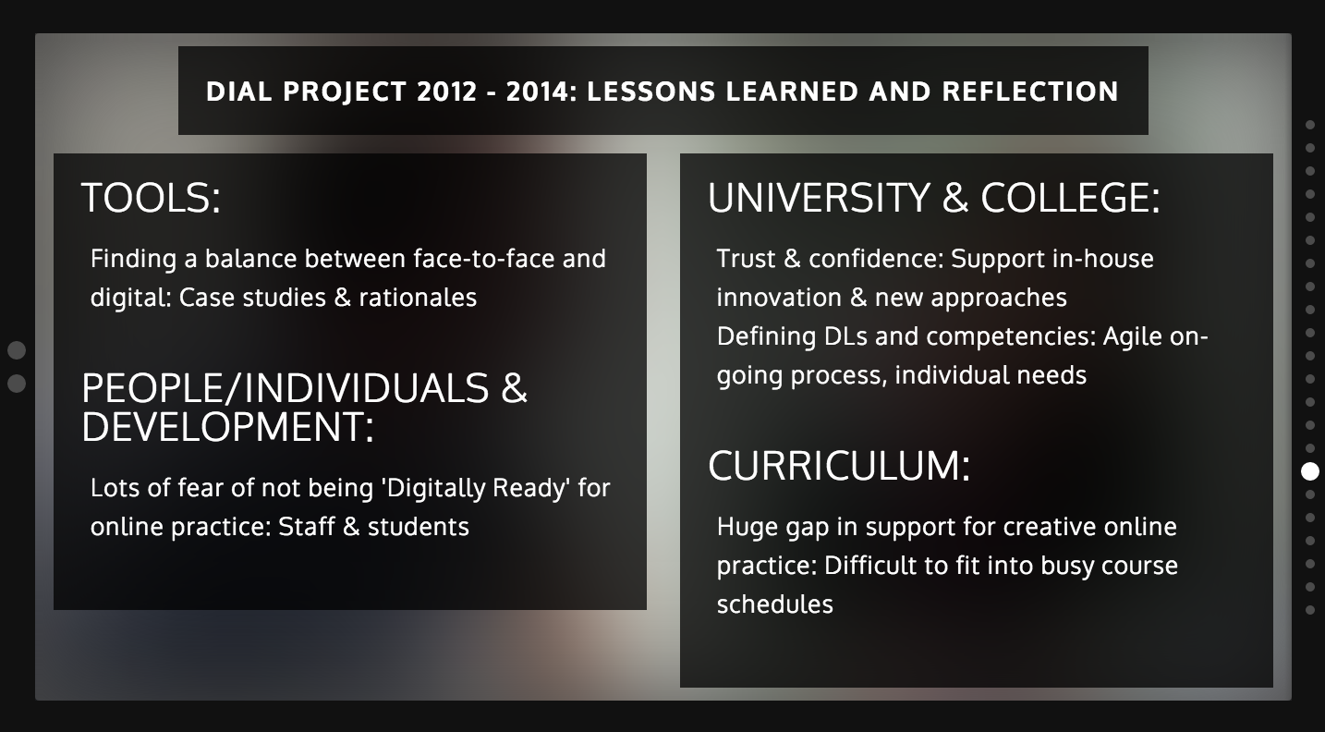

Slide 10
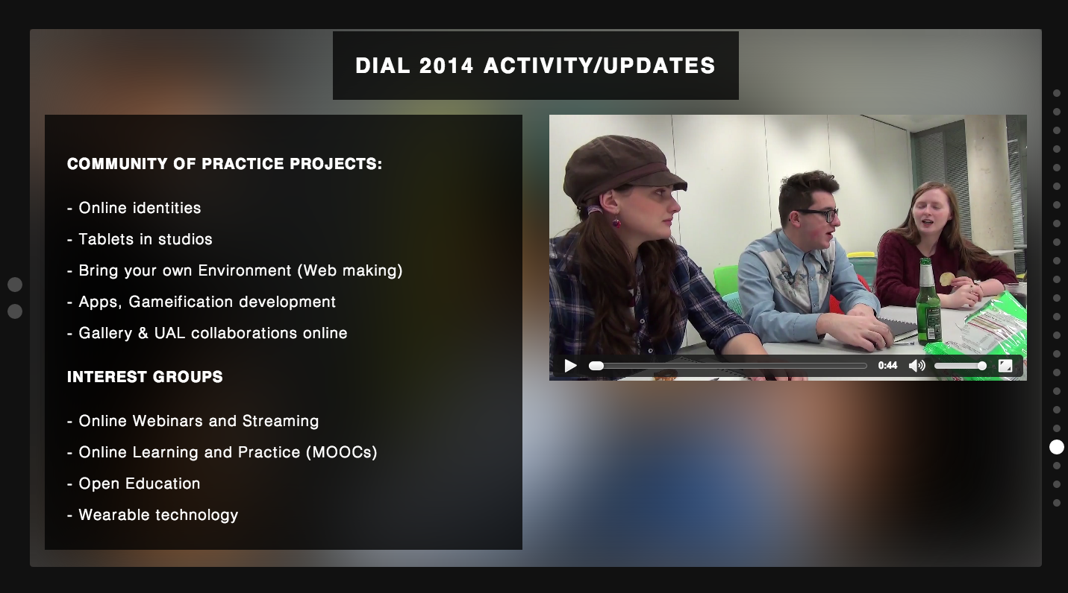
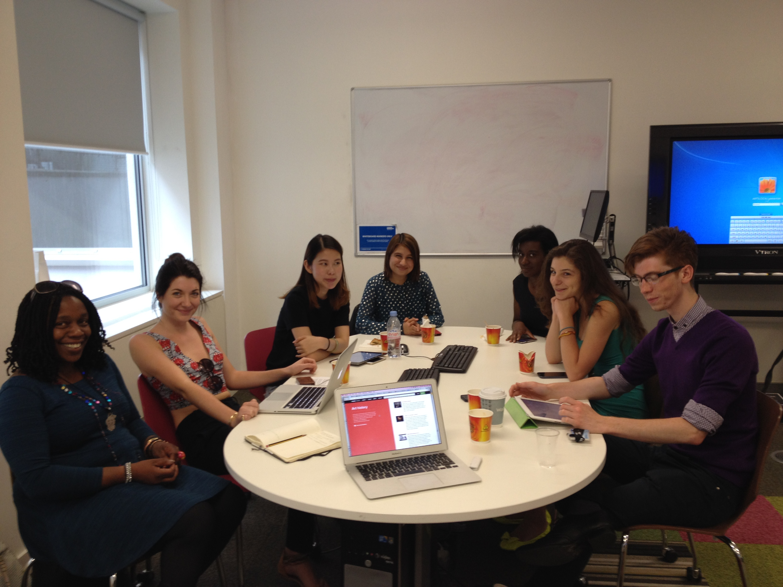

Slide 11
UAL Online Educational Tools
http://moodle.arts.ac.uk/
http://workflow.arts.ac.uk/
http://myblog.arts.ac.uk/
http://commonplace.arts.ac.uk/

Slide 12
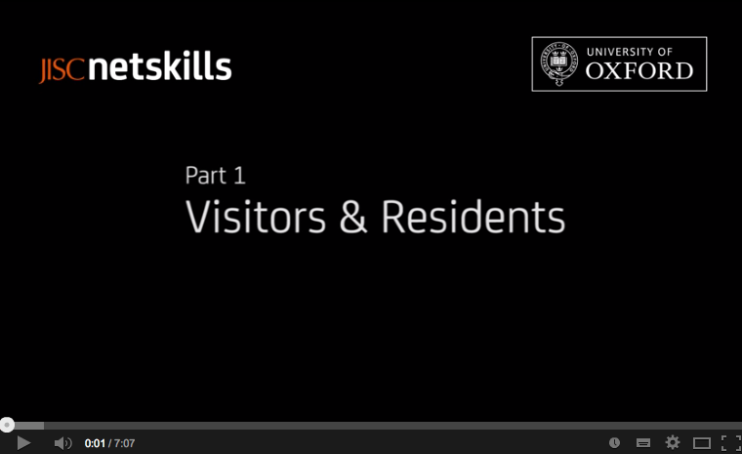

Slide 13
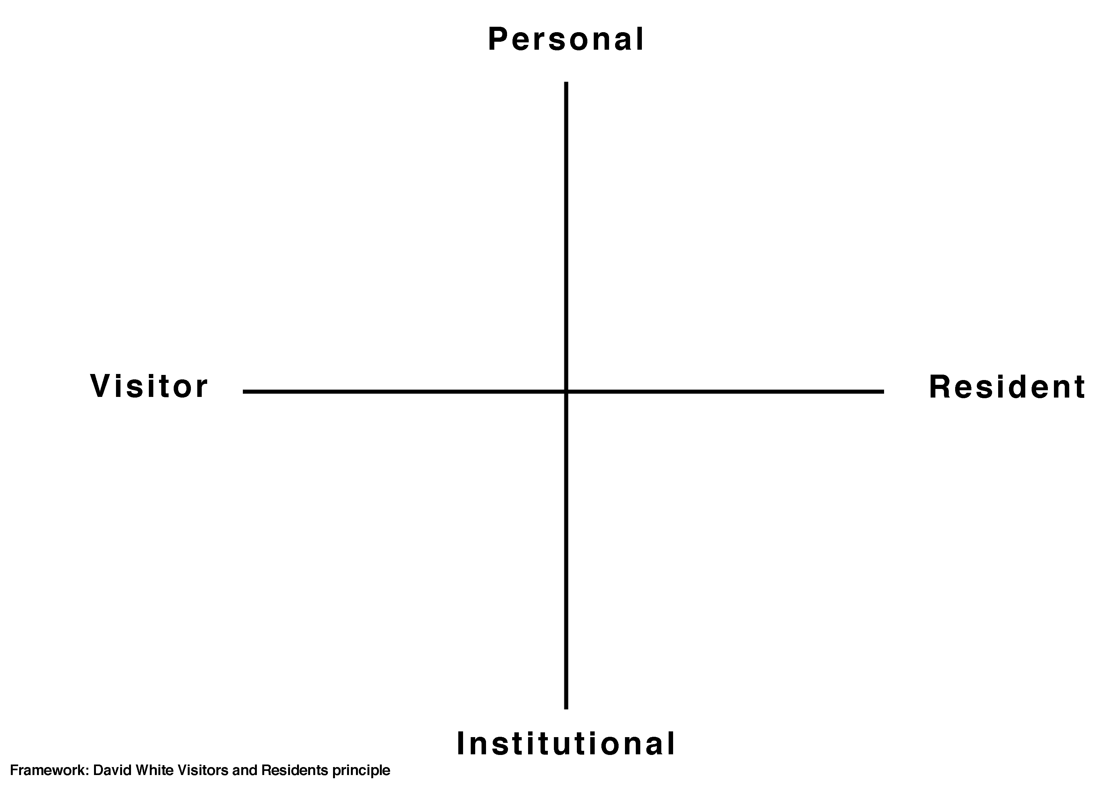

Slide 14
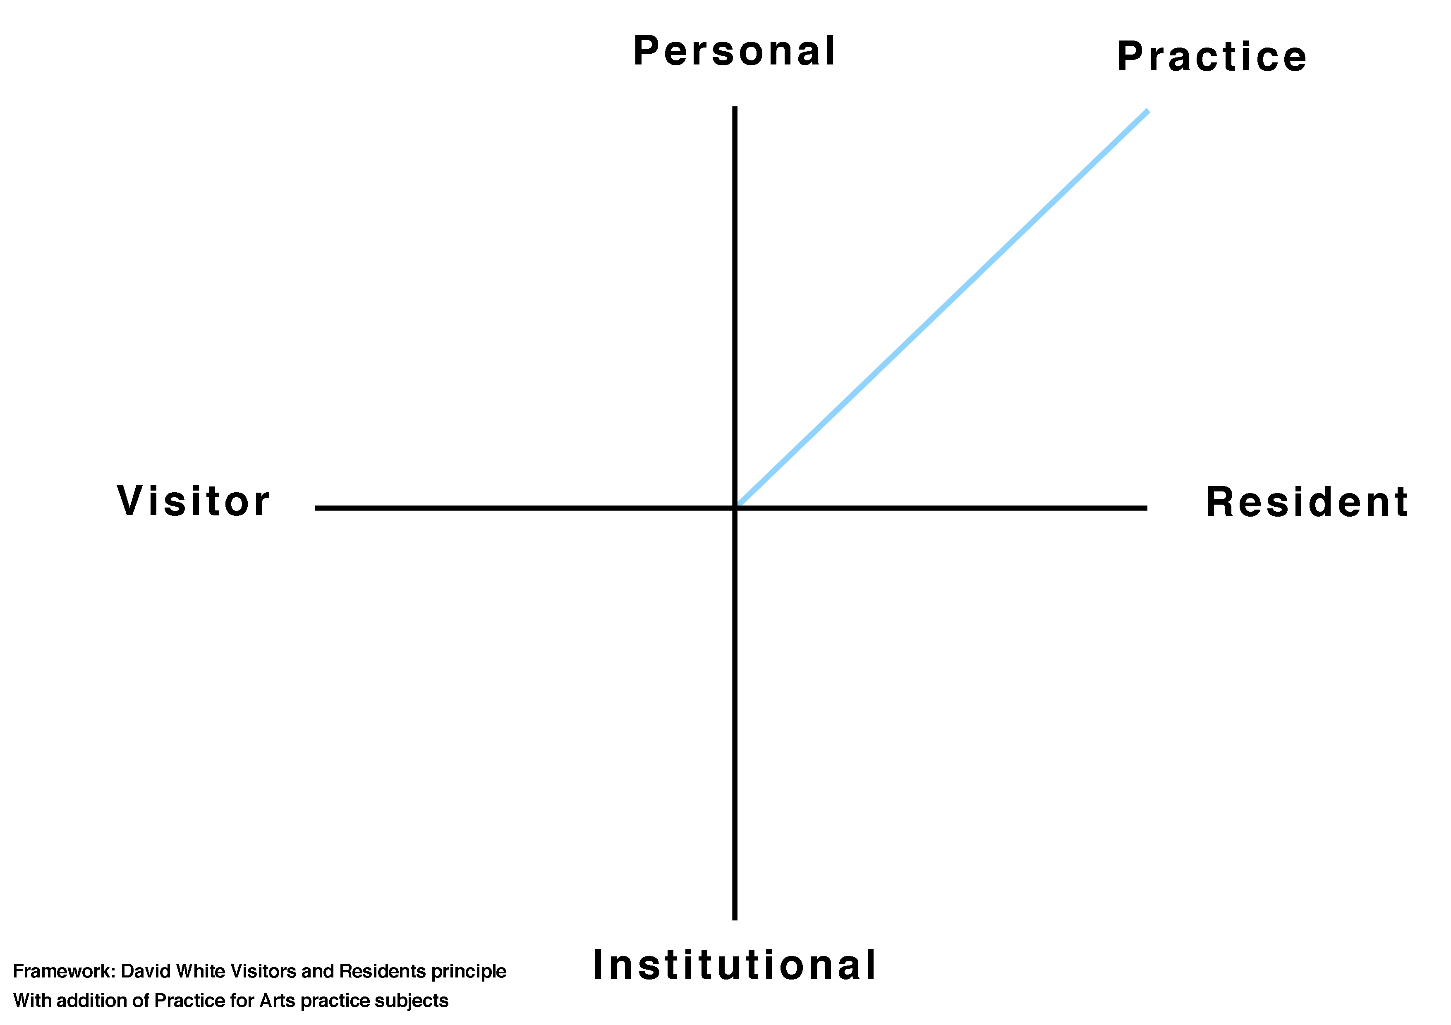

Slide 15
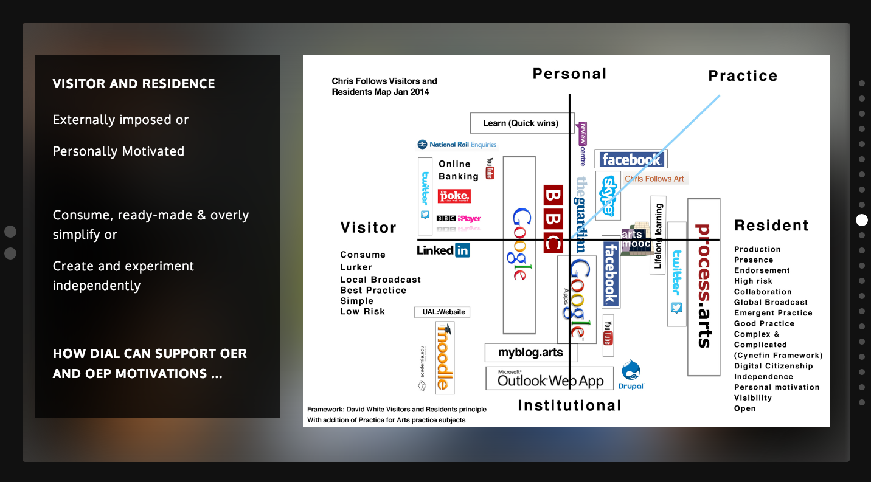

Slide 16
