Slide 1
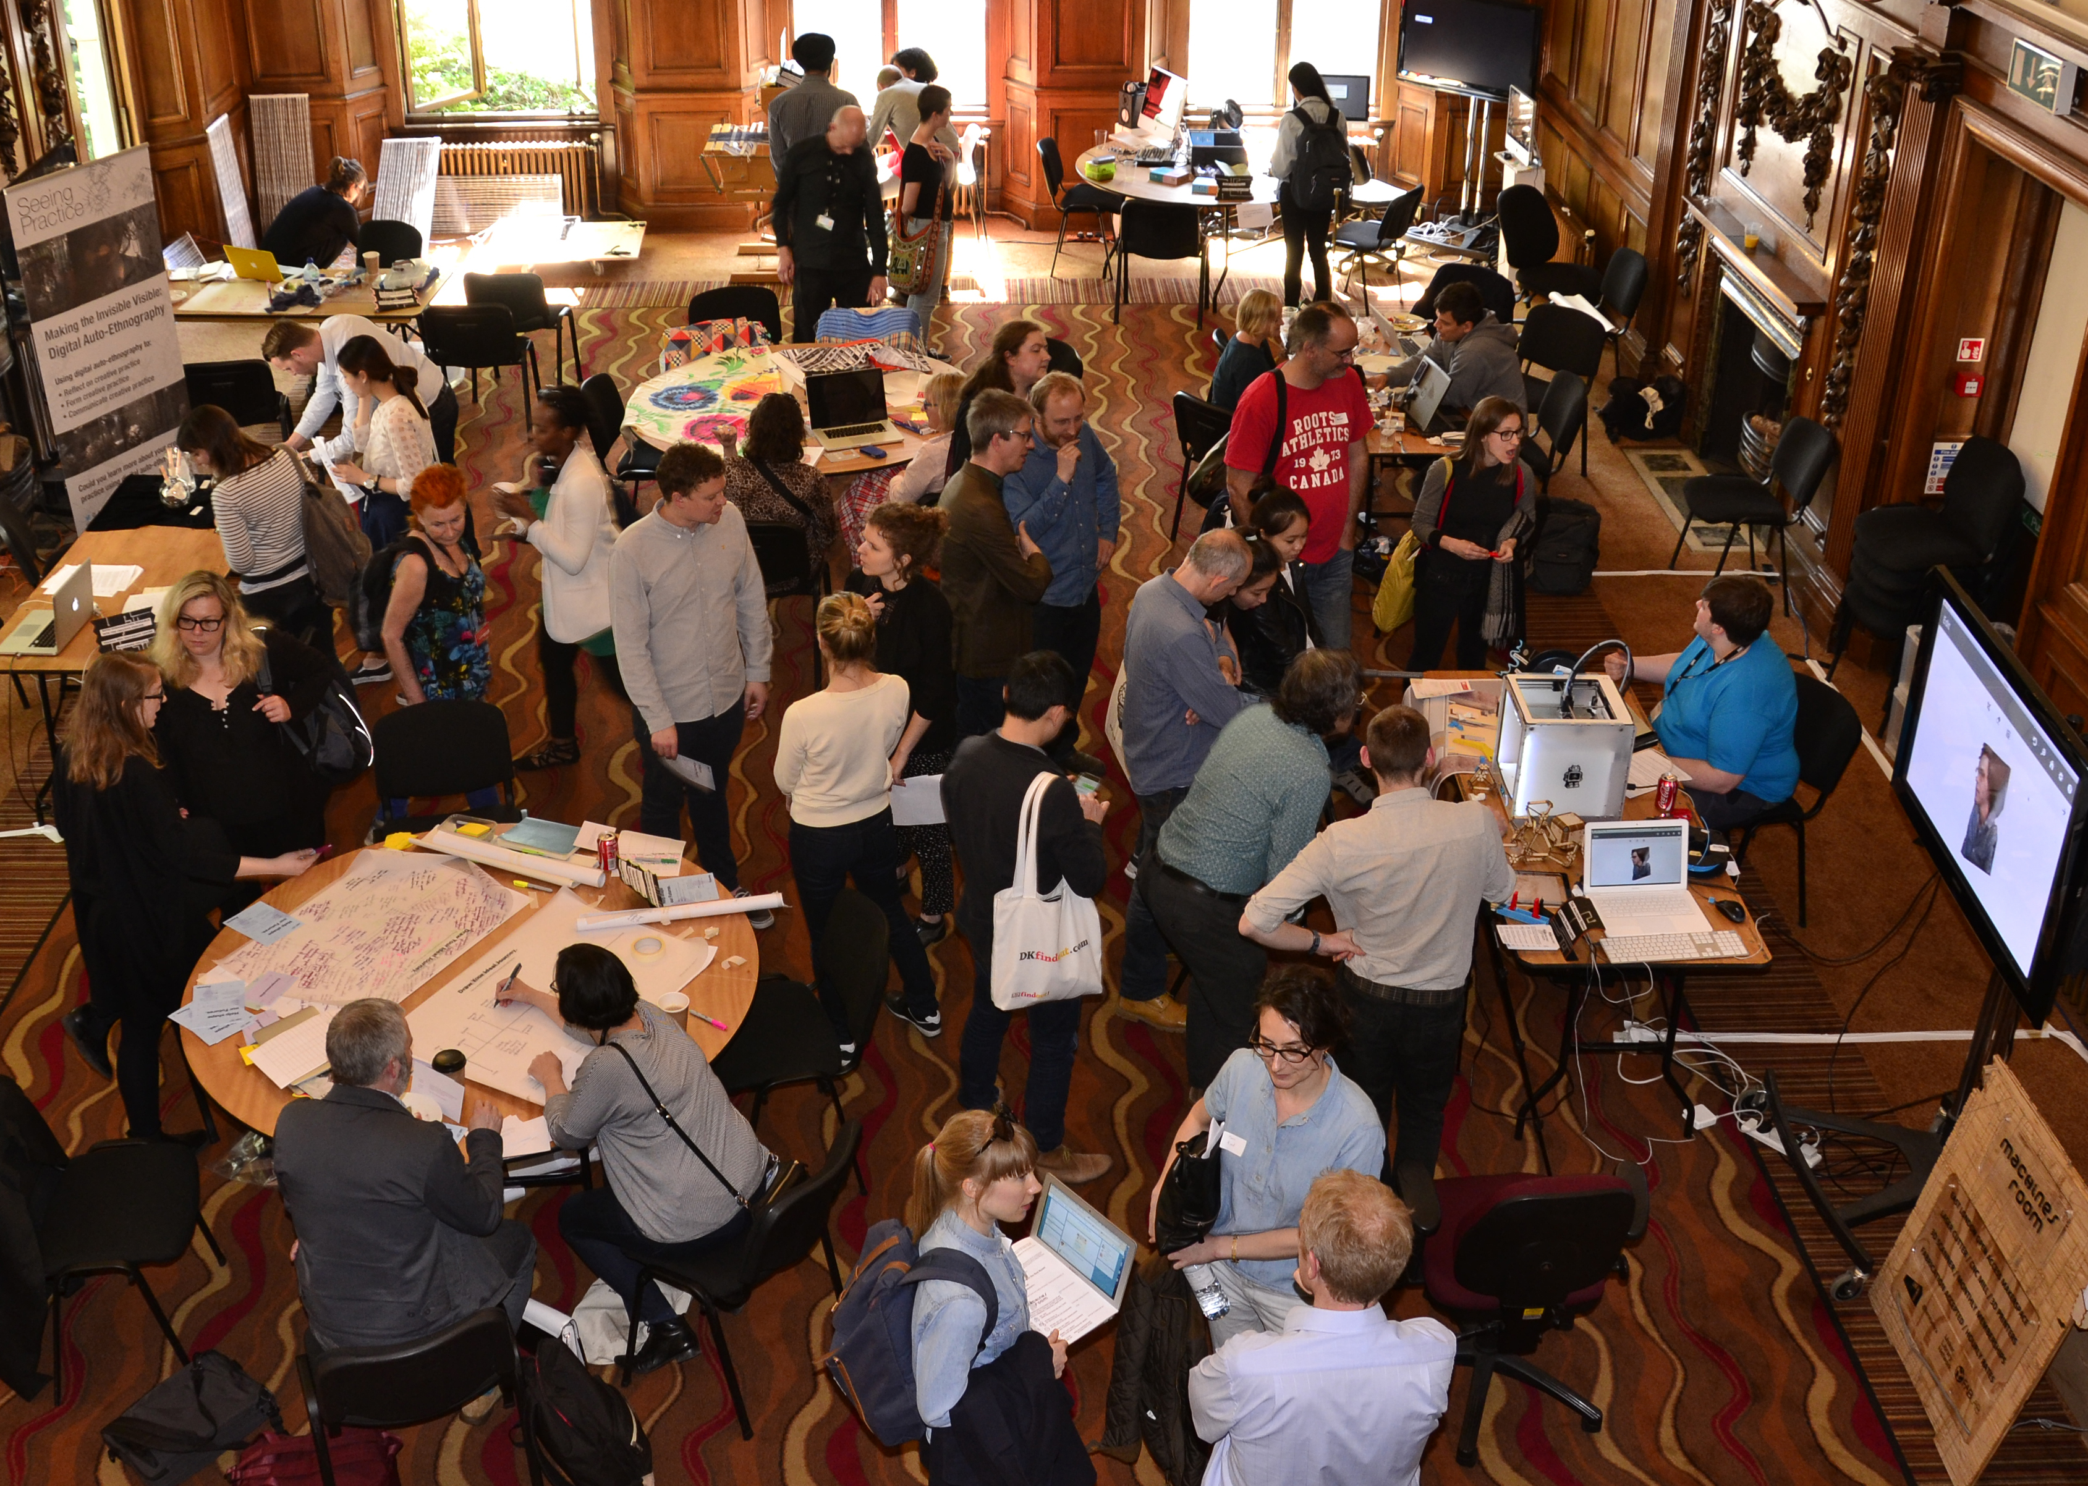
MakerSpace for Open Practice
Chris Follows | Digital Learning Technologies Manager
Camberwell, Chelsea & Wimbledon (CCW) | UAL
Notes:
Thank you and Introductions
About Title
Will describe what I mean by both terms
Make sense of open education landscape as we at UAL are experiencing it
Look at the culture of sharing & community embodied in the maker movement and how this can maybe support open educational practice ?

Slide 2
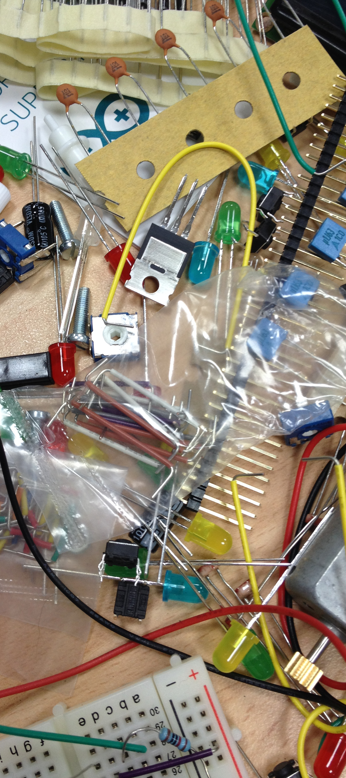
Awareness of Open Educational Practice (OEP) and Digital Making remain under the radar, outside mainstream pedagogic practice
Widening gap between institutional & grassroots practice
Notes:
How can we understand the value if we don’t engage
Become more mainstream and then become a problem – play catch up
Who’s responsible for progressing digital L&T enhancement & emergent practices – course or the institution?

Slide 3
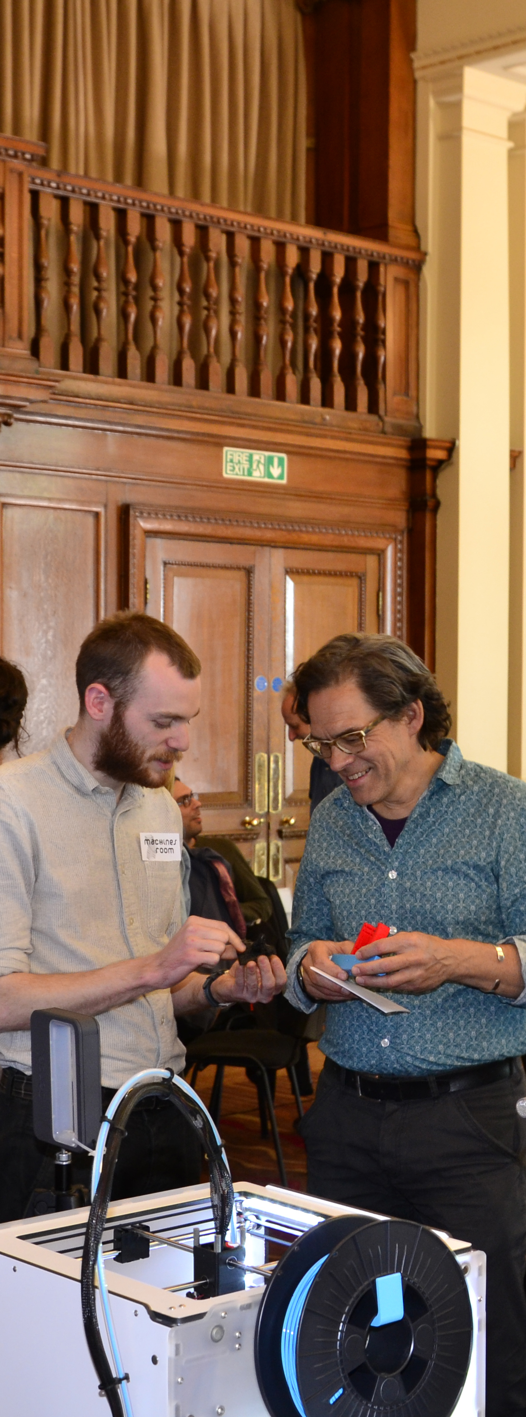
Digital Literacies
Self-identified digital skills and attributes needed to support personal and professional digital practice, ranging from awareness and participation, application of good practice through to participation in emergent and innovative digital practices.
Open education
Individuals and groups who share personal and professional practice openly online through participatory websites, blogs and online community networks, freely accessible for use and reuse. Content may be openly licensed using creative commons or similar.
Digital making
Experimentation and fusion of digital in emergent and traditional practice
Digital making:
Experimentation and fusion of digital in emergent and traditional practice
Notes:
Open Ed and digital making are DLs and need supporting:
Reach groups unlikely to have been engaged
DLs are often not gained through a prescribed set of competences
DLs are complex and sometimes conceptually difficult to understand, they are personal/individual
They are affective as well as skills based, and they should therefore not be over simplified or too prescribed
We need time, space and support to assess our individual DL abilities, anxieties and needs.

Slide 4
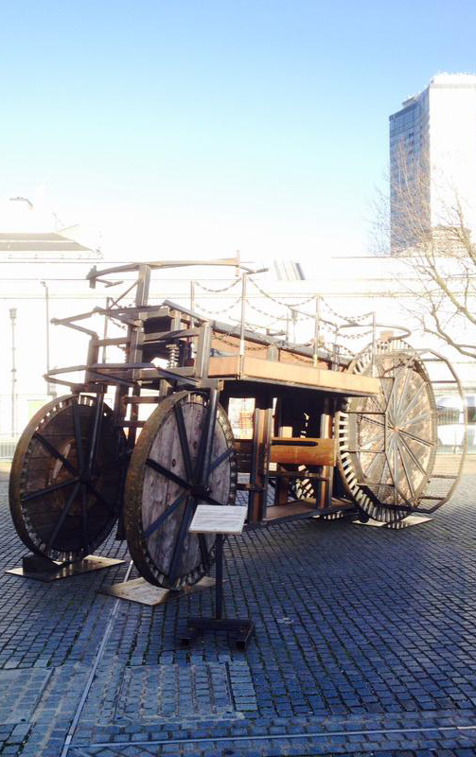
External or part funded UAL/JISC open education & digital literacies activities & projects over the past eight years.
2010 - 2011
JISC OER programme Phase 2
2011 - 2012
UKOER programme Phase 3
2011 - 2013
Developing Digital Literacies
Programme
Digital making:
Experimentation and fusion of digital in emergent and traditional practice
Notes:
Jump on the Band Wagon with trendy openness like MOOCs
Or
Yes we are doing that so no need for anyone else to do it …. We need to share experiences more & lesson learned

Slide 5
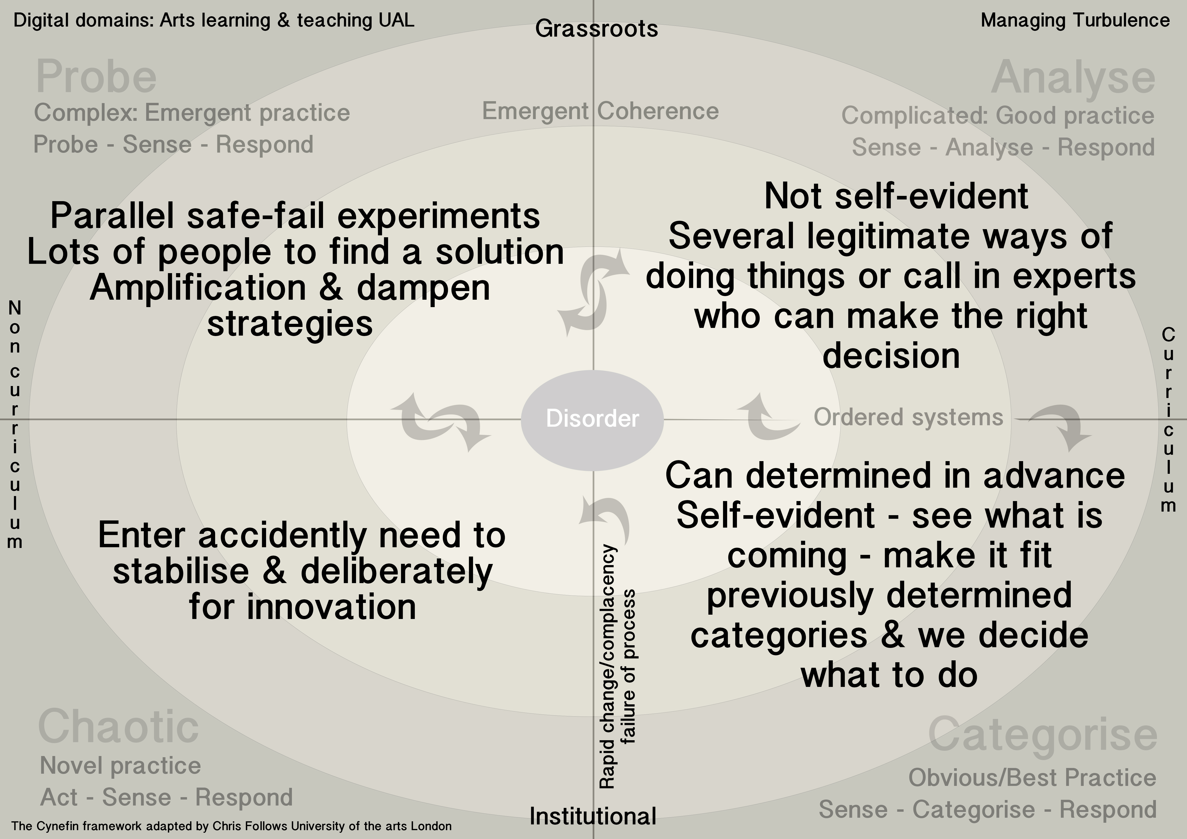
Sense Making Framework: Cynefin
Digital making:
Experimentation and fusion of digital in emergent and traditional practice
Notes:
Dave Snowden
I’m no expert (could spend whole presentation on Cynefin)
But its useful to try and make sense of digital literacies and changing thinking on how to approach DLs
No good place or bad place – transitions – good place & bad places out of context
DISORDER - Are we comfortable in our state of disorder ? Not Known
CHAOTIC - No constraints, random, temporary state – Wisdom of crowds – Lots of energy if created for innovation
PROBE – Work it out for ourselves - Partial constraints, constraints modified by behavior – uncertain - competing hypotheses (coherence & shared practice) - Managing an evolutionary process (Children, manage constraints) - requisite diversity
EMERGENT COHERENCE into Ordered Systems
GOOD PRACTICE – GOVERNING CONSTRAINT - Limitations on what can be done – support human judgment – Own choices
BEST PRACTICE – FIXED constraint one way – this is where work around happen if systems a too constrained - determines an outcome

Slide 6
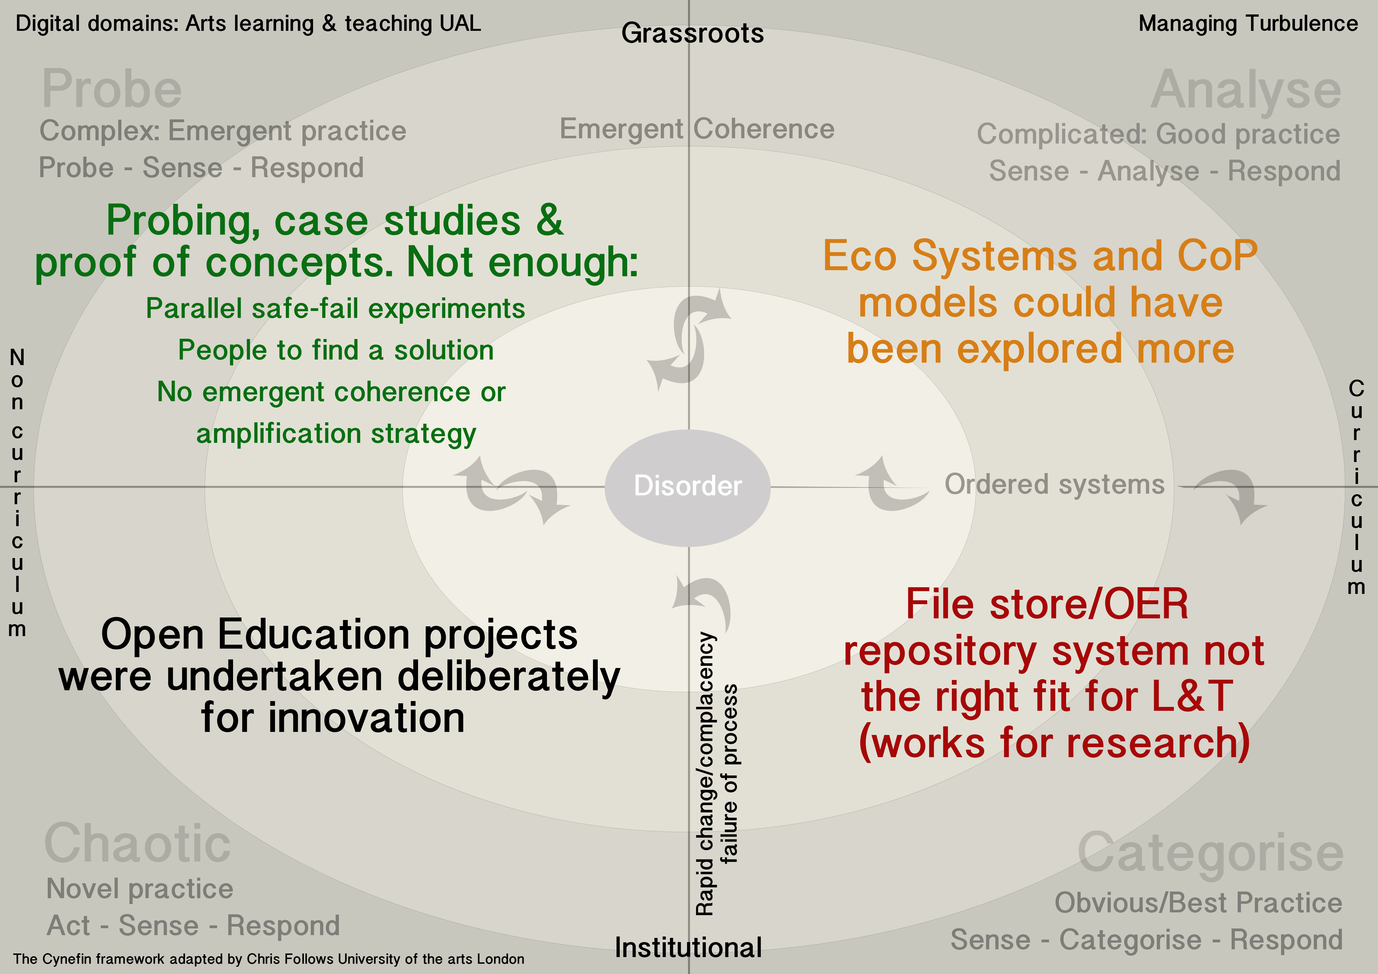
Post projects: Awareness of where we are with Open Education
Digital making:
Experimentation and fusion of digital in emergent and traditional practice
Notes:
Failure or not what can we learn from the projects
Maybe too constrained
REF journal articles and conference proceedings must be available in an open-access form to be eligible for the next REF

Slide 7
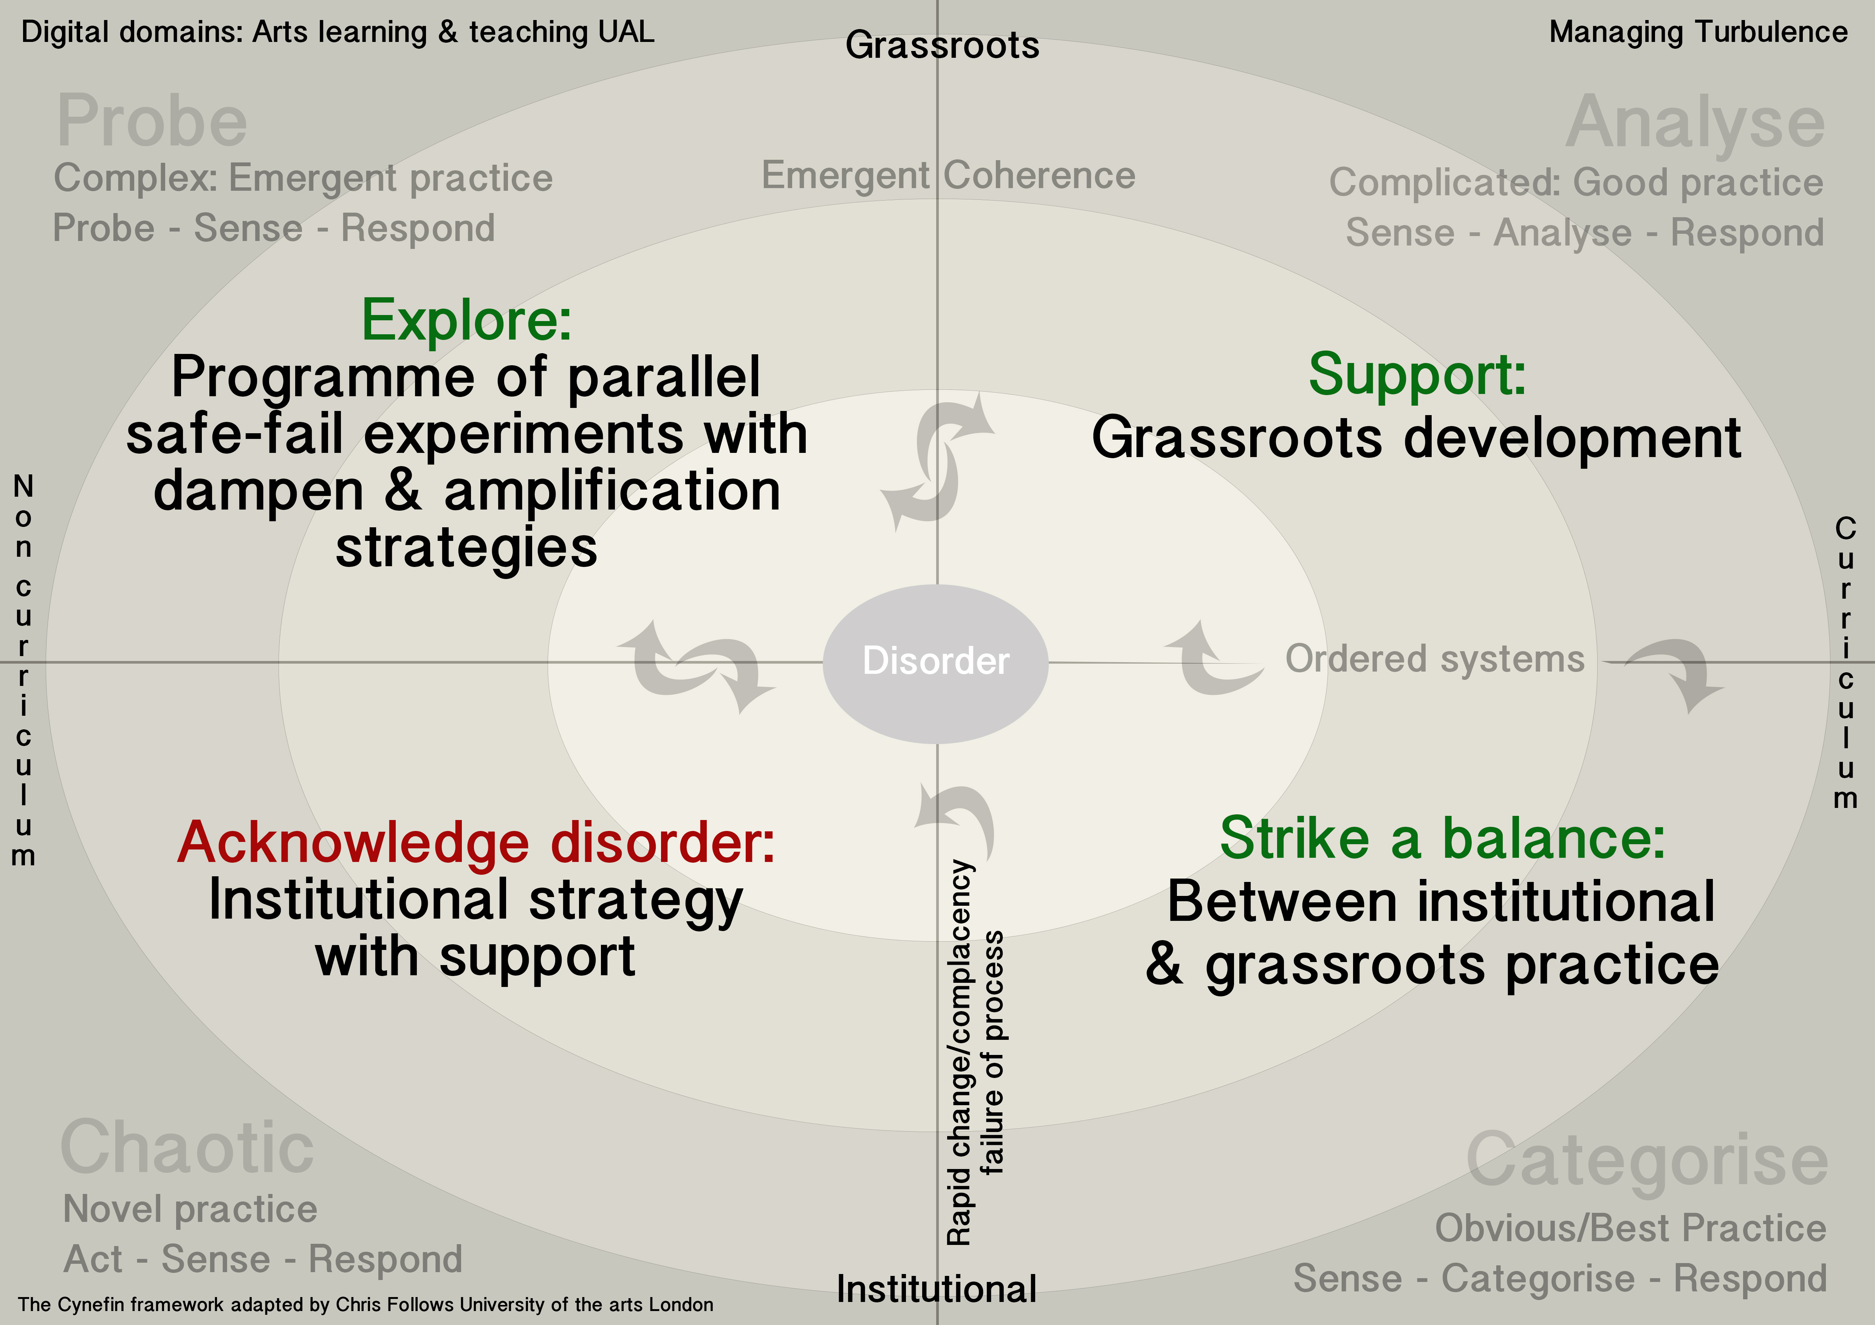
Forwards: Awareness of where we could go with Open Education/Digital Literacies
Digital making:
Experimentation and fusion of digital in emergent and traditional practice
Notes:
Could apply to ANY digital literacy activity
Homogenisation effects of institutional ownership

Slide 8
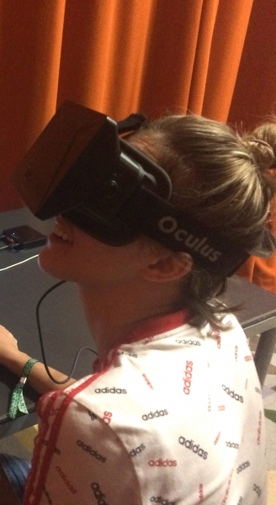
Open Education Motivations:
Individual (Staff & students):
Personal Professional Development
Develop new skills & practice
Critical reflection: Improvement in practice
Collaboration & networking
Research and personal archiving
Support sustainable practice
Risk taking & understanding the risks
Institutional
Student performance & satisfaction (NSS)
Widen participation: bridge to formal edu
Quality, marketing, Internationalisation
Teaching Excellence Framework ?
Funding & Collaborations e.g. Tate
All these can also apply to Digital Making …
Notes:
Not advocating open as many risks as there are benefits
Seeing is no longer believing – need to be believed to be seen (Charlie Choc Factory)
Equally lots of risks & vulnerability – Open can be Mandatory so best to be prepared via Informed consent
REF journal articles and conference proceedings must be available in an open-access form to be eligible for the next REF
Tate Example
All Motivations which are linked to Maker Movement collaborations

Slide 9
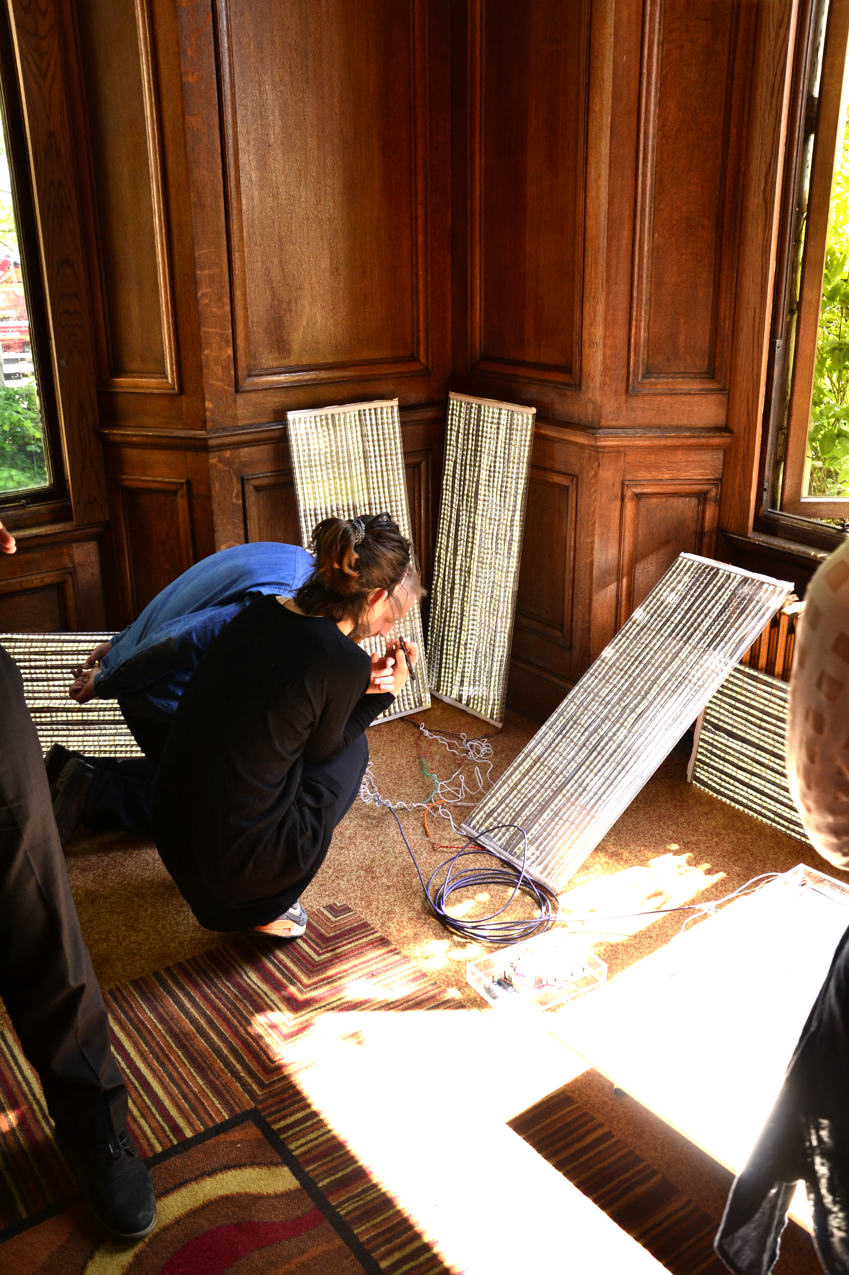
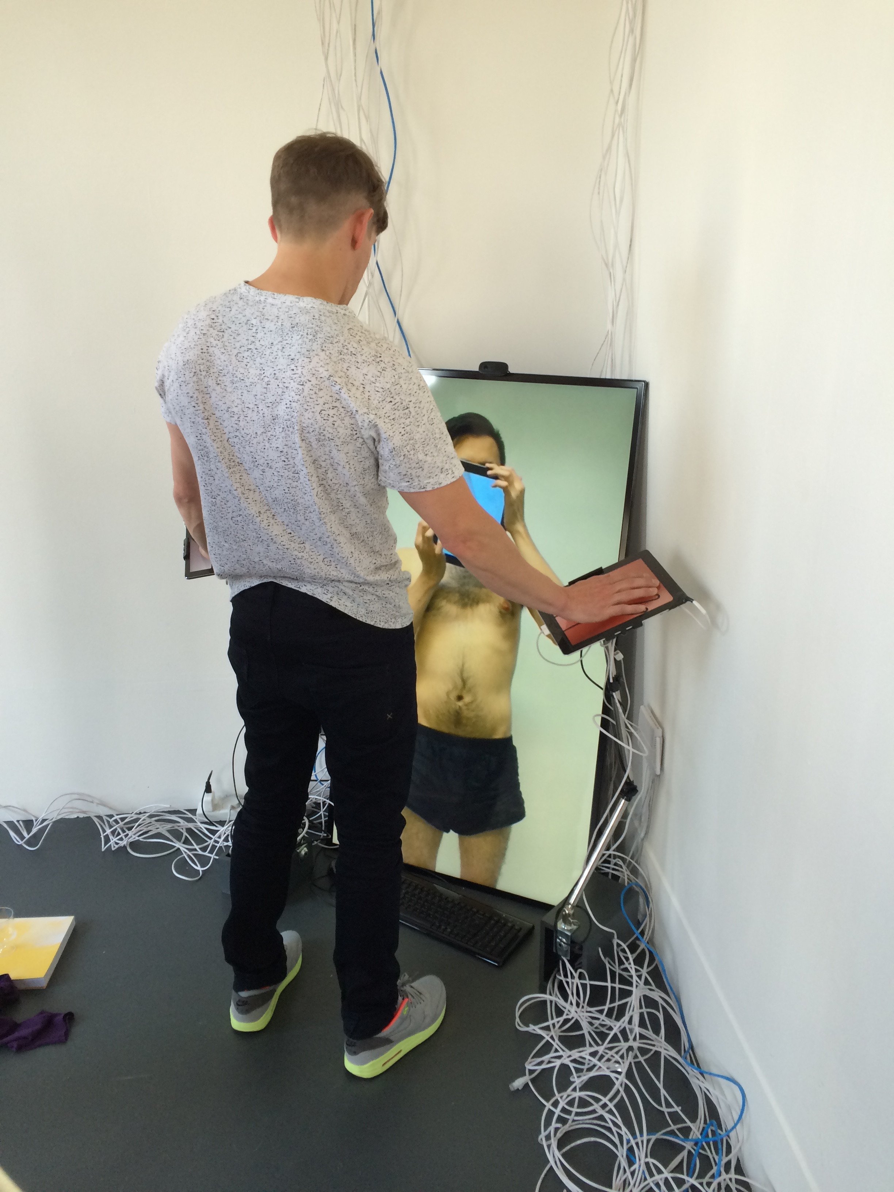
Digital Making at CCW
Experimentation and fusion of digital in emergent and traditional practice
Rosemary Munro Kerr WCA Student MFA
'Solar-technik'
a digital replication of experienced sunlight
John Clair
WCA Student MFA
Degree show
Notes:
Students work

Slide 10
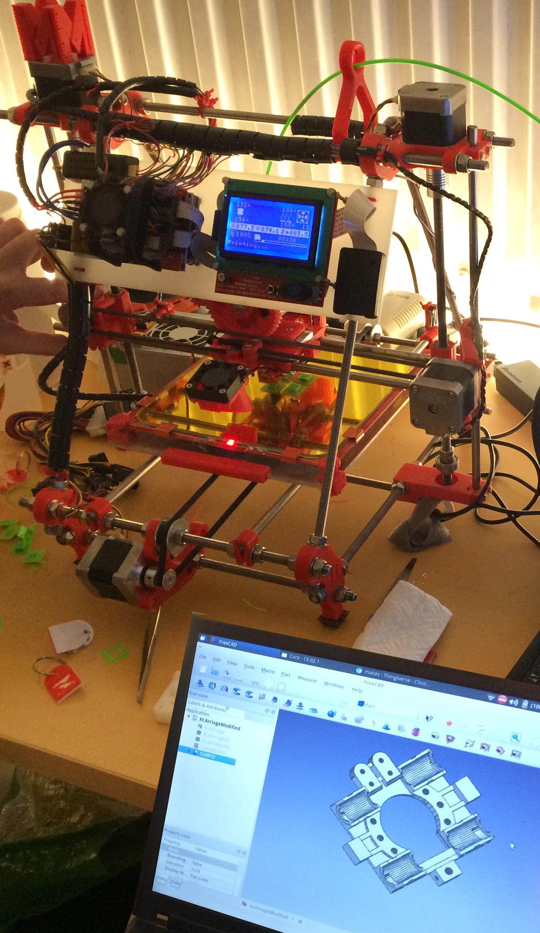
MakerSpaces
Community-run workshop where people come to share tools and knowledge
  “I go to whichever MakerSpace has what I need for my practice, tools & expertise, but most of all a MakerSpace has a community a peer network of digital makers"
  Arts students on why they go to MakerSpaces
Notes:
Upcycling
Ceramics
Printmaking
Digital fabrication
Physical computing
Casting
Web building

Slide 11
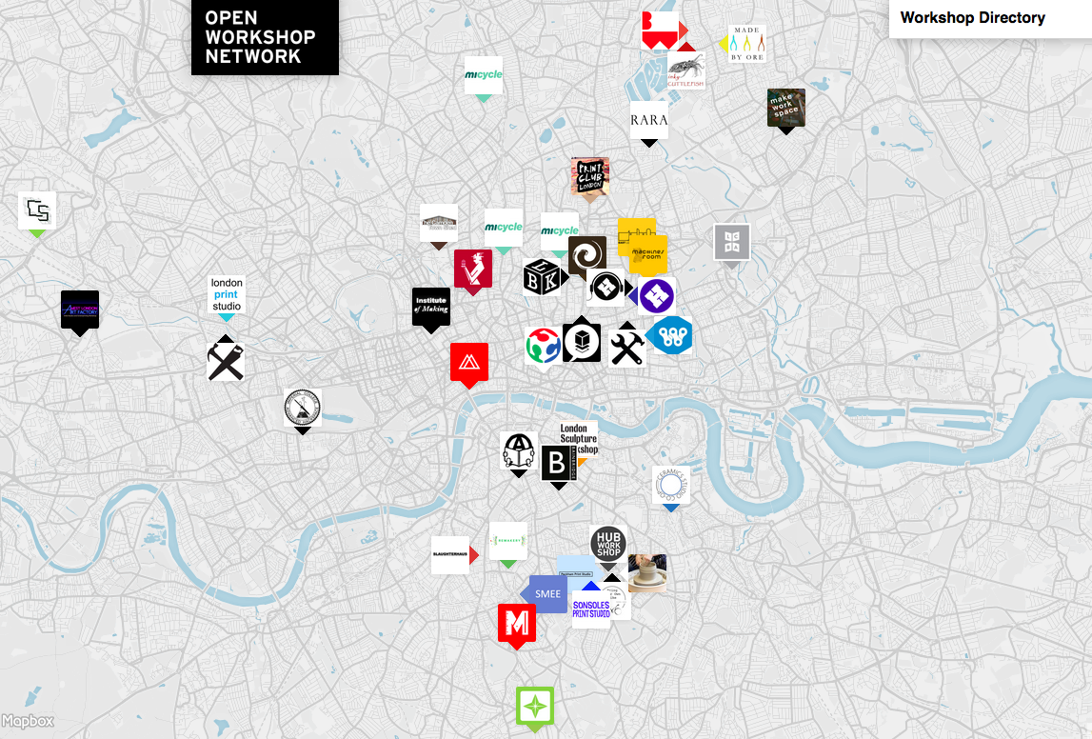

Slide 12
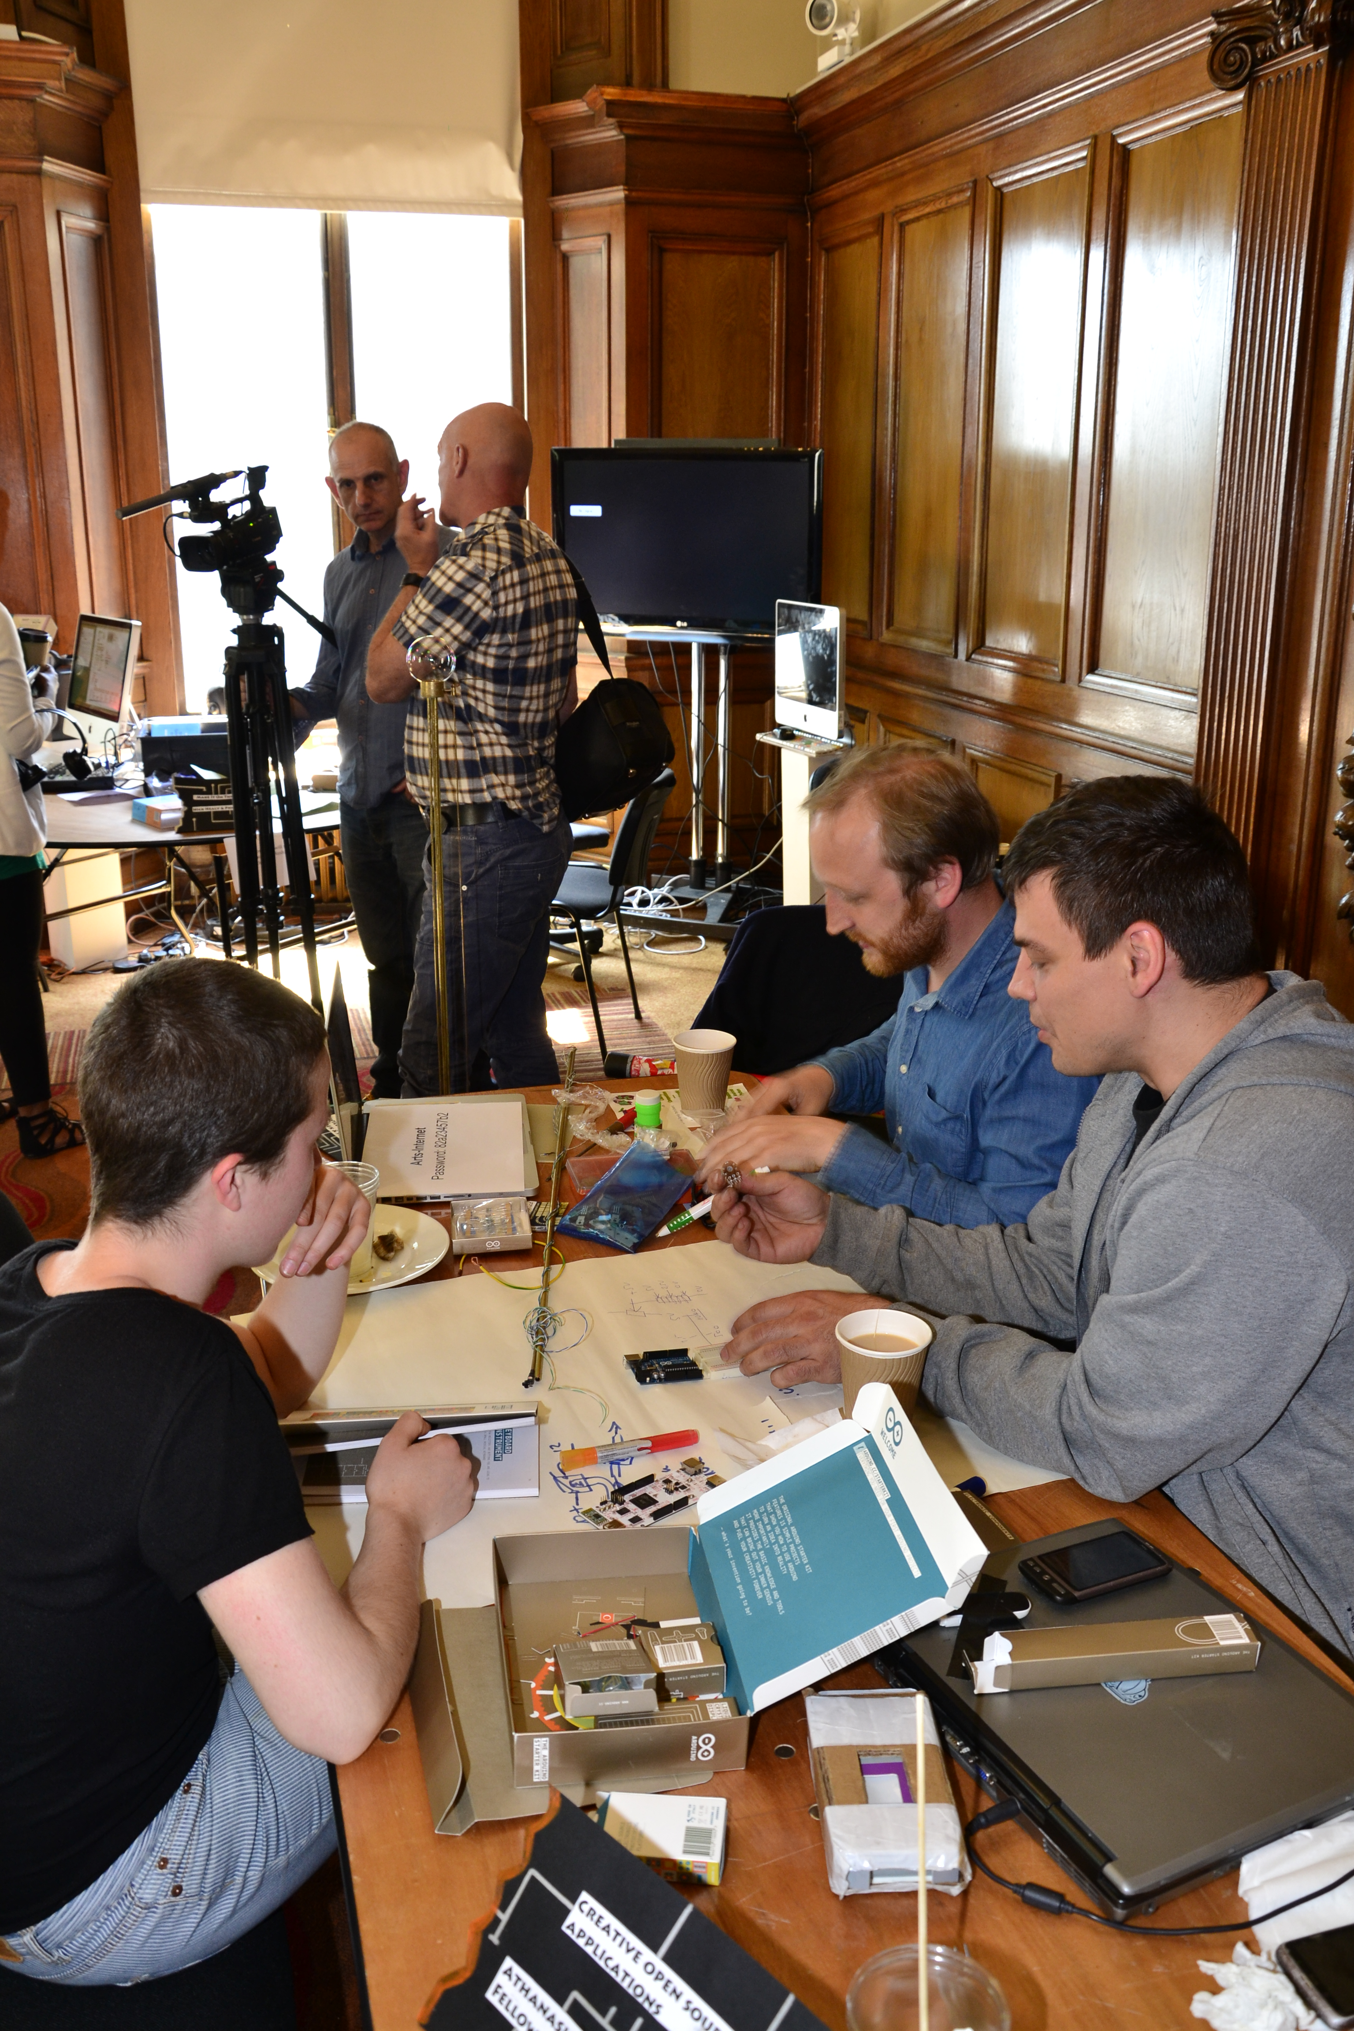
We have amazing workshops and specialist staff
Although some aspects of digital making practice are still under the radar and seen as ‘novel’ practice
Time to ‘probe’ the complexities of digital making
practice & culture
Notes:
Digital making experimentation at CCW
Channel into the hacker spirit

Slide 13

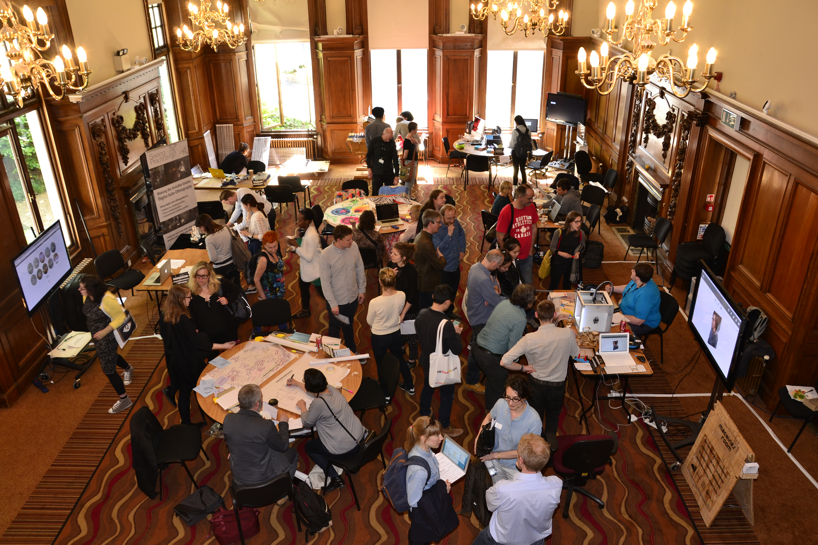
Community & awareness building: College, staff & student ownership
Understanding the maker movement and its impact on practice
Research into digital making practices
Notes:
UAL to acknowledge the maker movement and digital making
Build a community in-house and externally

Slide 14
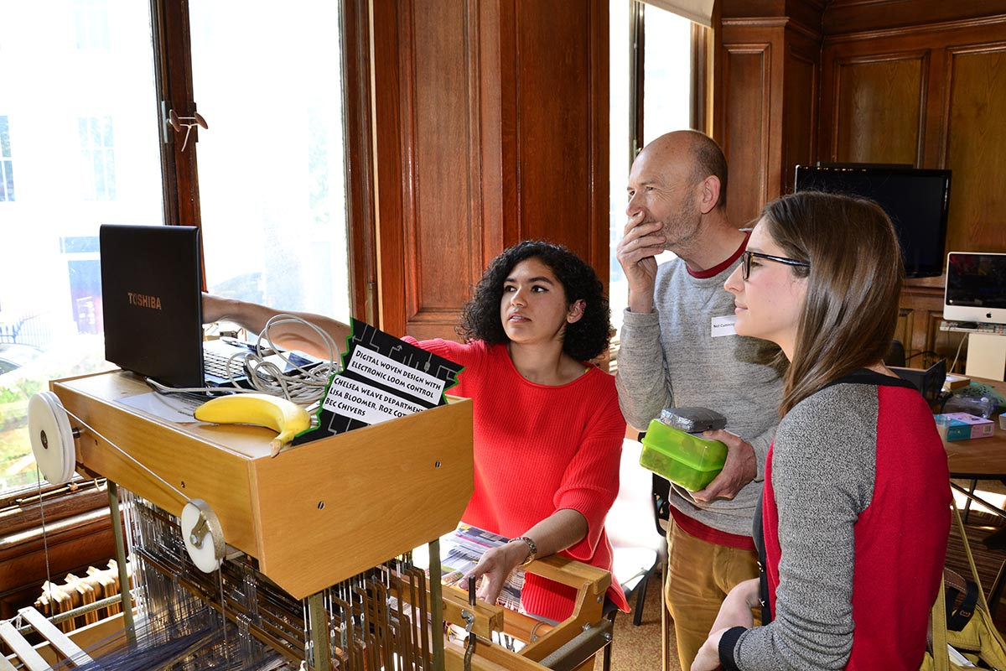
A place or hub to develop technology with a cross-disciplinary focus
Digital woven design with electronic loom control: Weave student Isabella Mackenzie
Notes:
Not sure what this looks like
Will be different for each course and college
Pop up MakerSpace is one idea

Slide 15

Maker MOOC
Virtual & Actual Learning
Spaces
Skills and Expertise
Community & Support Networks
Collaborations
Open Workshop Network
UAL staff & students
Maker Communities
Other Universities & Colleges
International Maker Movement
Arts practitioners
& artist run
groups
MOOC providers
Industry &
Sector
Notes:
Conclude
FINALY something I feel bring all this together
Actual - Physical eco system - Makerspaces & OWN community & UAL
Sector collaborations industry and arts groups
Expanded network – national and international relevance

Slide 16
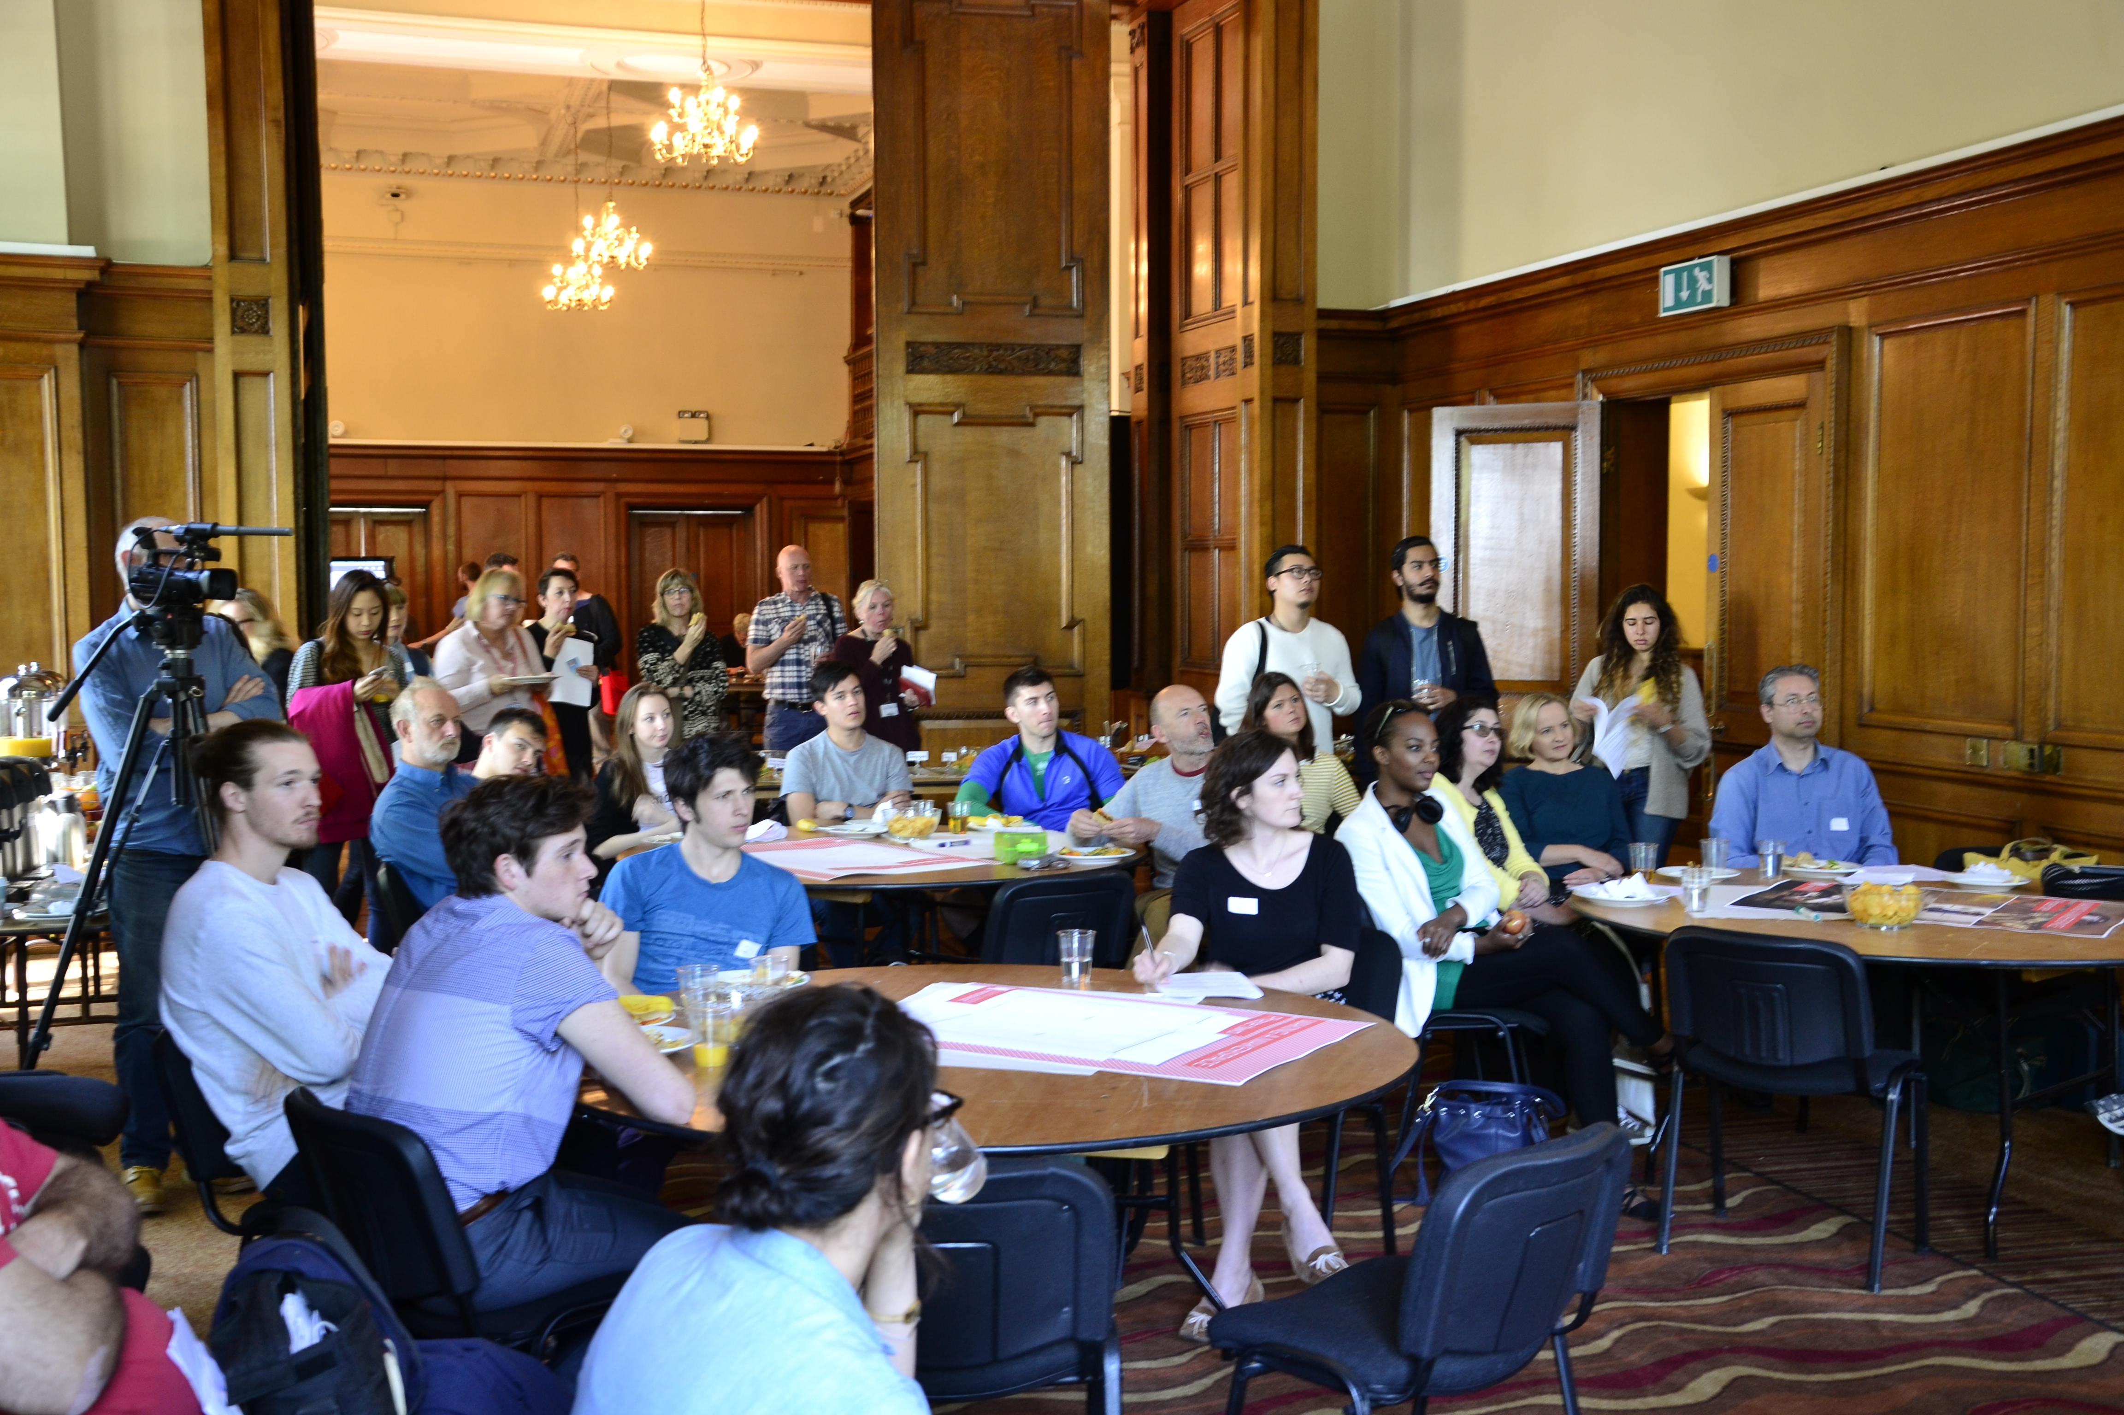
Would a maker MOOC be of interest to your staff, students and location (do you have MakerSpaces) ?
Do you have a strategy/policy for open education at your institution?
Have you any good/best practice examples of Open Practice?
How’s your institution acknowledge and support cross discipline Digital Making practices?

Slide 17
Thank you
c.follows@arts.ac.uk
@CCWPostDigital
http://process.arts.ac.uk

