Slide 1
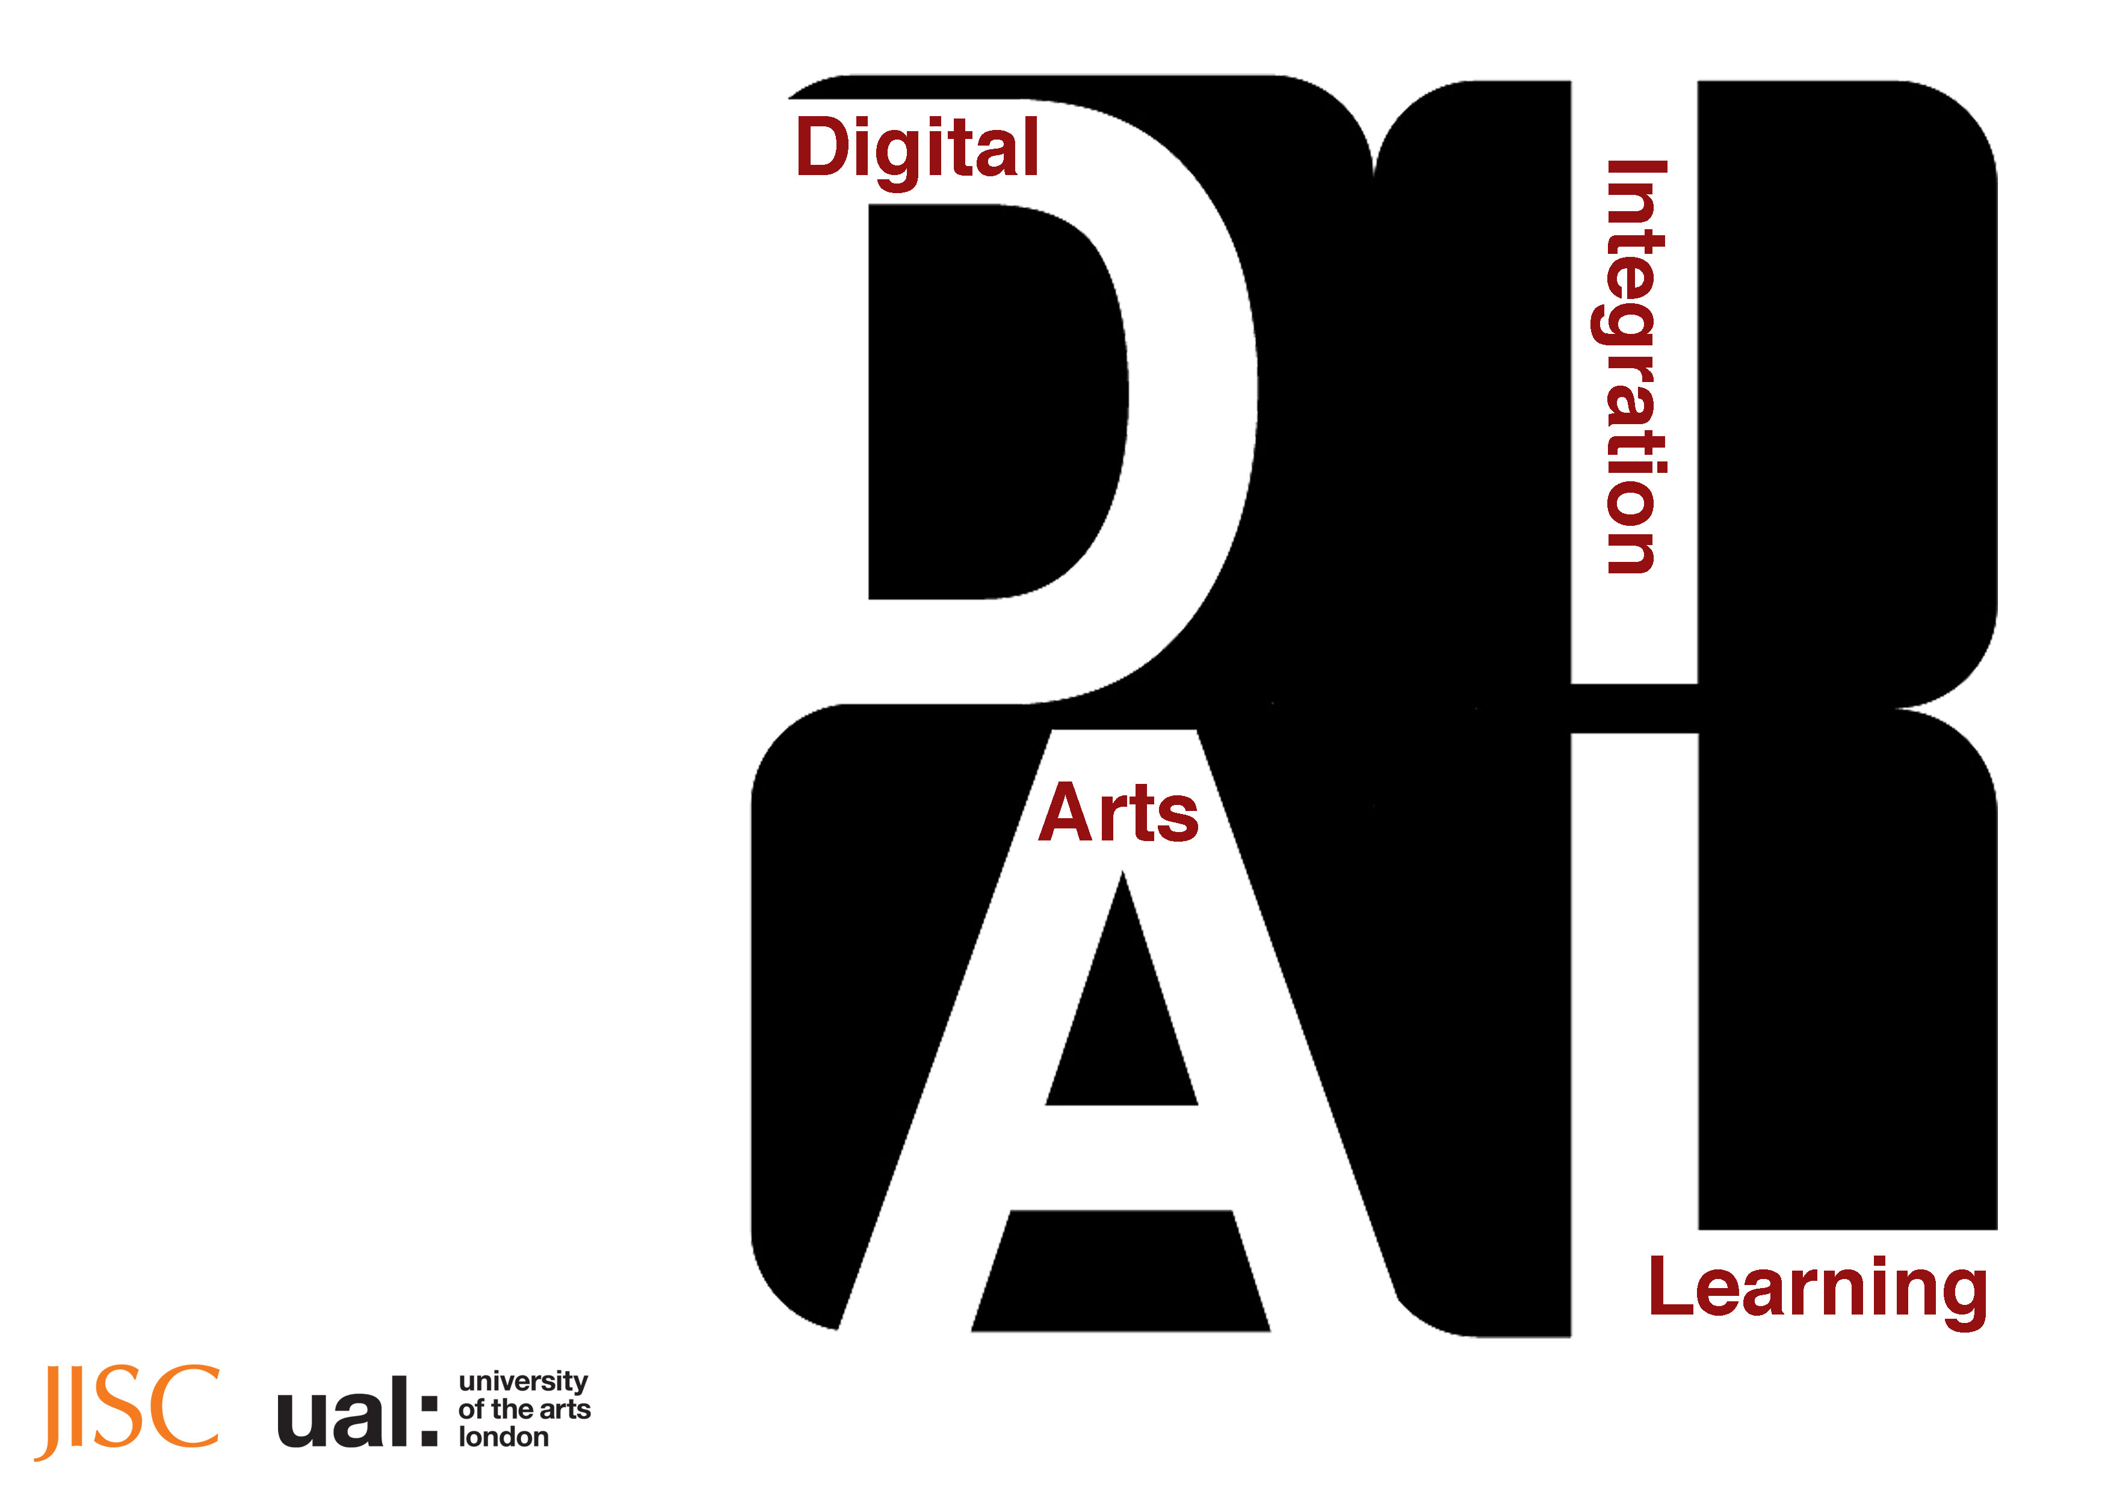
The DIAL Project
Developing digital literacies, sharing strategies and
Approaches.
Understanding Resources of Expertise
Designs on e-Learning Conference 2013
Wilmington USA
Chris Follows
Thursday 12 September 2013

Slide 2
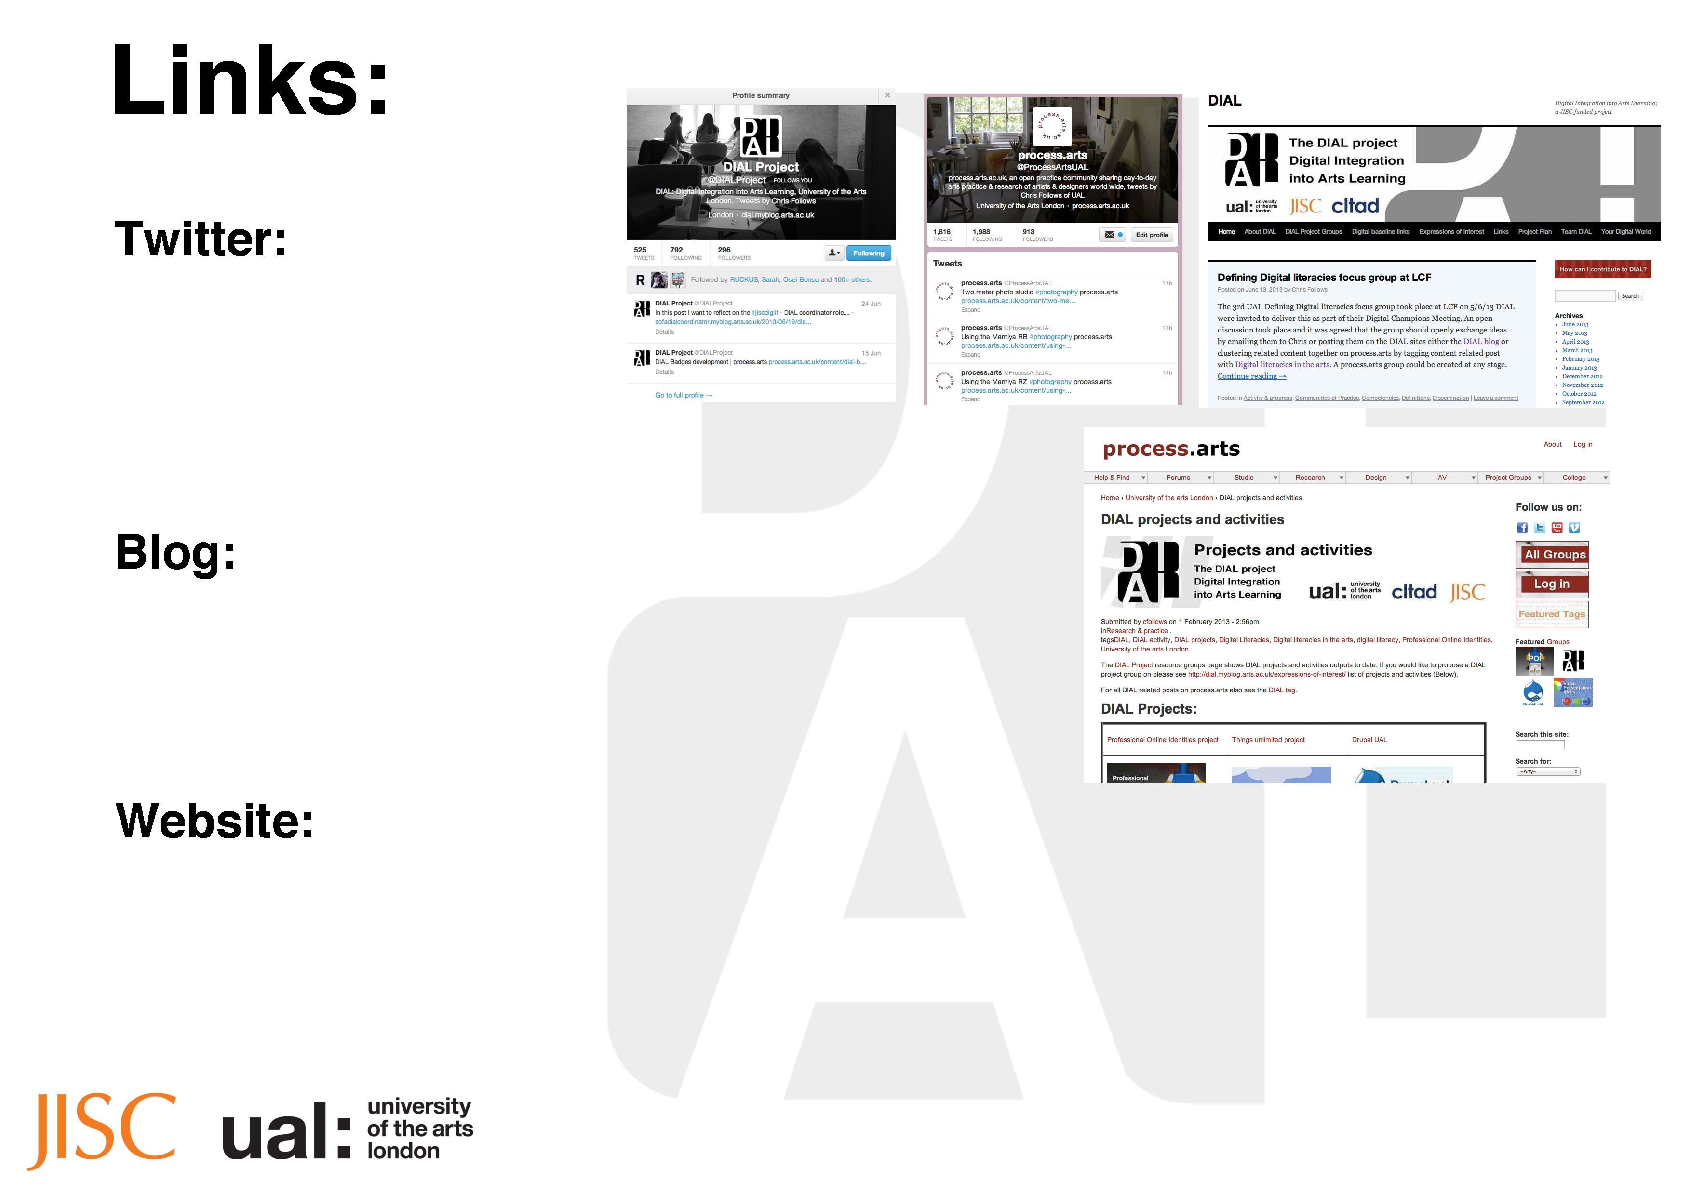
@DIALProject
@ProcessArtsUAL
http://dial.myblog.arts.ac.uk
http://process.arts.ac.uk/content/dial-projects-and-activities

Slide 3
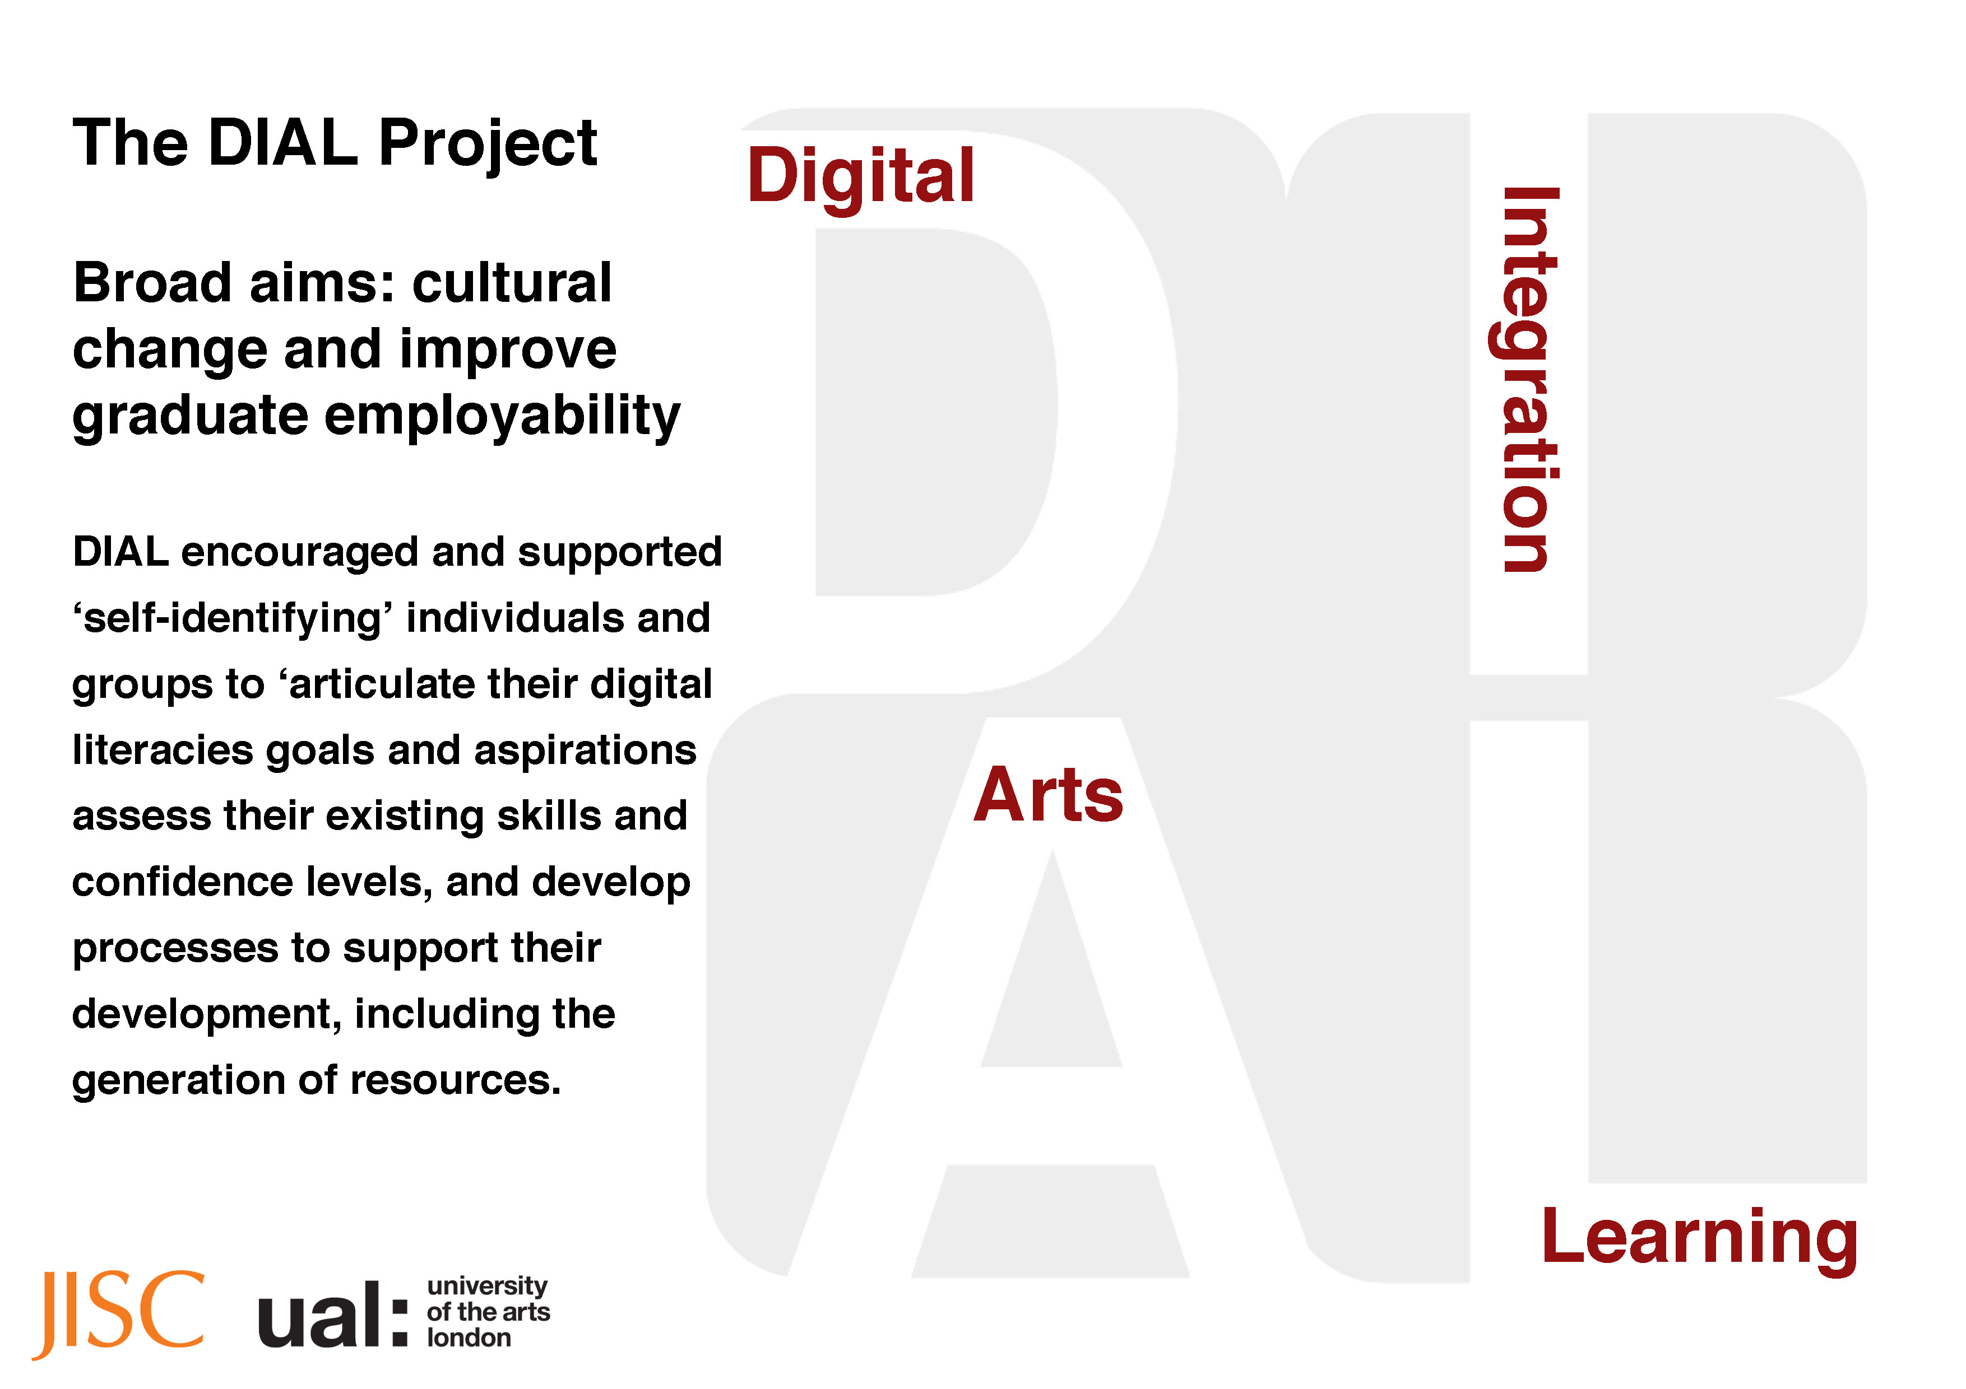

Slide 4
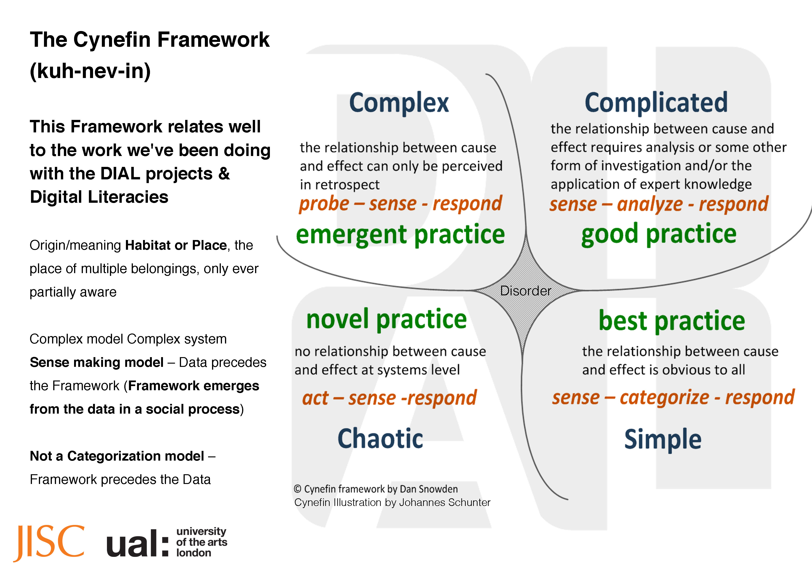

Slide 5
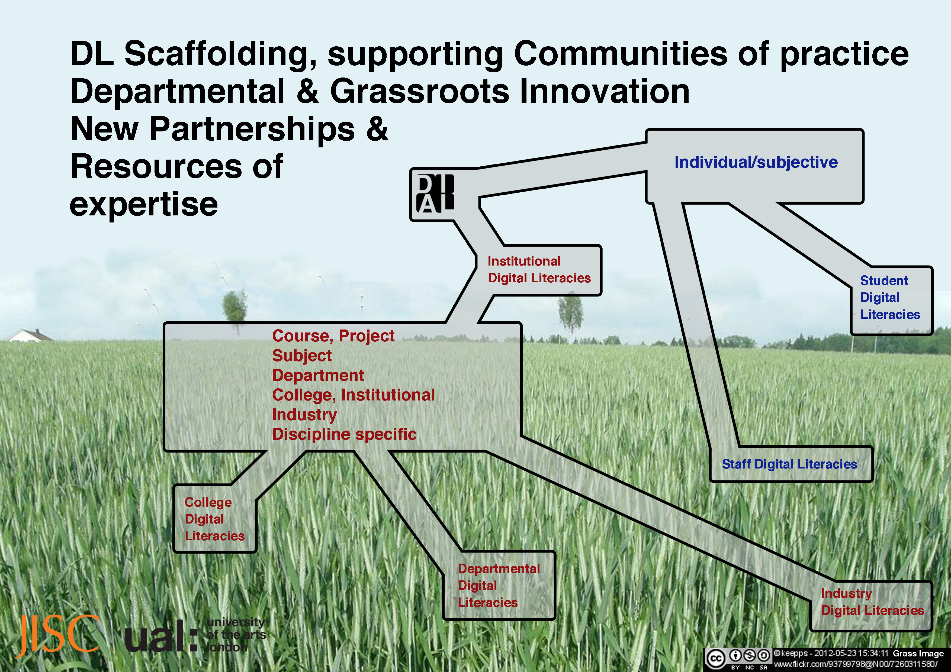
Resources of Expertise
Resource environments
People

Slide 6
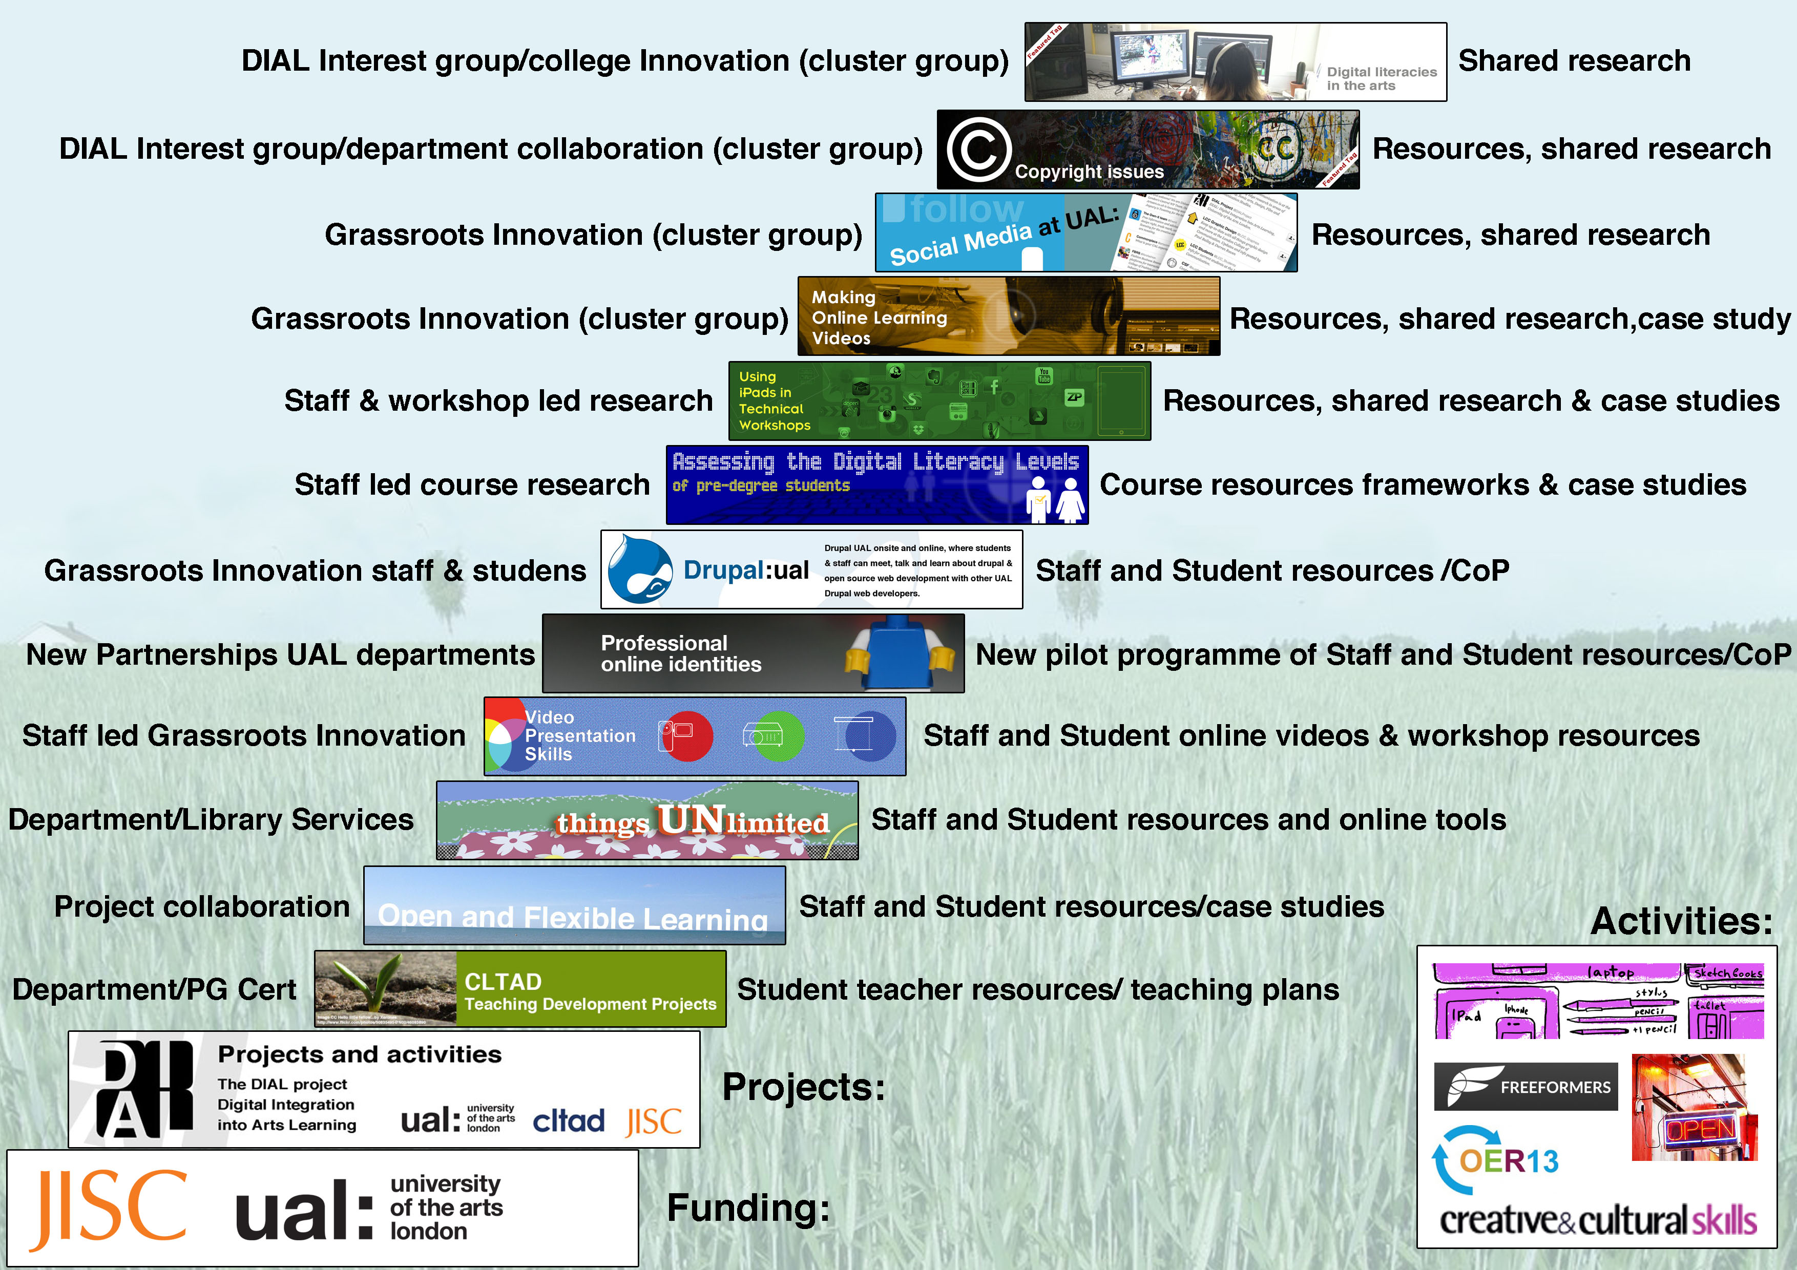

Slide 7
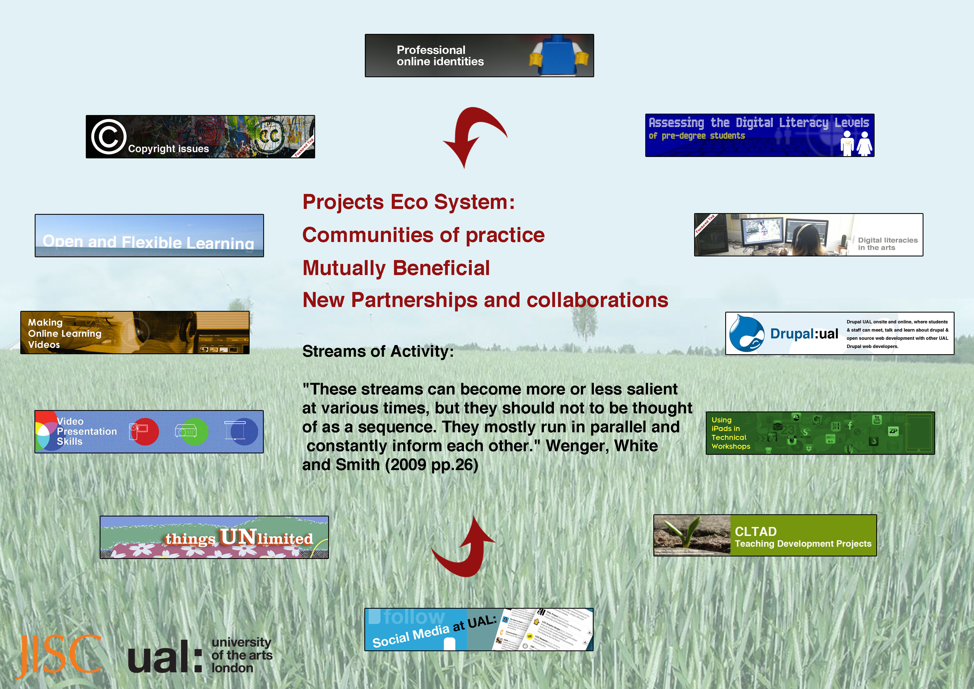

Slide 8
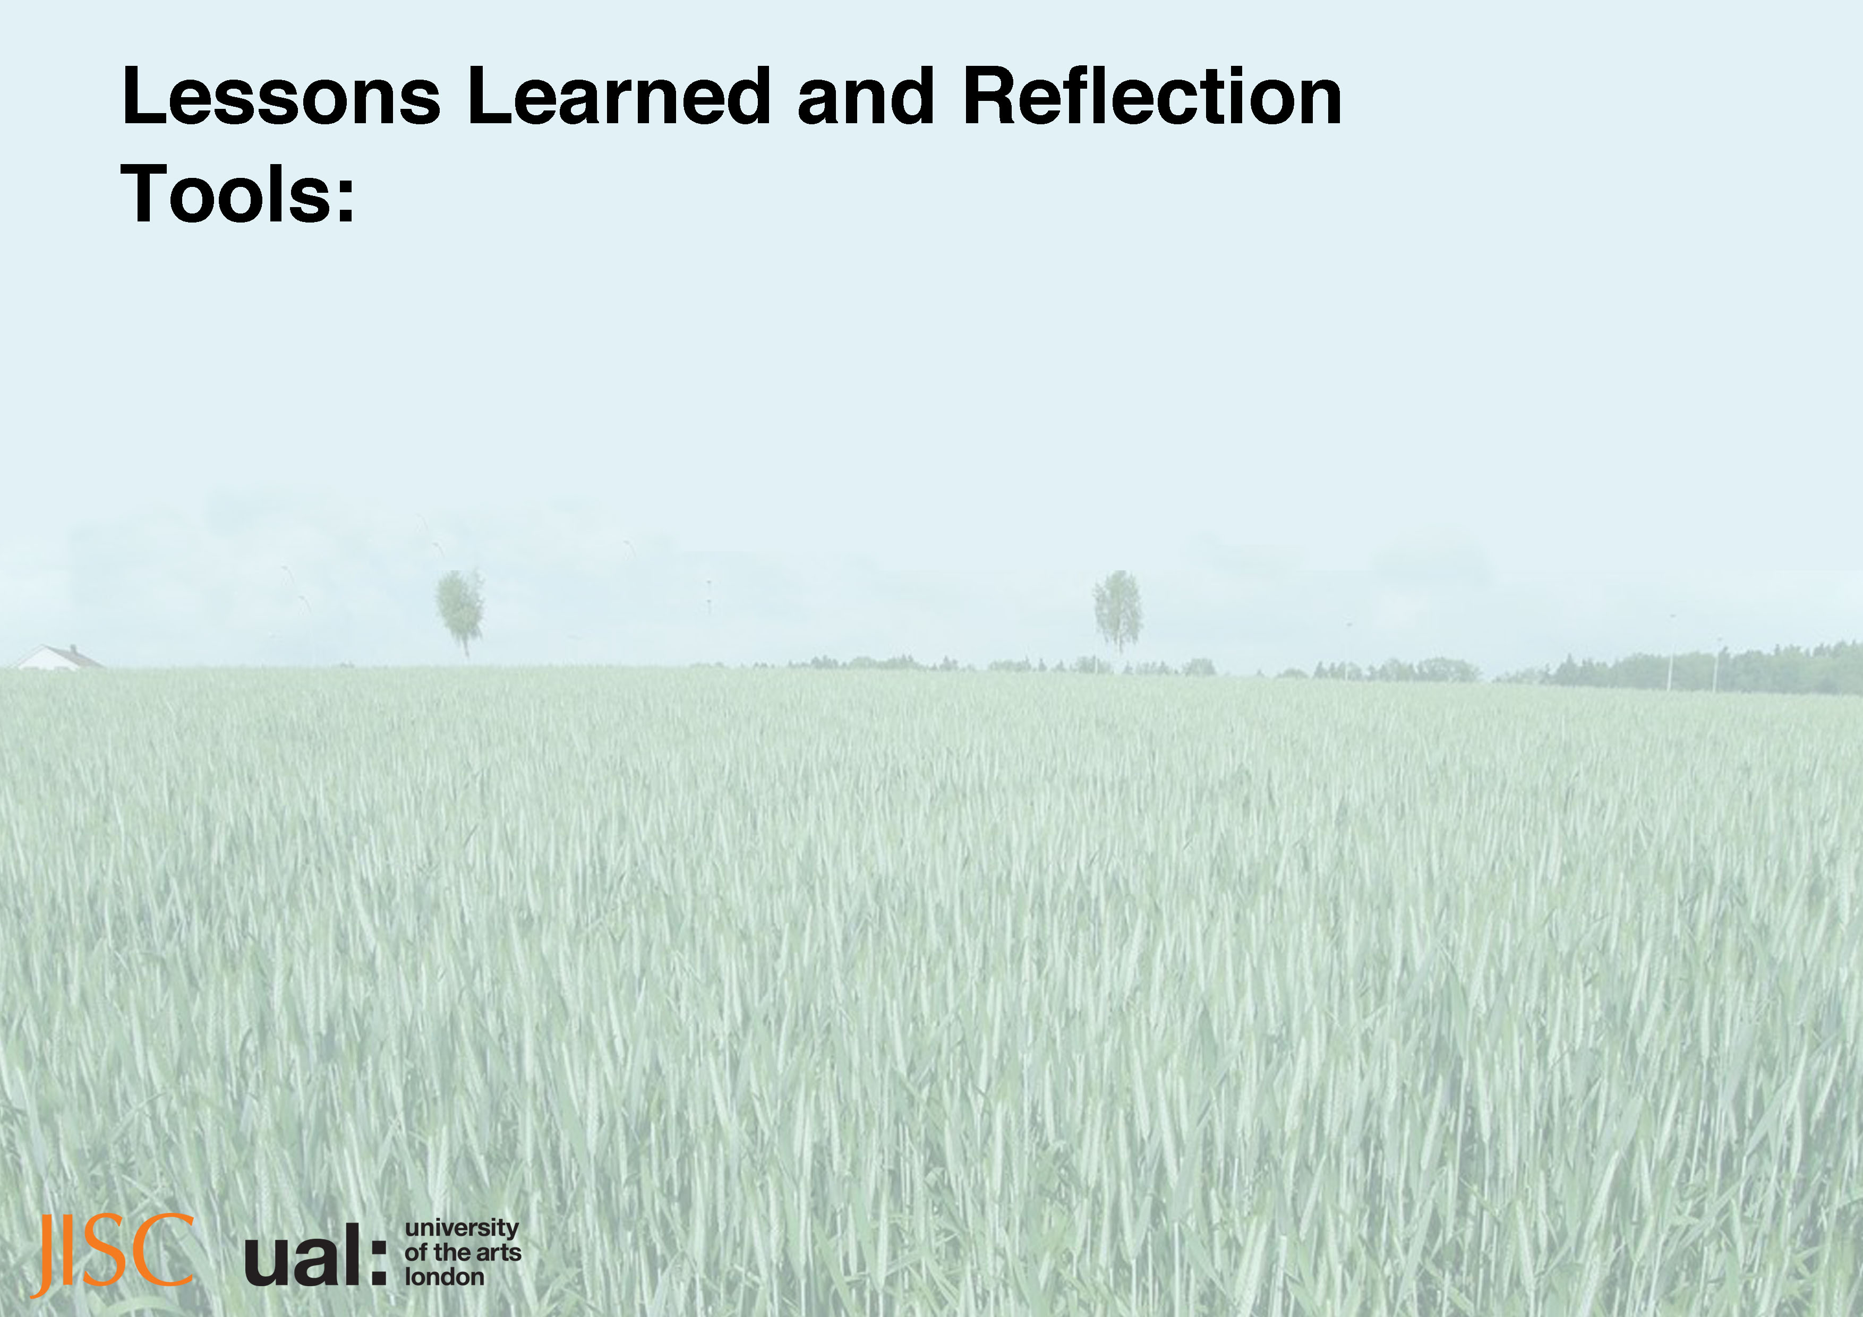
Course staff equipment: Building a ‘use case’ for right tools for the job, not iPad for sake of an iPad.
Bring your own environment; Online Infrastructure: In-house UAL digital tools and processes and 3rd party tools and processes need to meet somewhere in the middle. Need good digital/web Infrastructure.
Finding a balance between face to face and digital: Don’t rely on one or the other, find a mutually complementary processes.

Slide 9
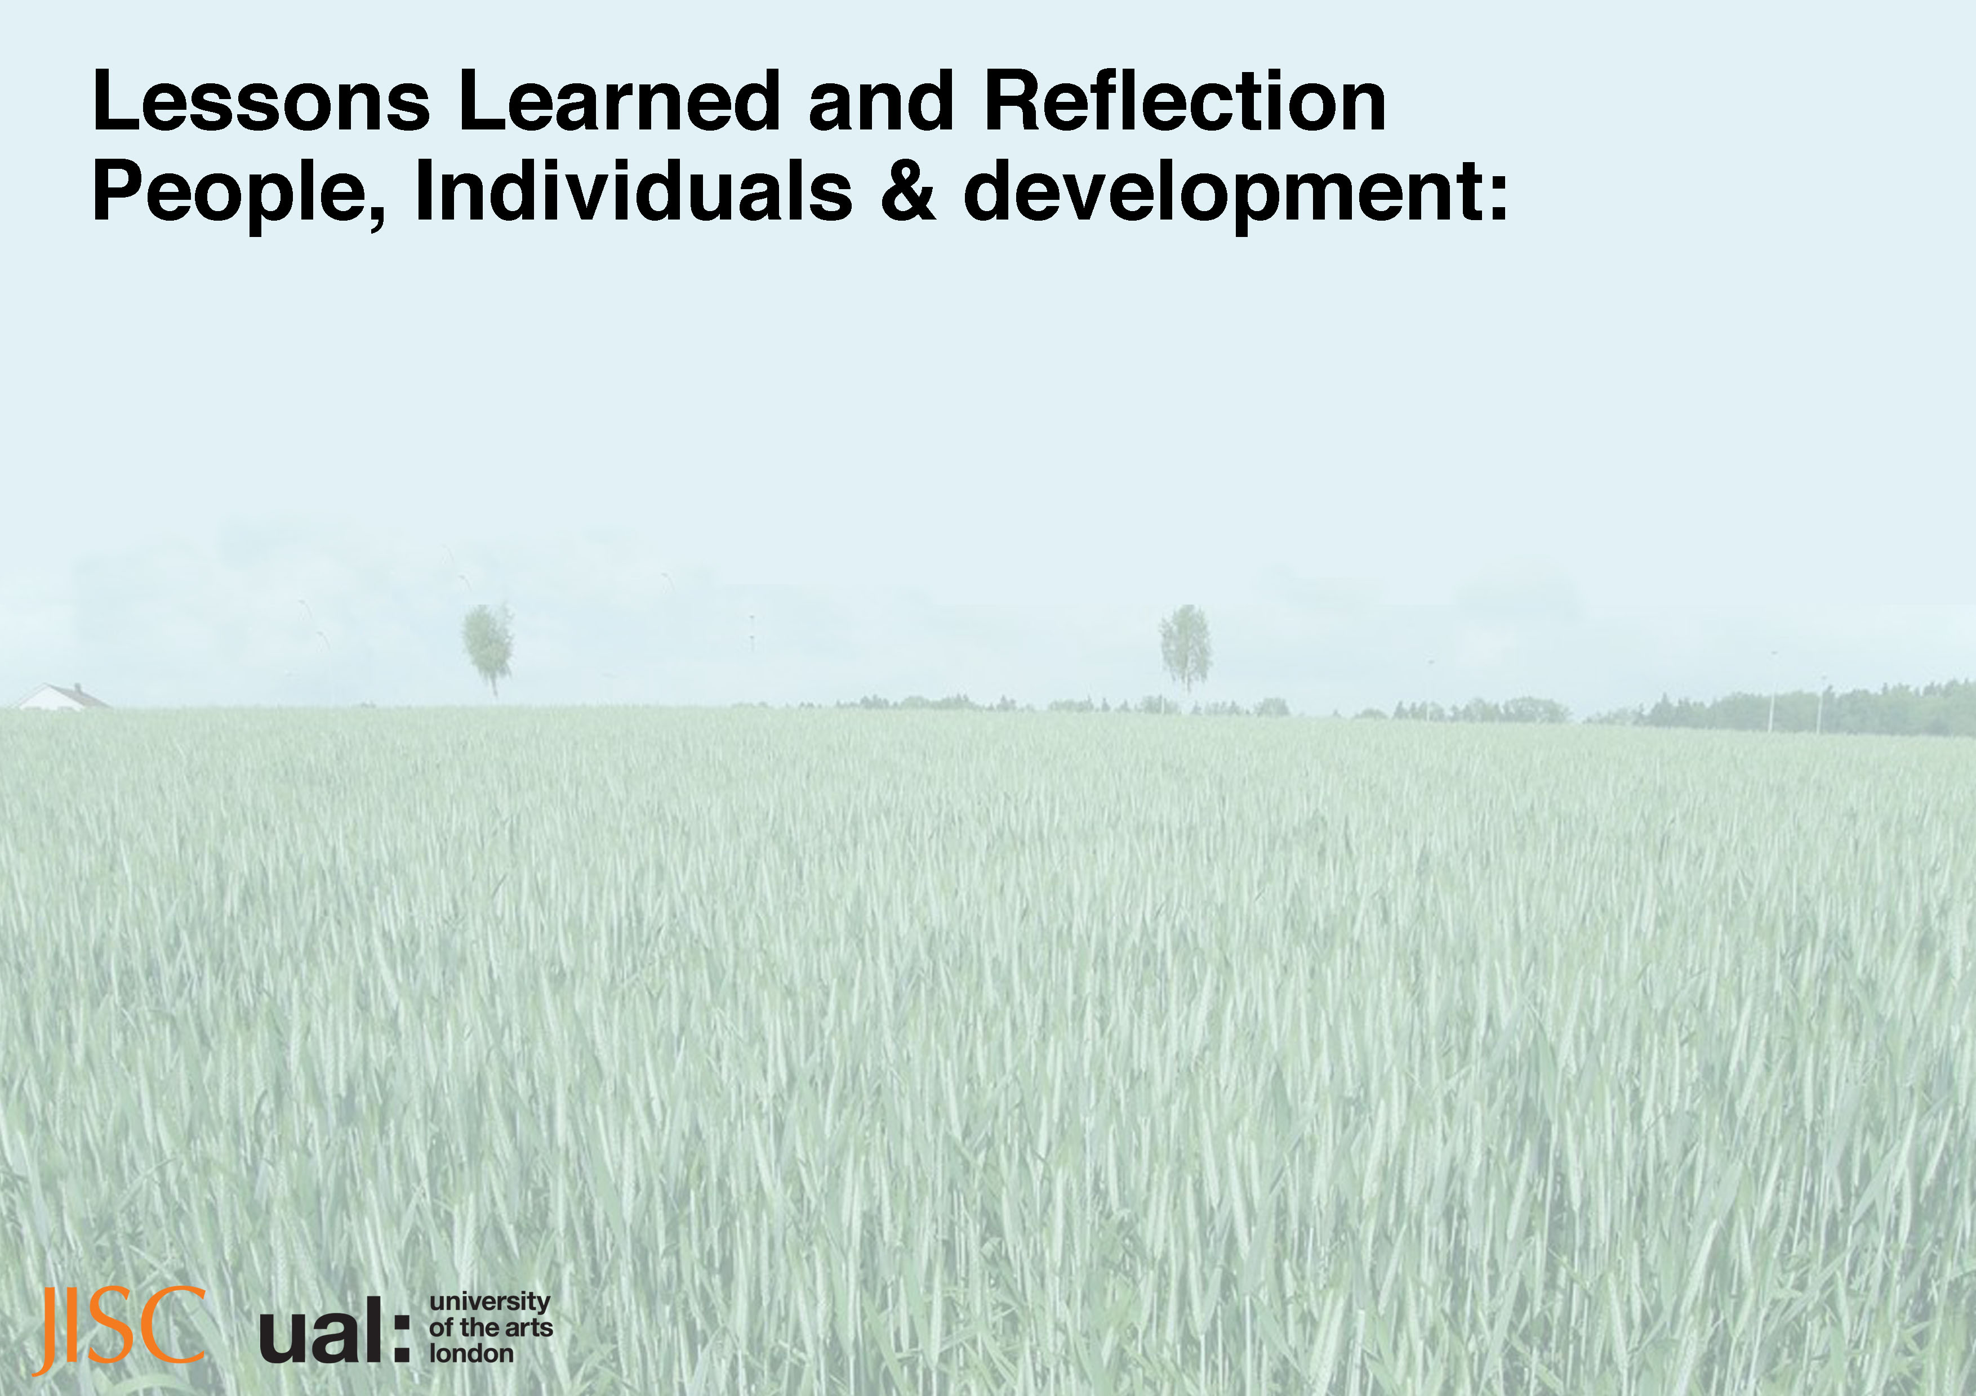
Managing Expectations: essential in everything you do from project management to one-to-one development, it’s a daily task.
Guidance and support for DLs: Staff and Students need training; guidance and support in DLs specifically web literacies.
Understanding student DLs needs: DIAL learnt that students from across all years preferred and appreciated being asked/supported and encouraged into developing their 'specialist learning and professional practice' digital literacies and skills.

Slide 10
Open practice and online reflection: Very useful for others and hugely rewarding but challenging for most.
Alumni need DL support: DL training seems to be an important need to stakeholder group looking for support.
Staff and students working DLs out together: encouraged to learn and teach DLs together, experimenting with different approaches and combinations of virtual and face-to-face interactions.

Slide 11
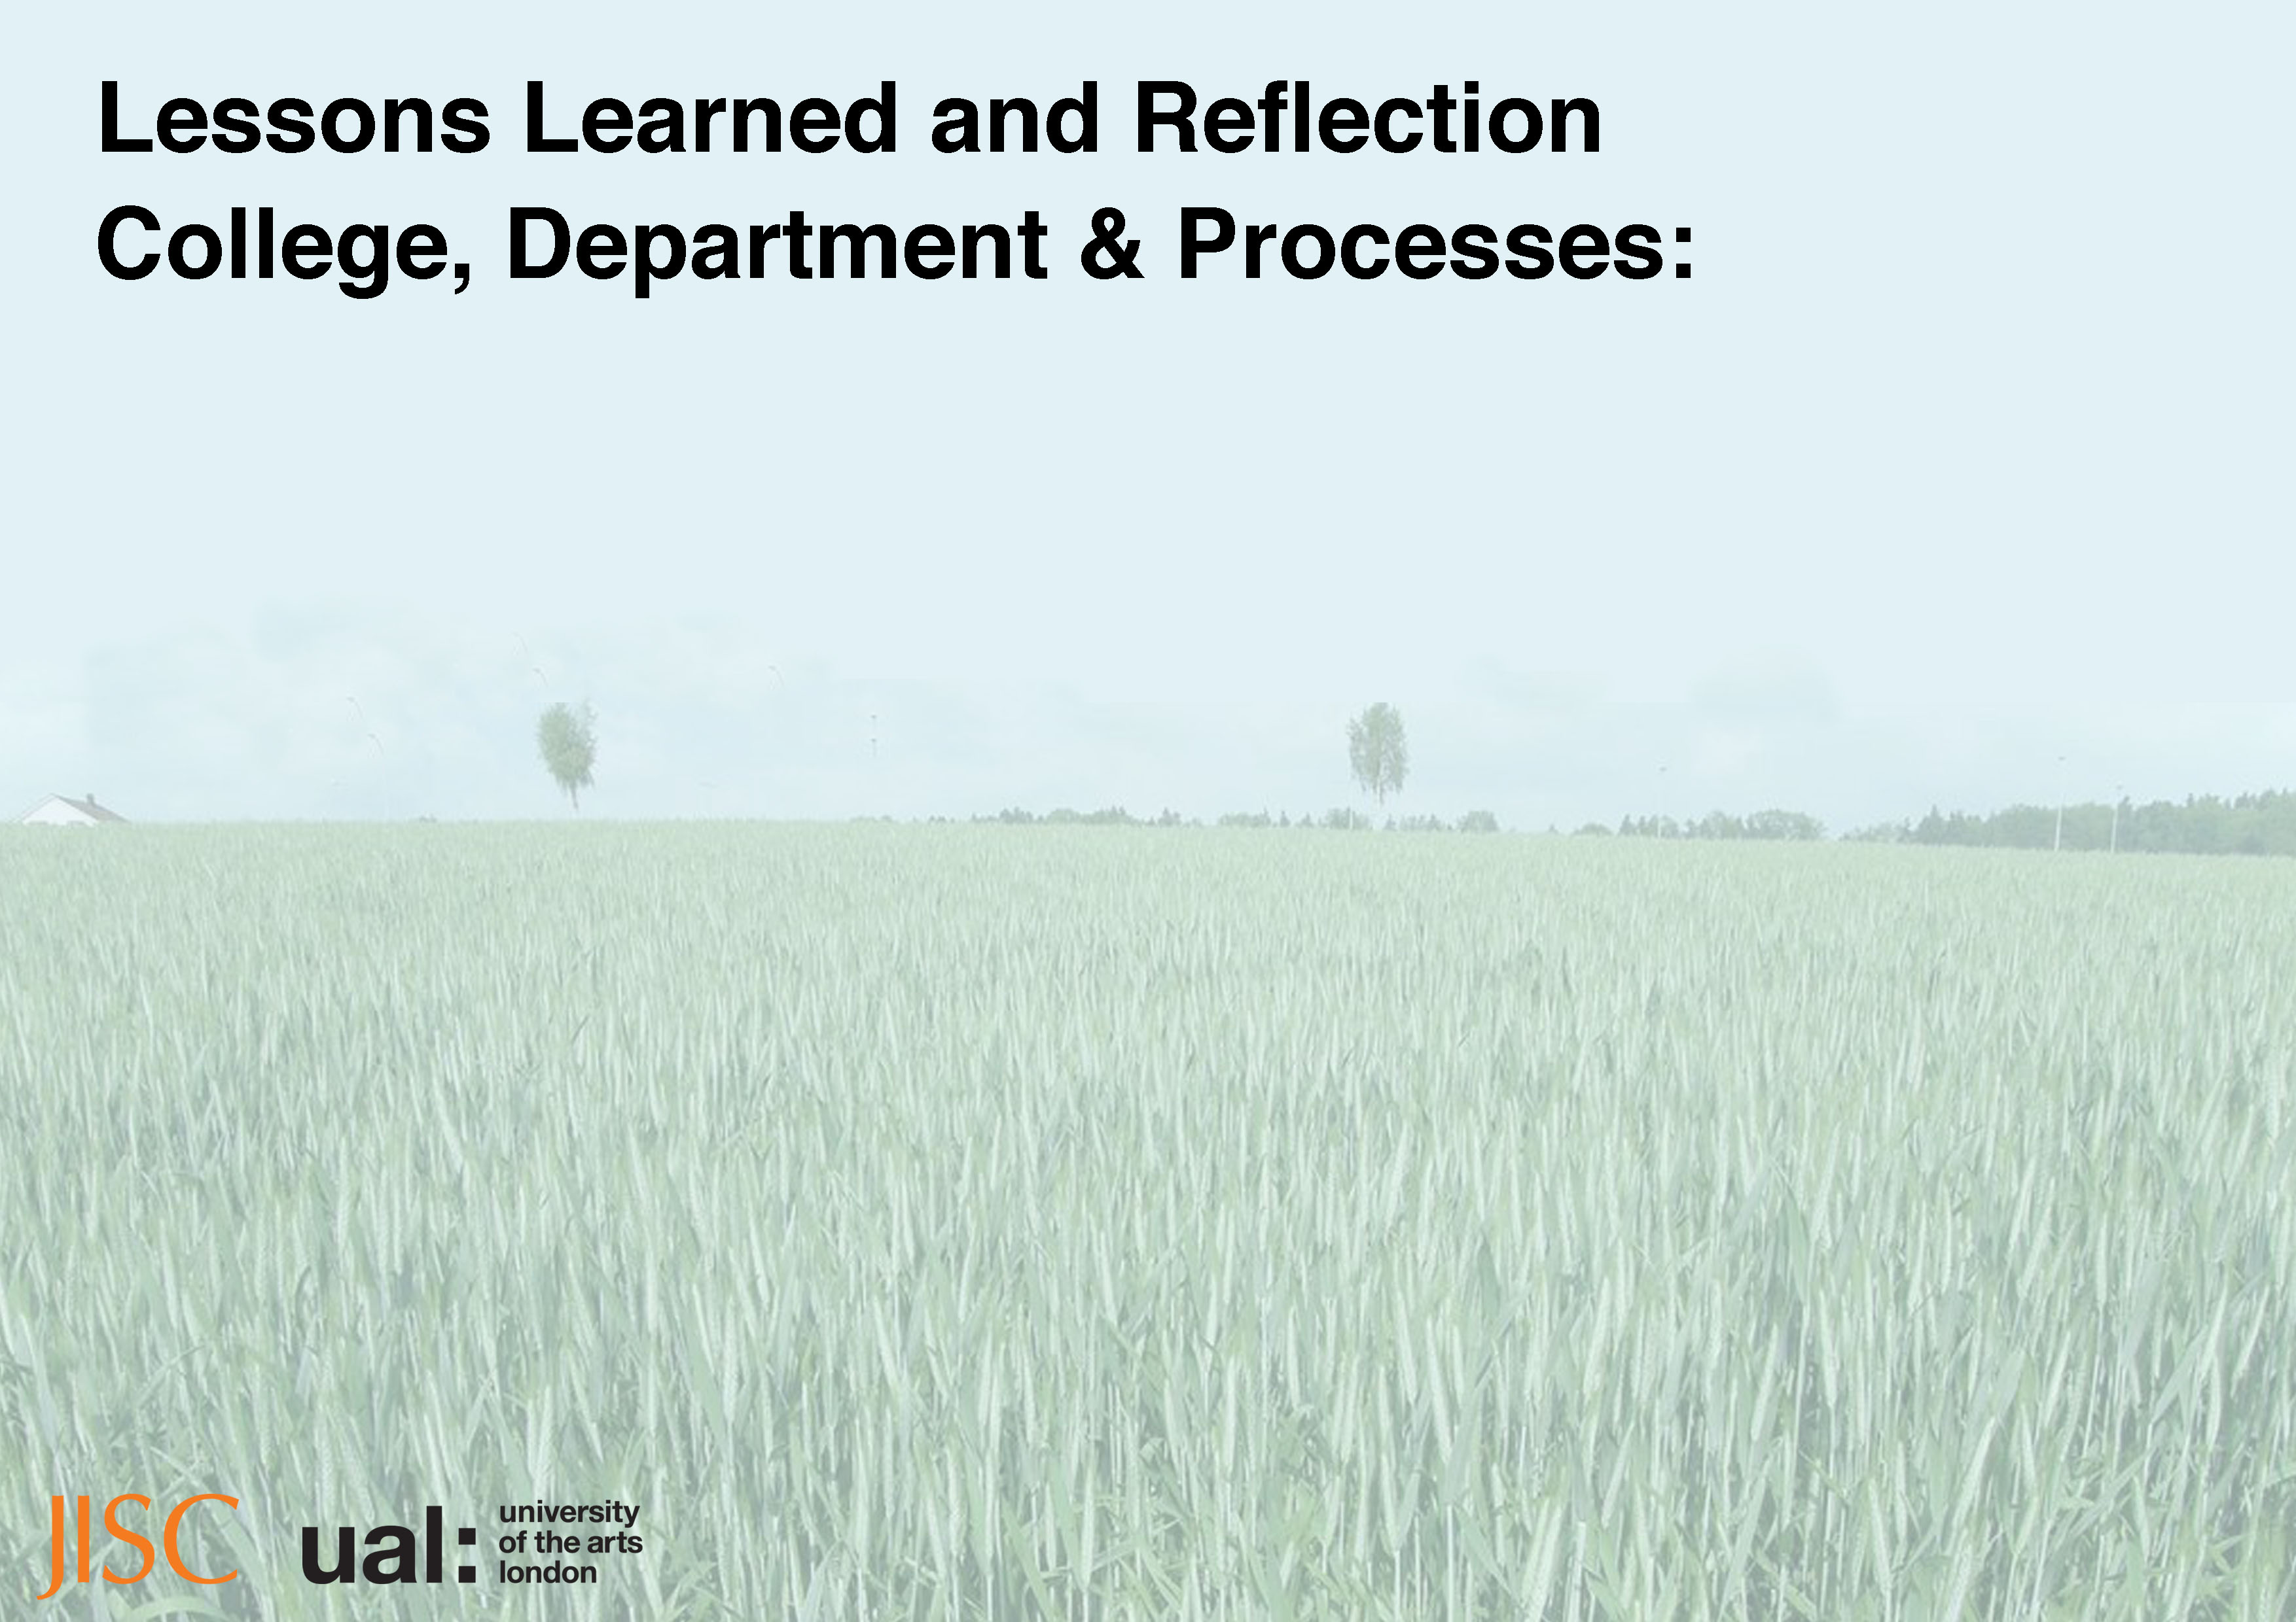
University Integration
Trust & Confidence: Dealing with DLs can be tricky and sensitive work; It’s OK to make mistakes, even if you’re an expert. Be persistent and keep trying, DLs do not come as a one size fits all solution; no one has the all the right answers.
Small steps towards local strategy: Once the trust and confidence starts to spread across a community/department and ownership of DLs expands.
Partnerships for sustainable growth, exchange expertise: Developing and delivering DL training and resources try and avoid becoming another short course department use in-house departments to your advantage.

Slide 12
College integration:
Understand the disciplines, culture and processes: DLs are complex, understanding or having team’s who understand the disciplines, culture and processes are essential.
Defining DLs and competencies: needs to be an agile on-going process.

Slide 13
Curriculum integration:
How/do we need to embed DLs: Courses may see DLs as optional extras as an optional add on of day or two training at the end of a course rather then integral part of professional practice. Should DL development and training sit inside or outside the curriculum?
Communication email & course calendars: We found emails to be the least successful, course integration; officially via course & calendar most successful
Little time for DLs with busy courses & teams: The difficulties of running these projects with busy course teams and department staff

Slide 14
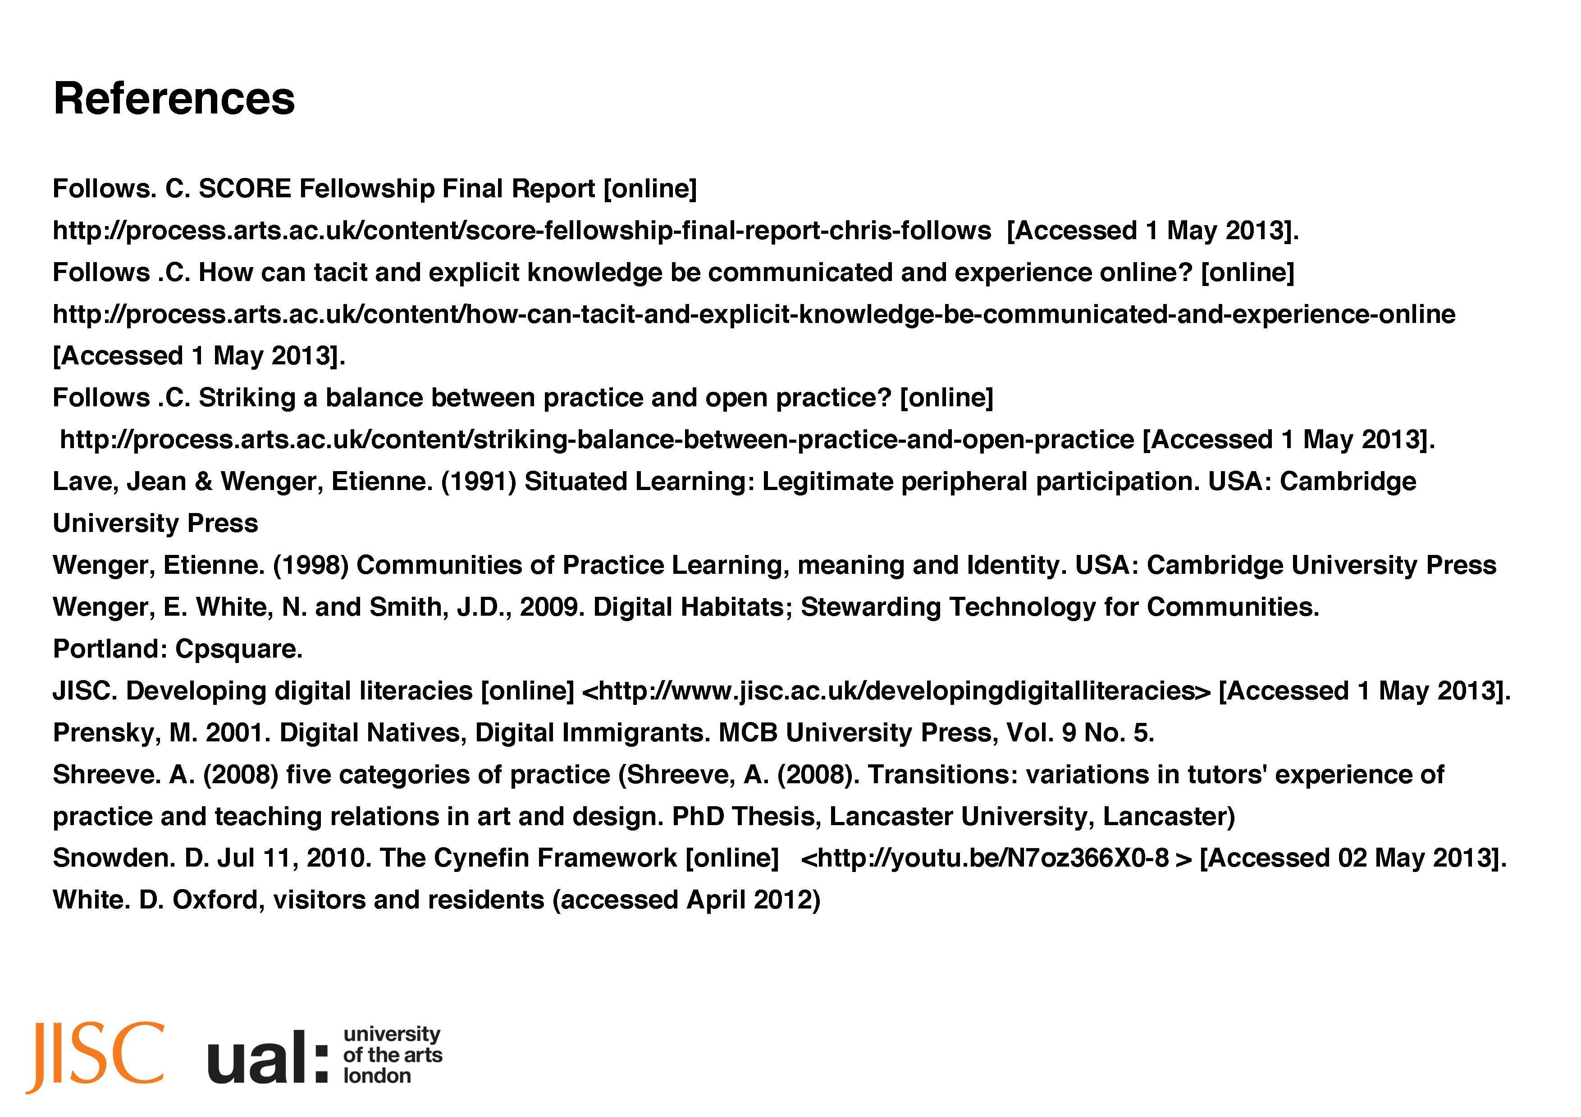

Slide 15
Thank You
@DIALProject
@ProcessArtsUAL
http://process.arts.ac.uk
http://dial.myblog.arts.ac.uk
http://process.arts.ac.uk/content/dial-projects-and-activities

