Slide 1

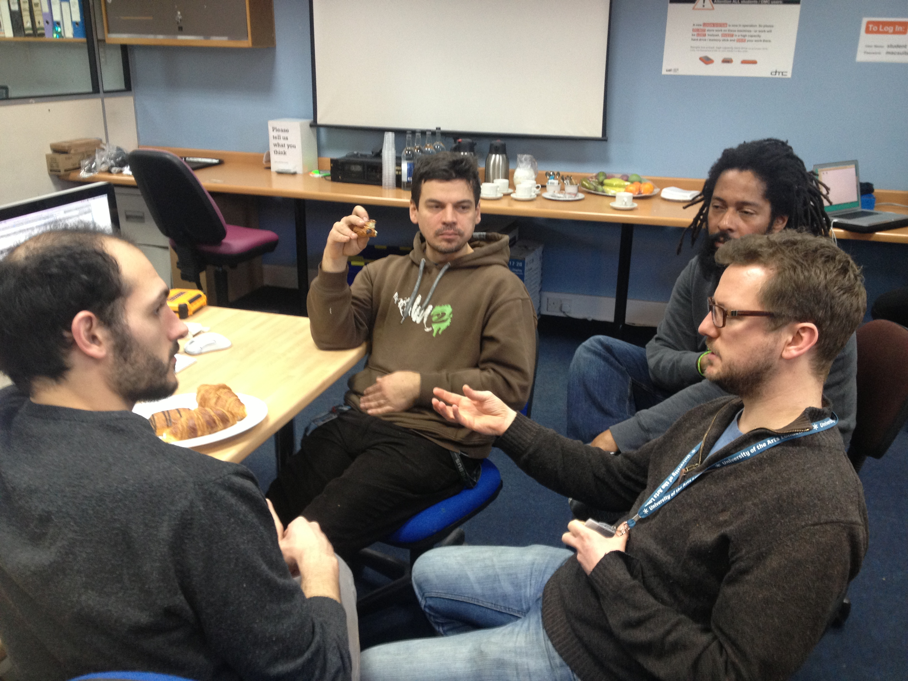




Chris Follows Drupal developer and web project manager (DIAL project manager)
Grzesiek Sedek Lead Drupal Developer (CCW Staff)
Michele Durante Web designer, Drupal Developer (WCA Alumni 2013)

Slide 2

The Drupal UAL project aims to:
Encourage and develop a new open support network (Community of Practice) for UAL staff and students to explore, experiment and share ideas and knowledge of using and developing Drupal ‘open source’ web software environments and projects.

Slide 3
What is Drupal?
An open source CMF (content management framework) web environment/software (goes beyond a static basic website)
Free to download, use, repurpose and develop
Endlessly expandable web environment for building online communities and rich media sharing

Slide 4
What is an open source software?
Drupal is a sharing community, software released under a (GNU General Public License)
Those that ‘take’ eventually also become part of that ‘giving’ sharing community and so the open source Drupal community grows from strength to strength.
You will need some Drupal training, support and experience…
…. This is where Drupal UAL comes in.

Slide 5
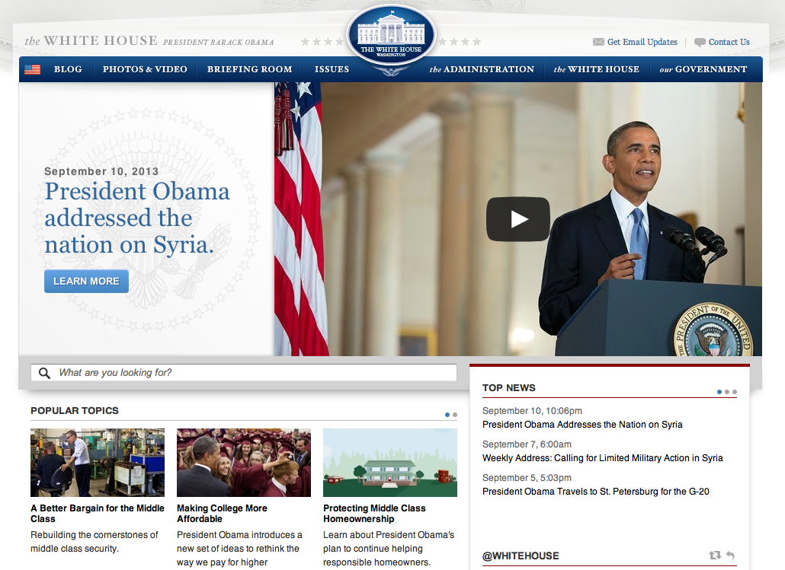
Who uses Drupal?
Used as a back-end system for at least 2.1% of all websites worldwide (Ref Wikipedia)
whitehouse.gov
data.gov.uk
Knowledge
management

Slide 6
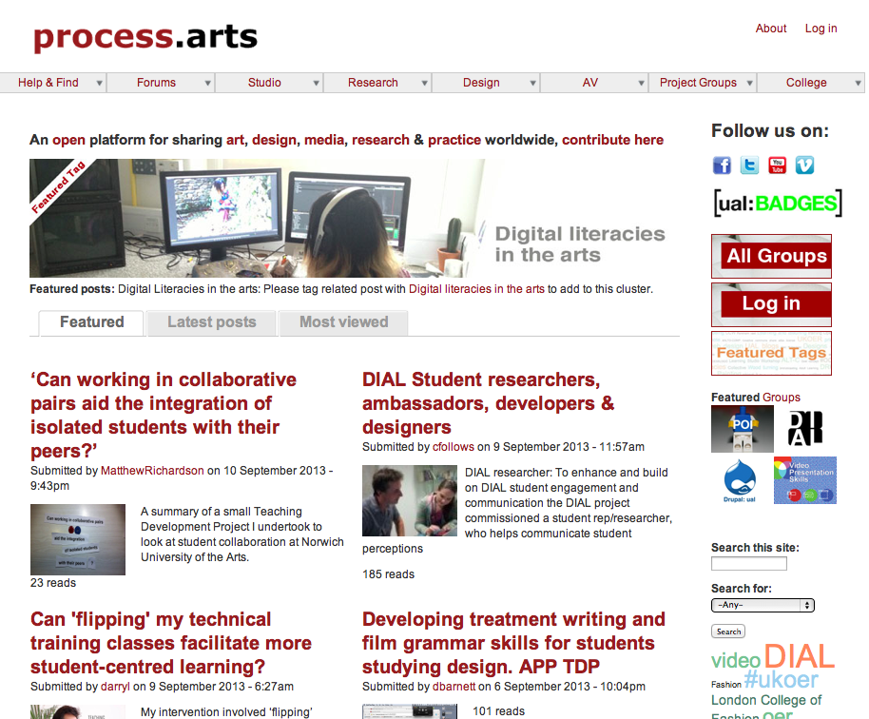
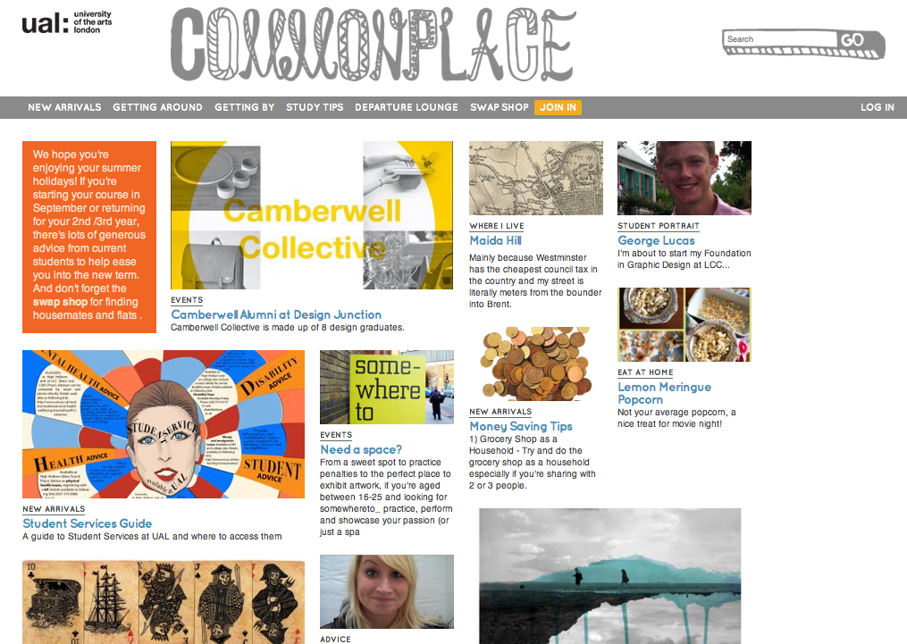
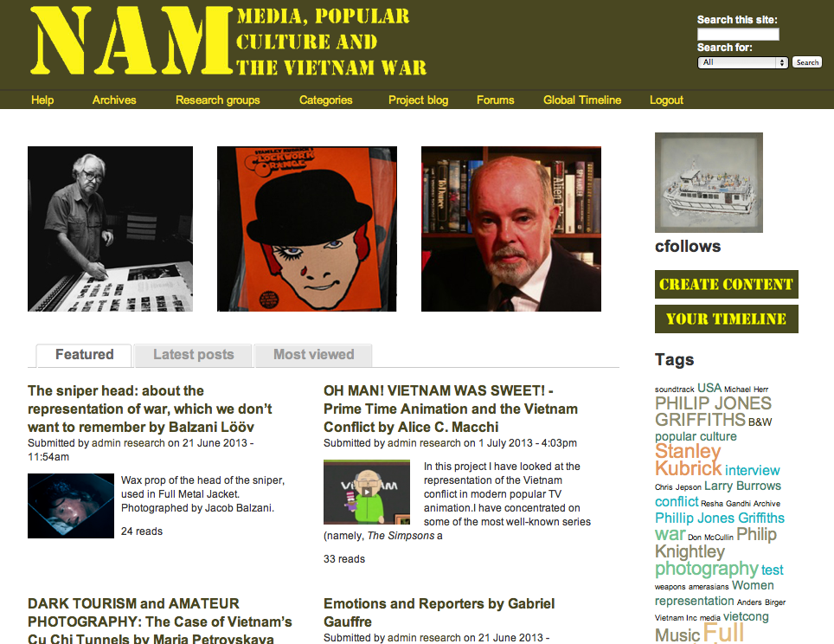
Who uses Drupal at UAL?
http://process.arts.ac.uk
http://commonplace.arts.ac.uk
http://conflictandmedia.arts.ac.uk
… and many more!

Slide 7
Why Drupal?
Build expandable and dynamic web environments
Build large online communities (of practice)
Manage/showcase large amounts of rich media content
Be part of a huge global development community
Benefit from new and up-to-date web2.0 functionality
Possible creative career opportunities: Huge shortage of Drupal developers as demand is rising
It’s free

Slide 8
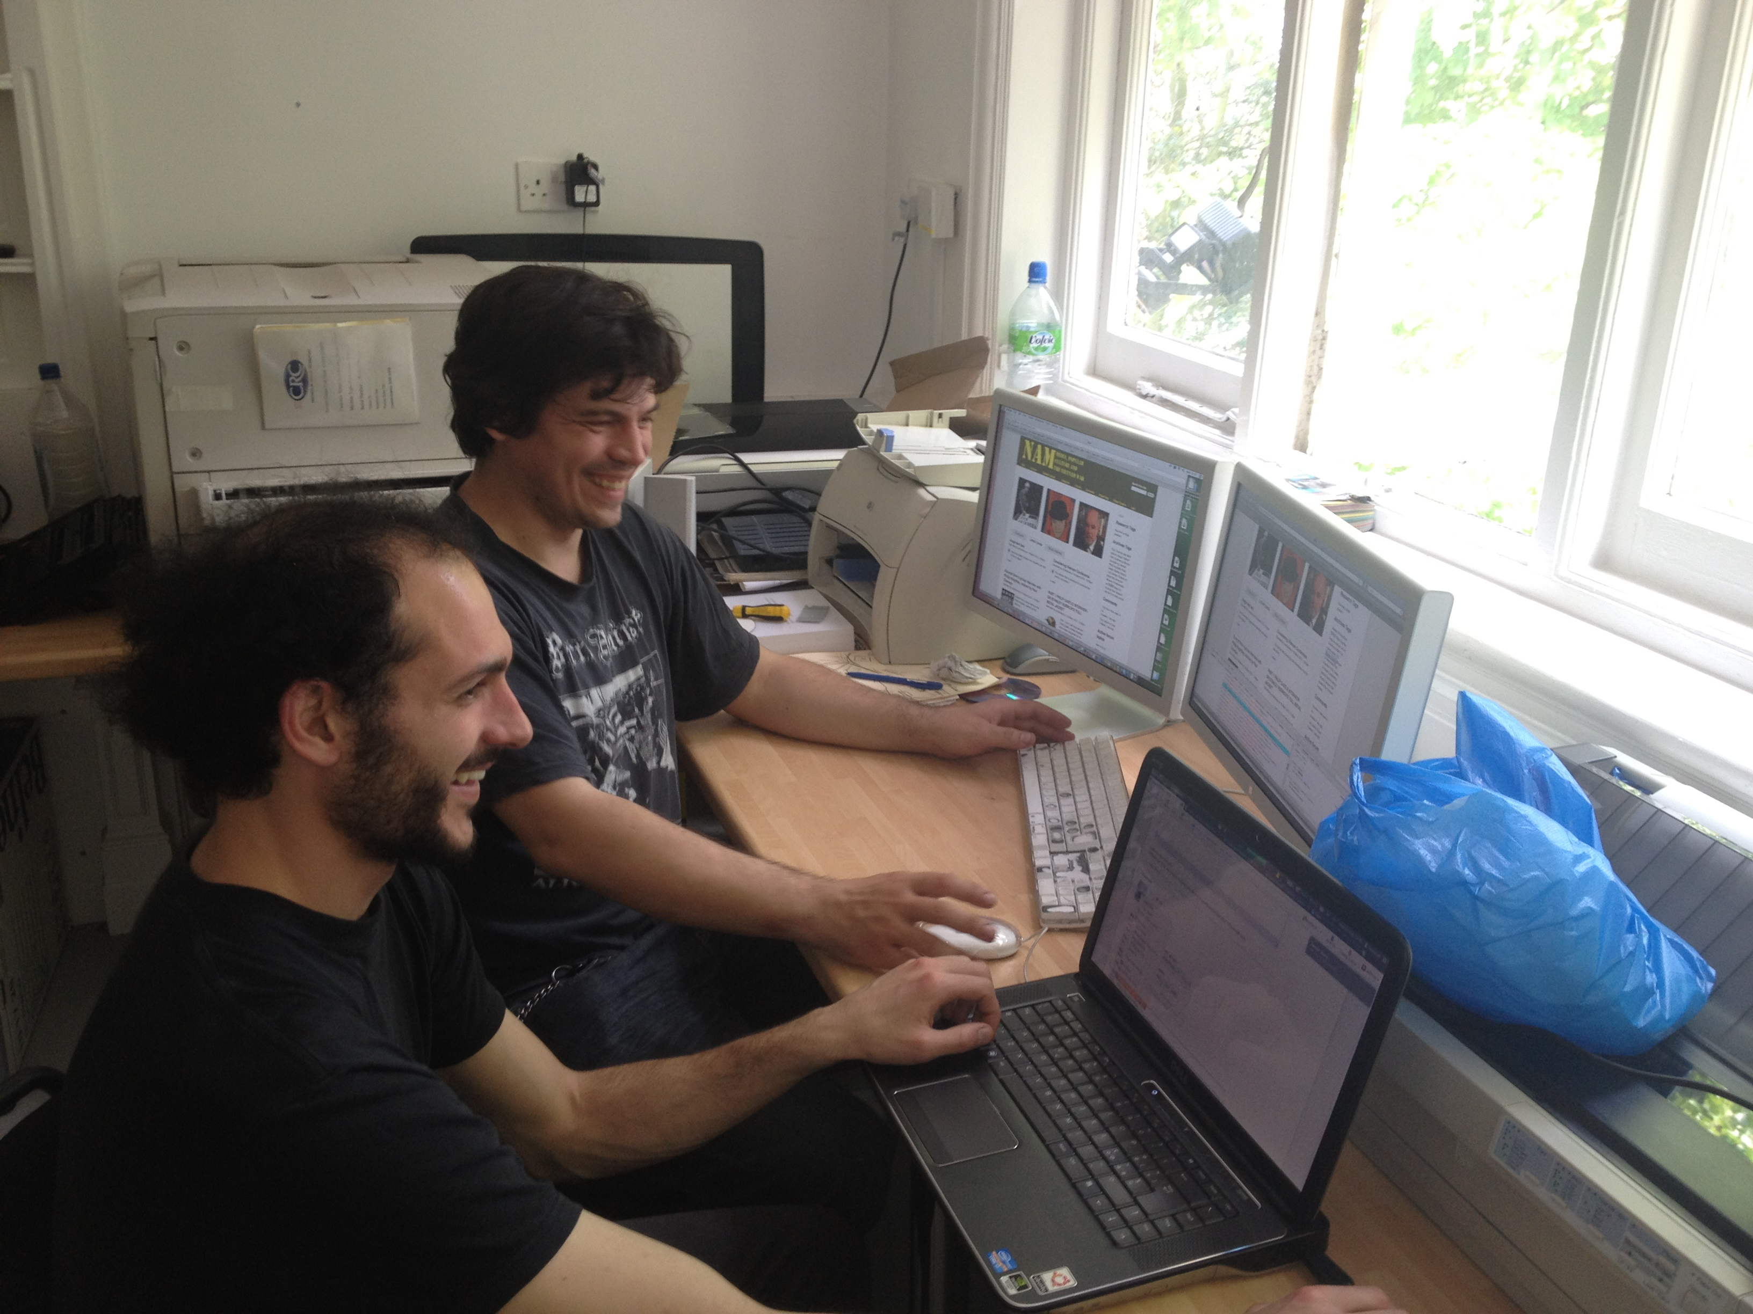
What we did?
Getting started, Core Team Building:
We formed a starter group of UAL staff and students
The core team of existing UAL developers included:
  Chris Follows (DIAL project manager)
  Grzesiek Sedek (Specialist technician at CCW)
  Michele Durante (3rd year students at WCA 2013)
The team arranged to meet regularly as often as possible on Friday mornings mainly at WCA but also at CCAD to plan the project.

Slide 9
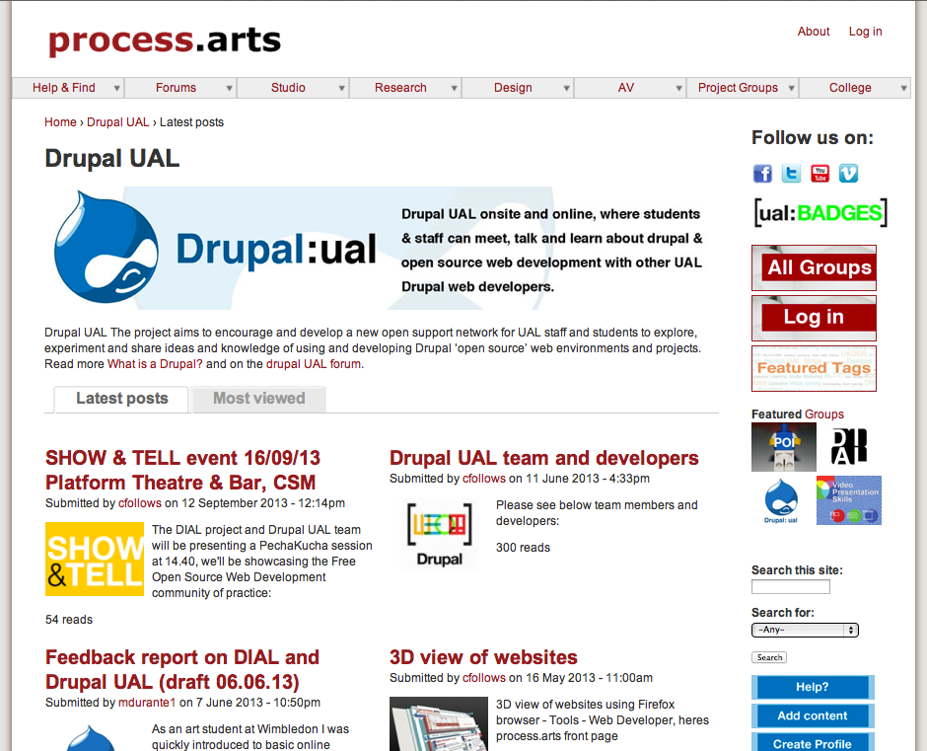
What we did?
Getting started, Project communication:
We set up on an online space on process.arts to cluster content and resources, communicate our project and to encourage debate and participation from a wider audience.
Resources - http://process.arts.ac.uk/category/project-groups/drupal-ual
Forum - http://process.arts.ac.uk/forum/2110

Slide 10
What we did?
Getting started, Project communication:
We received interest from staff and students and from people outside UAL and the information on the Drupal UAL site has attracted many views.
“I understand DIAL run drop-in sessions on Drupal? How do I go about getting involved?”
“I'm new to UAL (student) - I'm very interested in Drupal. I've been looking at Drupal Garden and it
seems very interesting. I'd like to learn more about Drupal so I can start building my own sites in the future
as I plan to do some freelance work etc.”
“I'd be very interested in attending Drupal sessions if you're having them?”

Slide 11
What we did?
Project integration and sustainability
In order to embed the project at UAL and explore a possible sustainable future, we aligned the Drupal UAL CoP with the DIAL project (Digital integration into arts learning).
Our aim was to try and extend the support (financial, technical and community) for the Drupal UAL Cop to help grow and establish the Drupal CoP long term.
The Drupal UAL project gained extra funding and support from DIAL and will now continue to run until December ‘2014’.

Slide 12
What we did?
Project integration and sustainability
Benefits of this collaboration with DIAL UAL:
Extra funding
Longer/extended project timeframe
DIAL staff support the project development
Promotion and exposure
Curriculum Embedding through wider project integration
Mutually beneficial
Technical and server support (CLTAD)
Web site and online Cop stewarding support.
We could do more e.g. we supported MD to attend Drupal Con 2012 on behalf of Drupal UAL

Slide 13
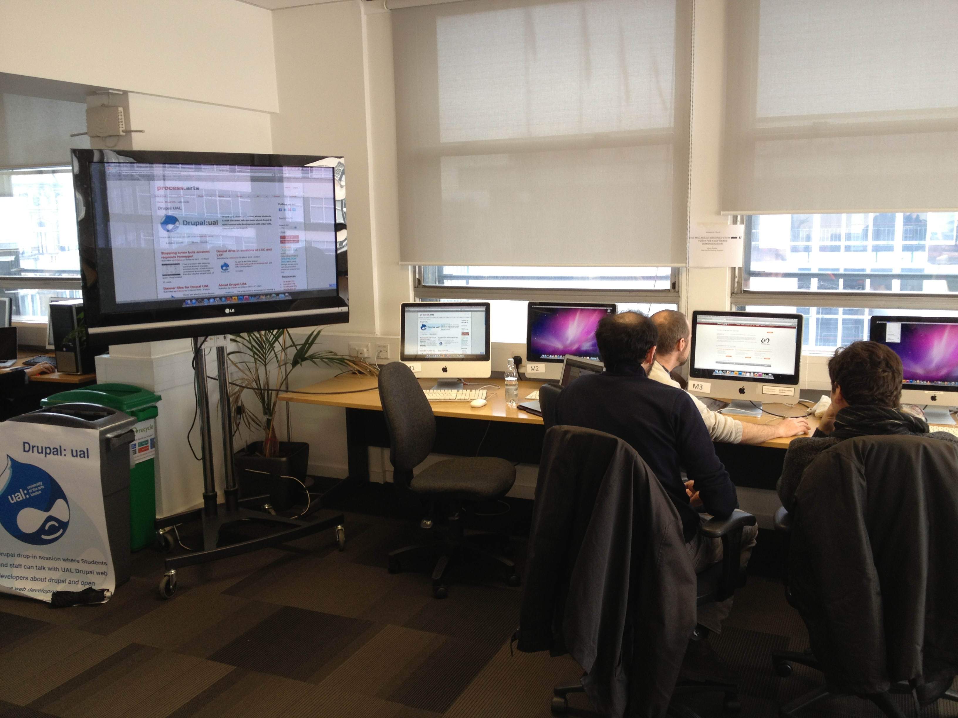
What we did?
Drupal UAL Drop in sessions
We arranged a series of Drupal drop in sessions across UAL colleges
These were attended by a number of staff and students (around 5 per session)
Participants were very interested in the CoP and many spent a full 2 hours in discussion All participants said there is a real need for such a support network at UAL and wanted more sessions in the future.

Slide 14
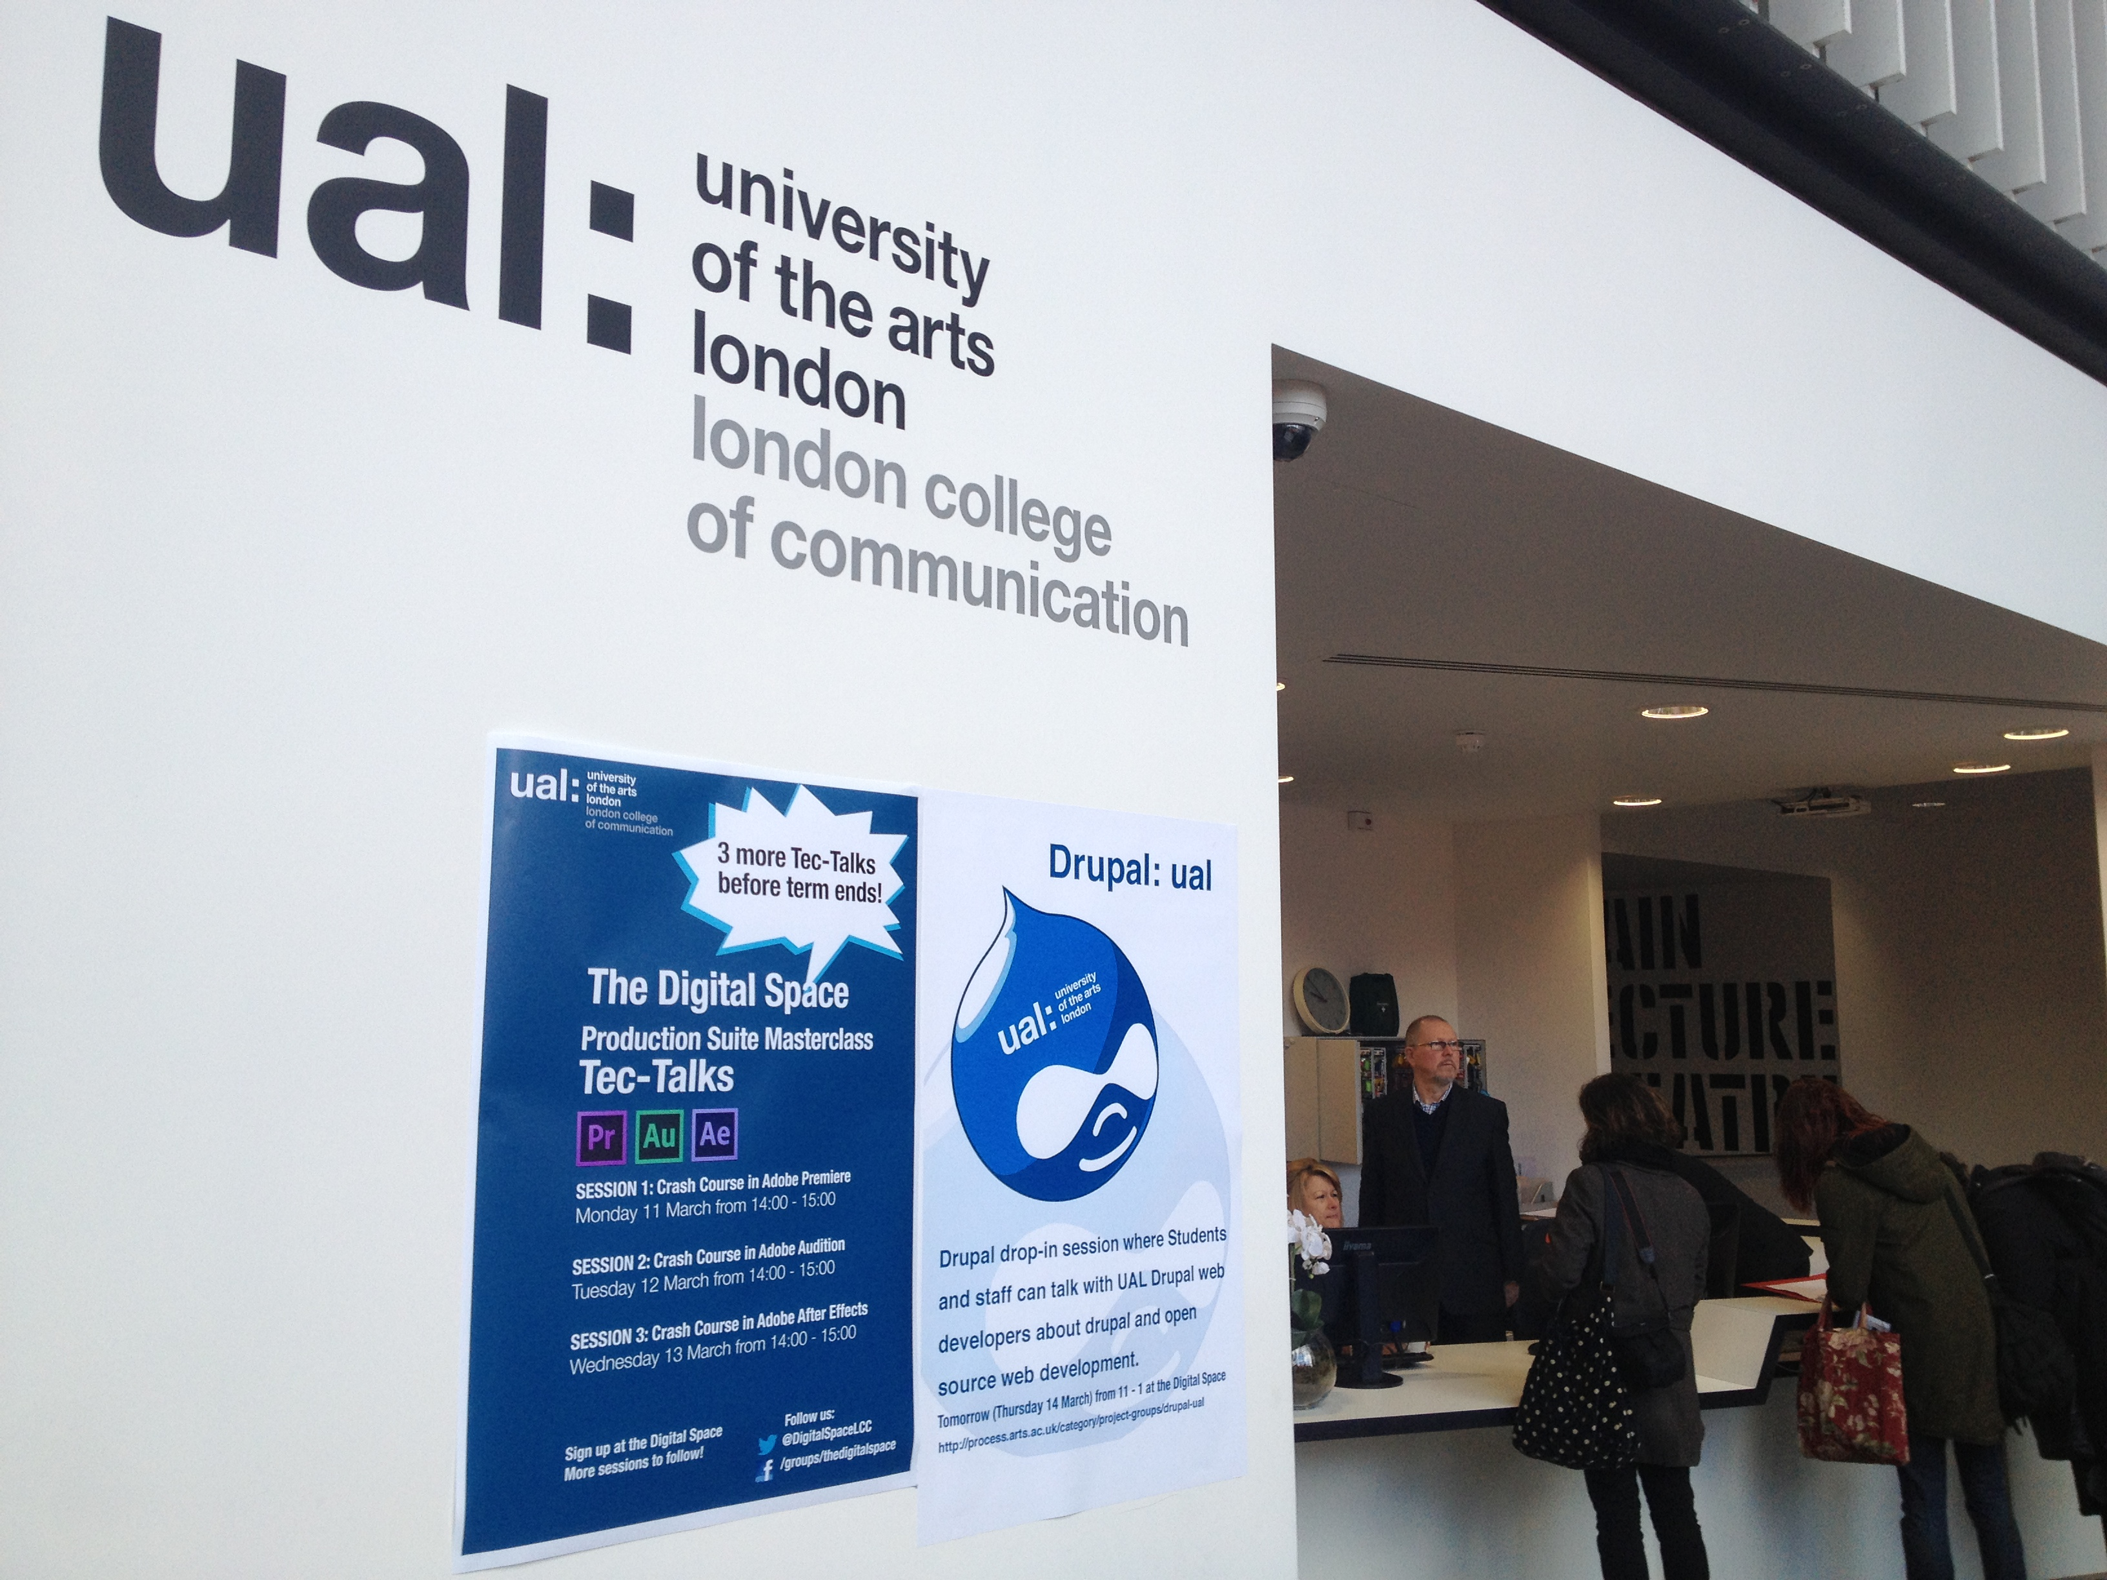
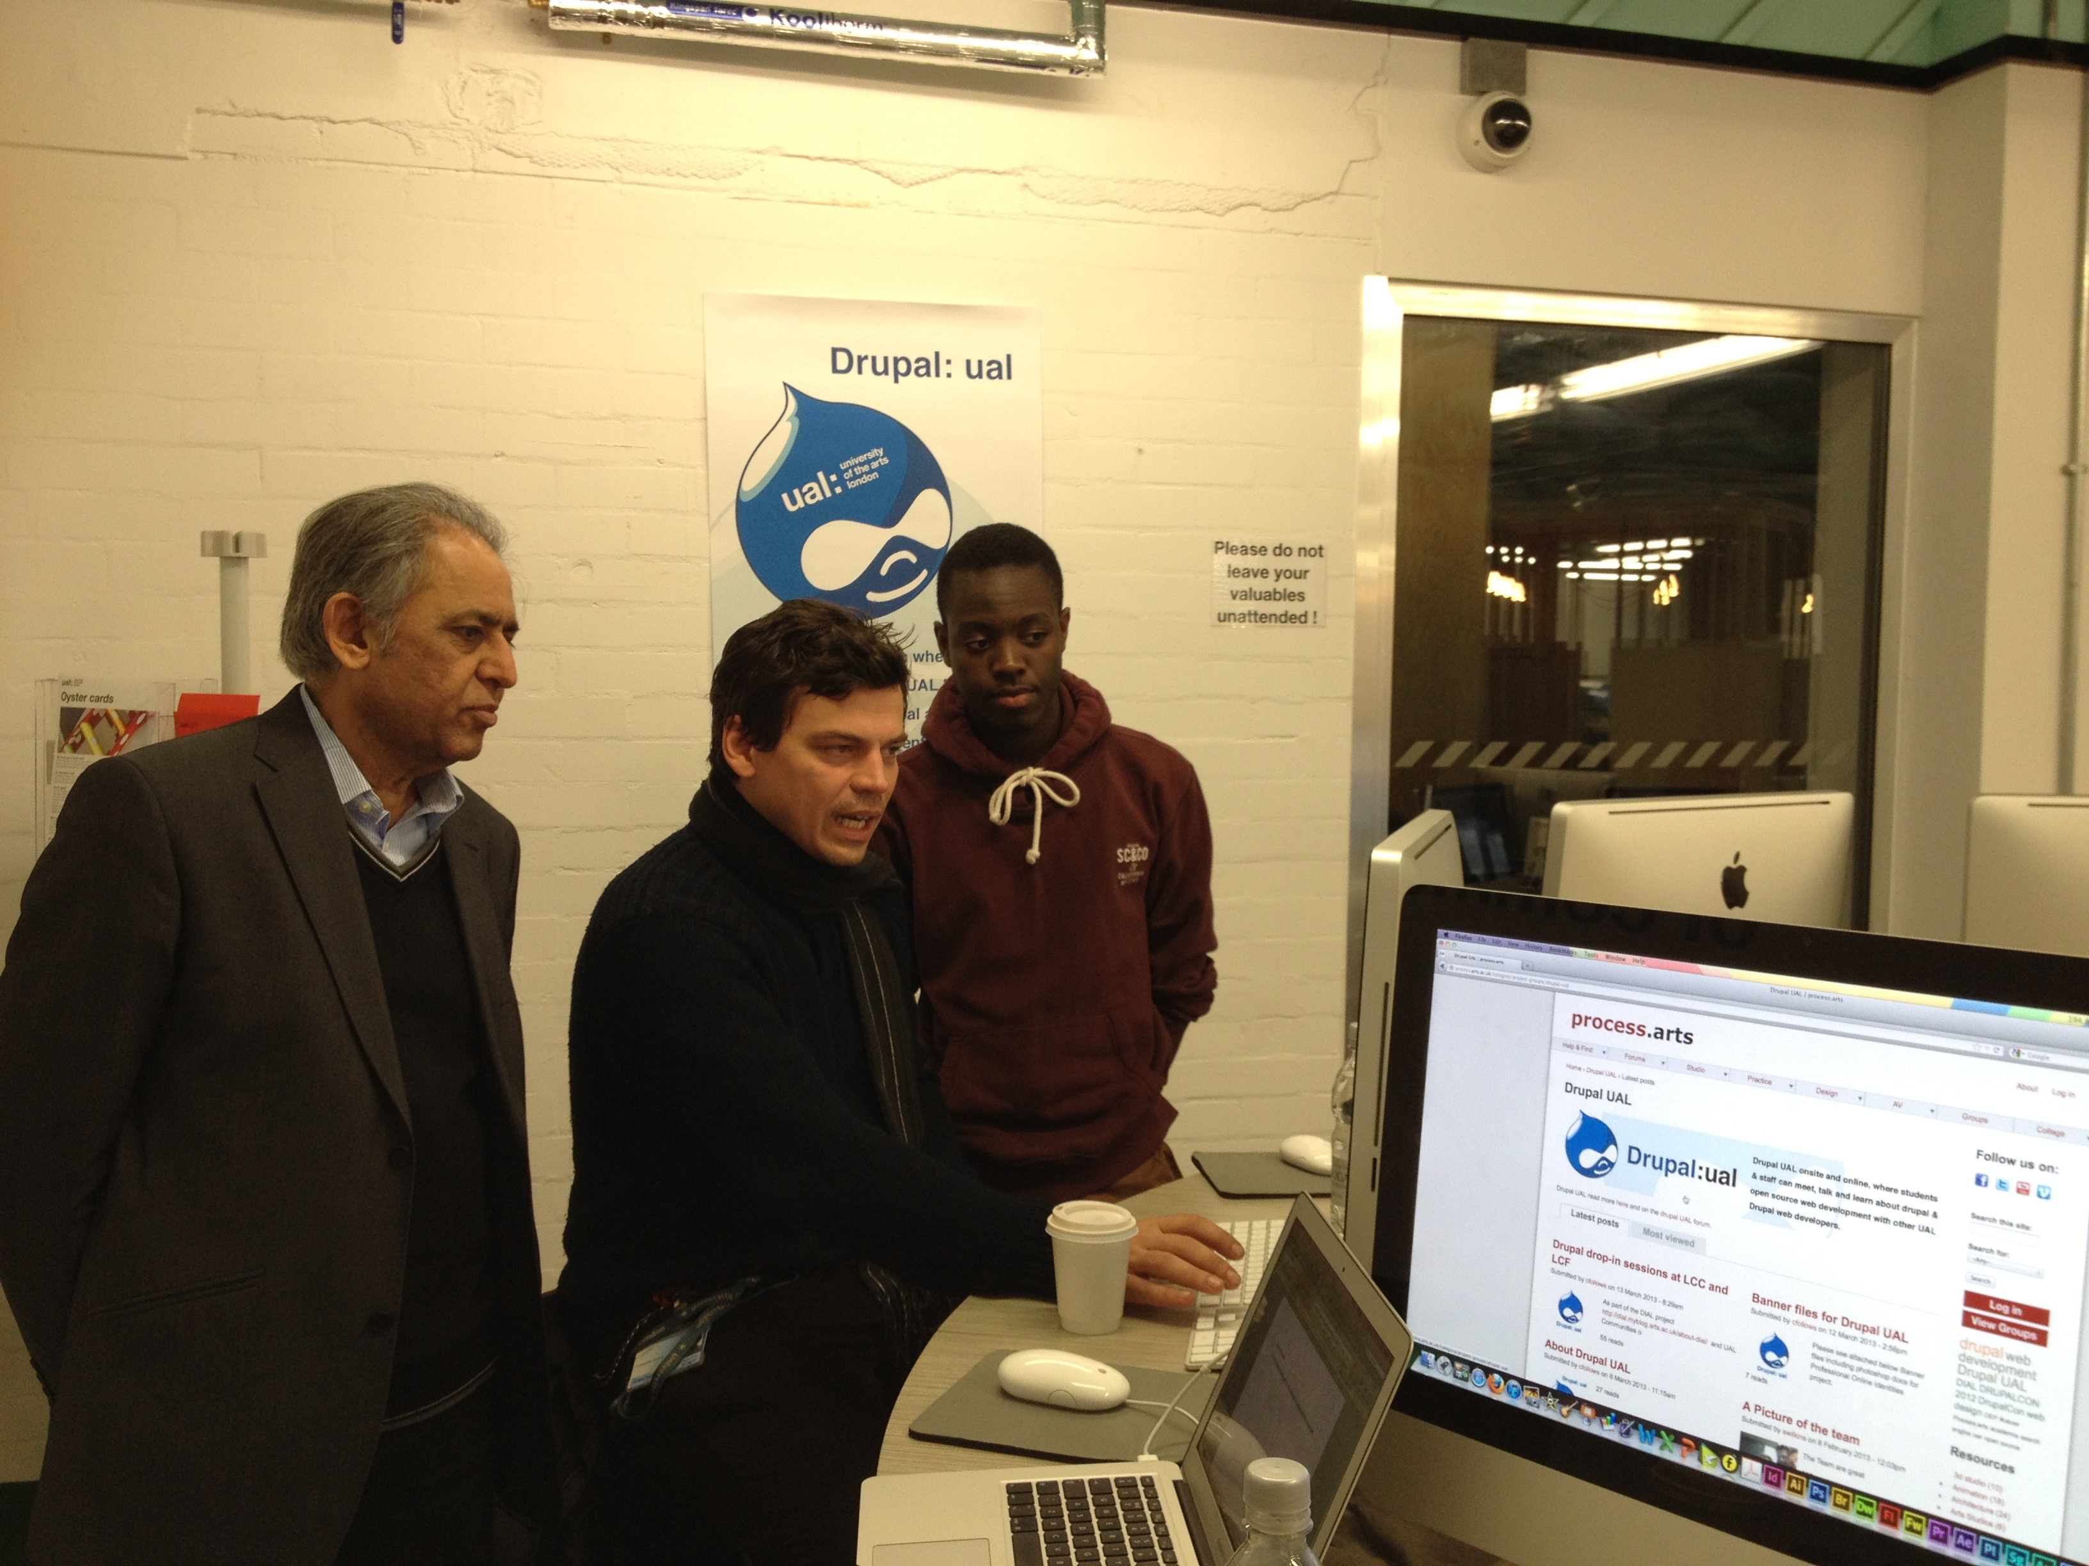
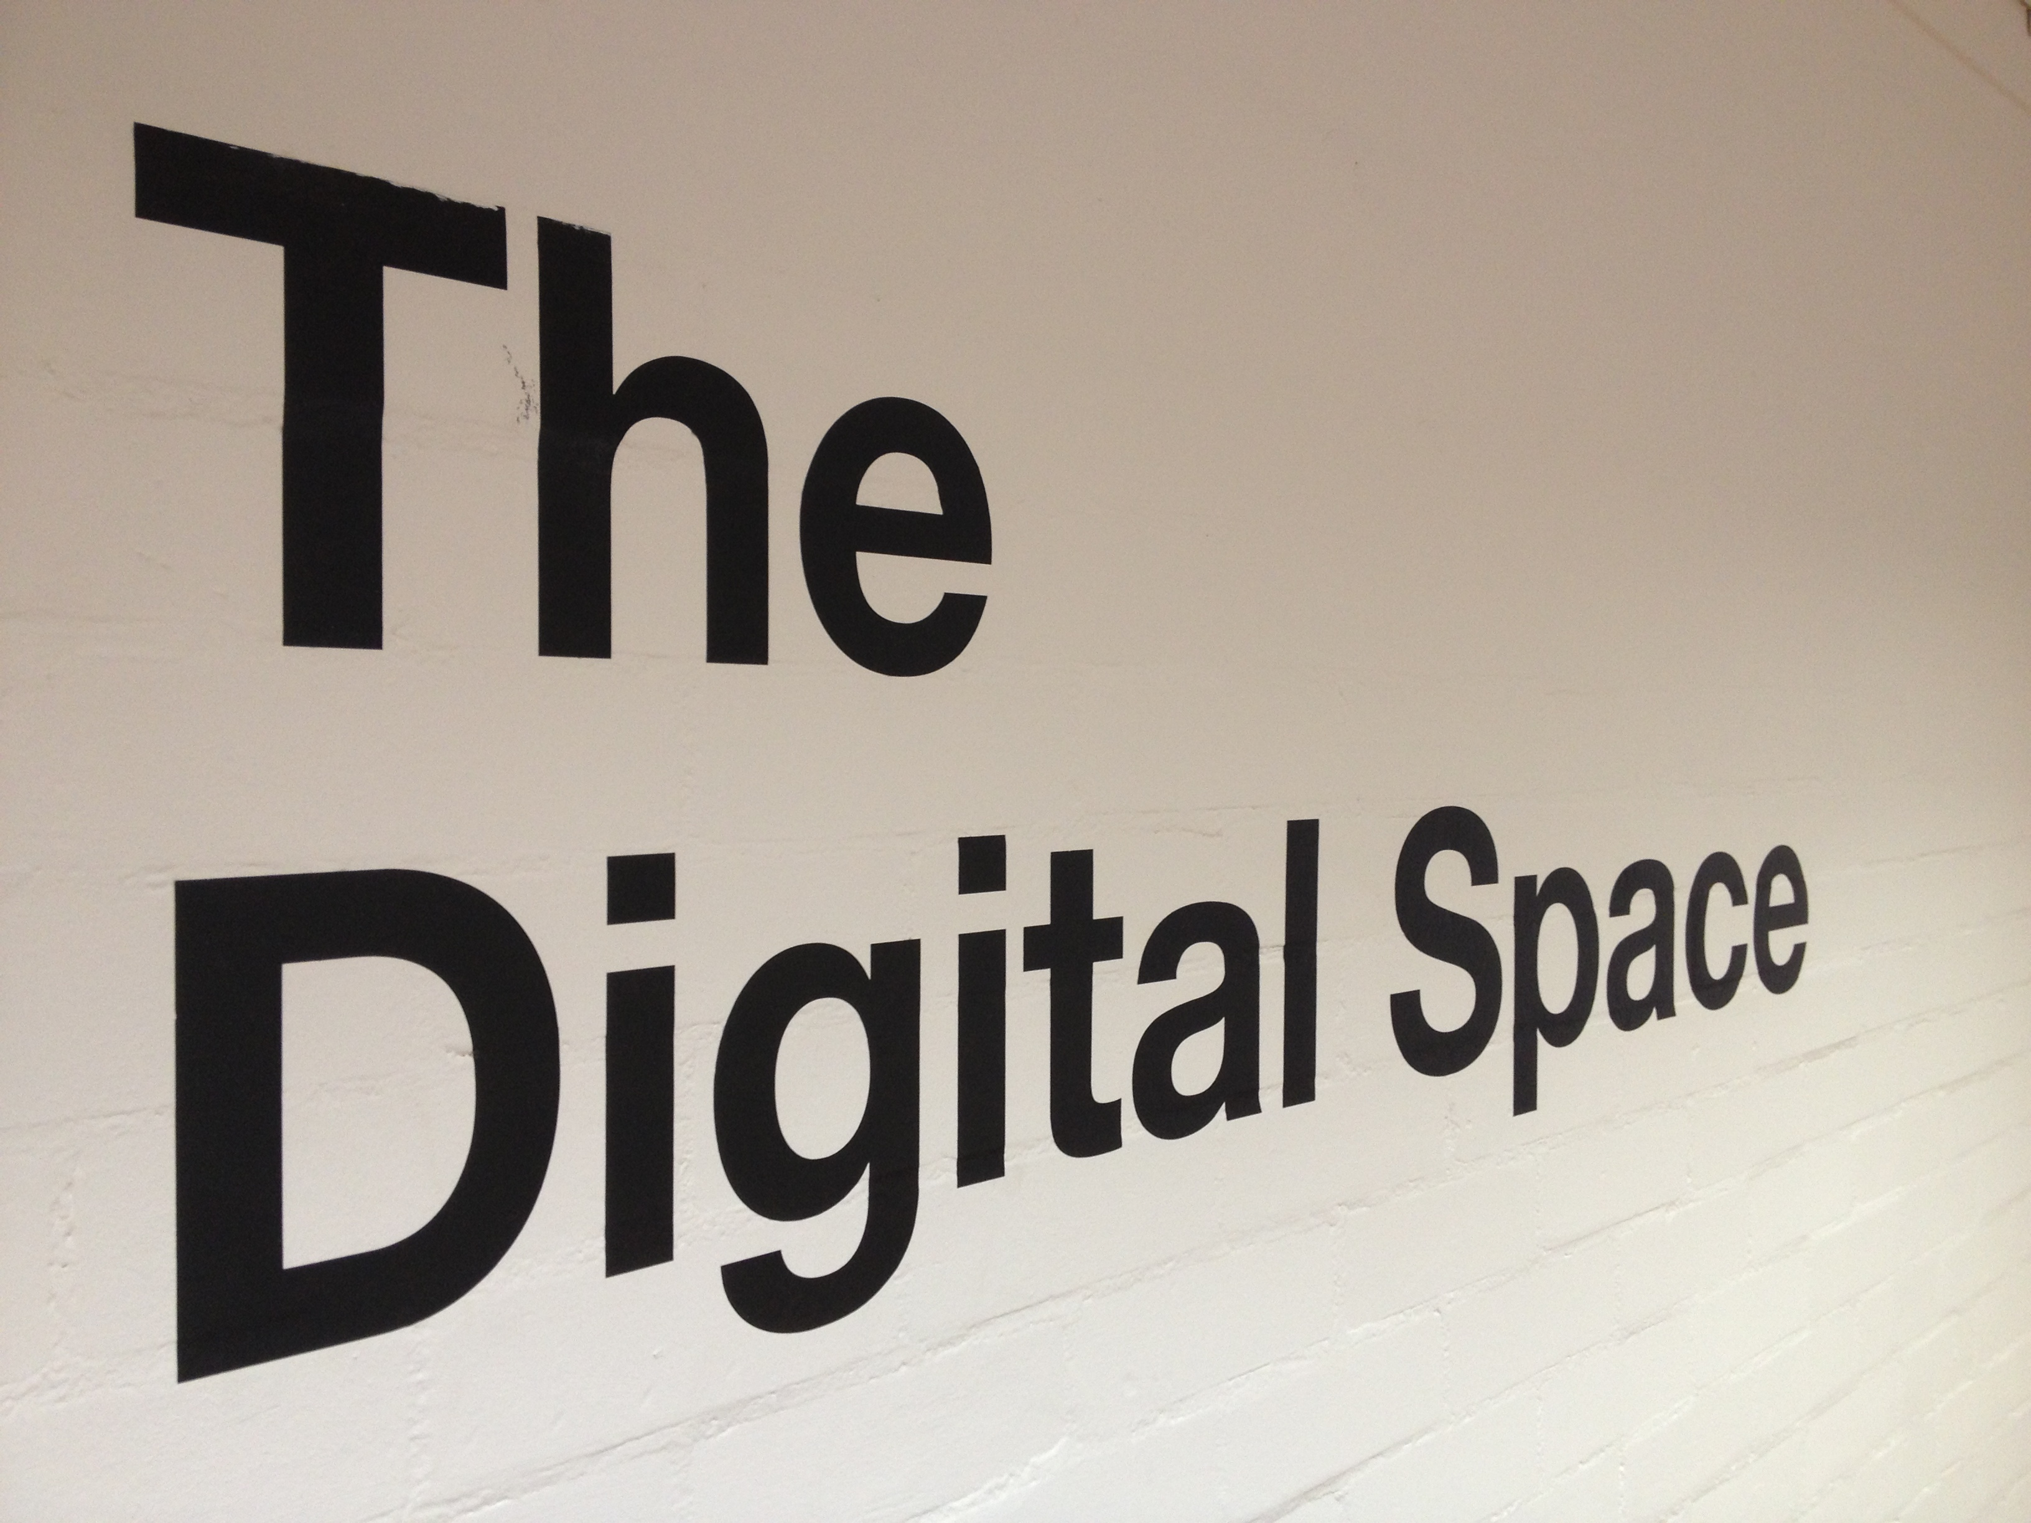
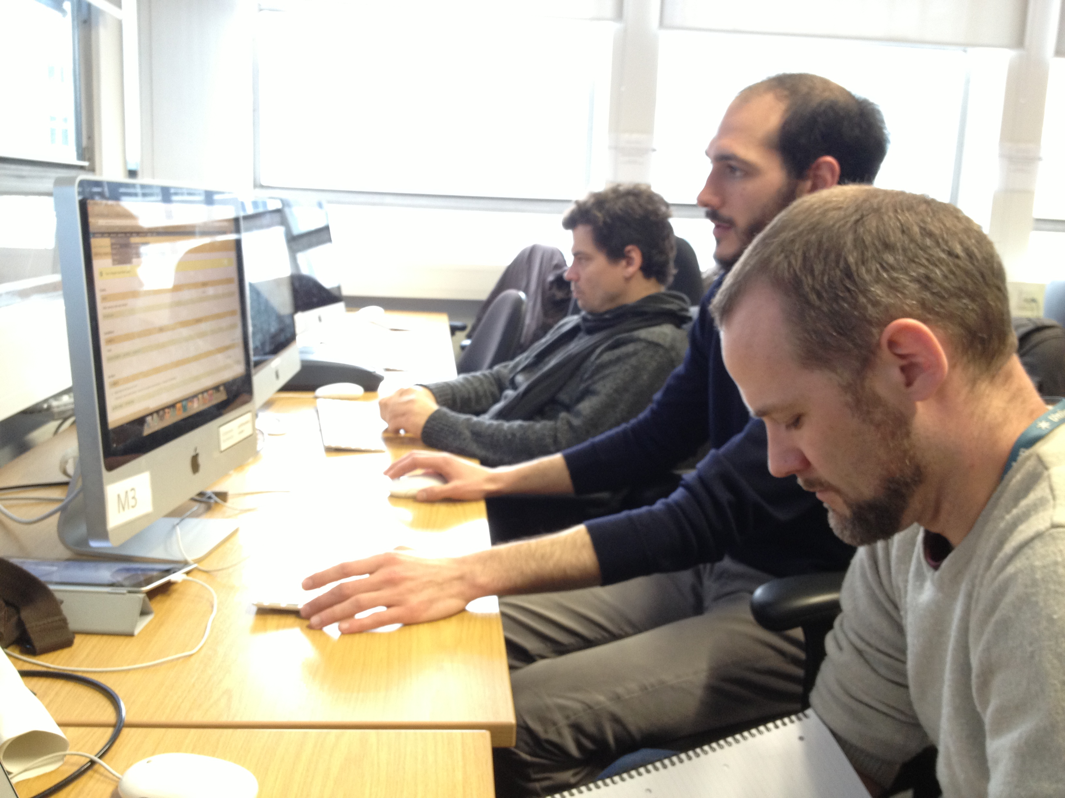
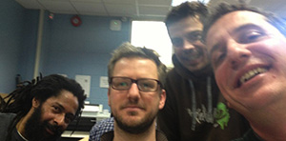
What we did?
Drupal UAL Drop in sessions

Slide 15
Lessons learned/challenges?
Drupal Sand pit: From the drop-in sessions we found a need to provide a vanilla ‘out the box’ sandpit Drupal environment. We set up a private external server and have started to use this in the workshops.
Outsiders: Extra Curricular: Planning ‘digital reliant’ events across UAL is very difficult, some colleges are not equipped or have the capacity to support ‘externally’ organised workshops as they are difficult to ‘fit in’.
Try a wider catch: The drop-in workshops were successfully received, although only students or staff who were available or confident enough to ‘drop in’ would participate.

Slide 16
Other Challenges
Finding time to meet up and organise events etc. is difficult.
Encouraging online participation is difficult, the face-to-face drop-in sessions were more successful means of collaboration and communication, but the online environment is useful for wider communication and clustering ideas and resources.
Who will support this project long term?
People contacting us were very interested in the project but found it difficult to find time to join the group sessions (more varied/location and session types needed and regular/frequent times)

Slide 17
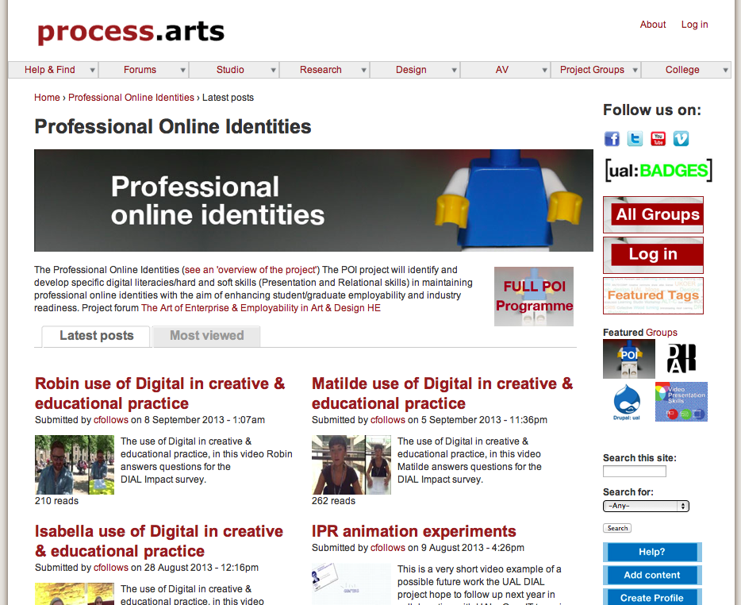
What next?
Curriculum embedding:
Pilot an embed approach by integrating with the POI programme
http://process.arts.ac.uk/content/professional-online-identities-poi-programme-2013

Slide 18
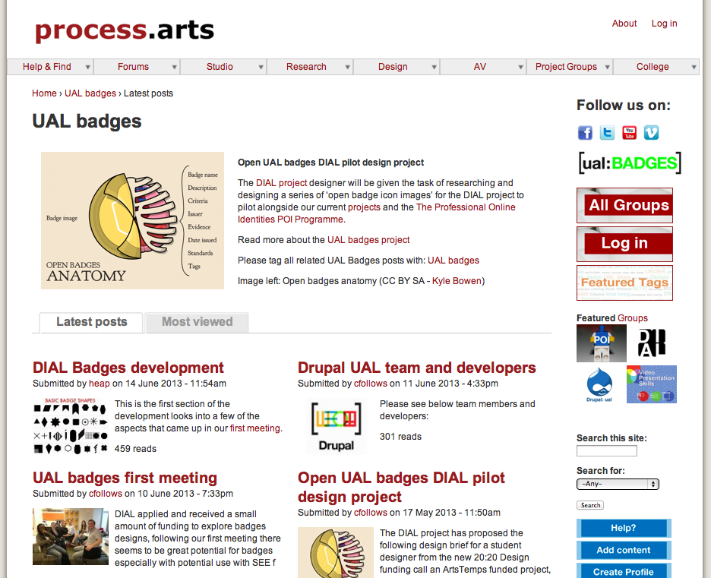
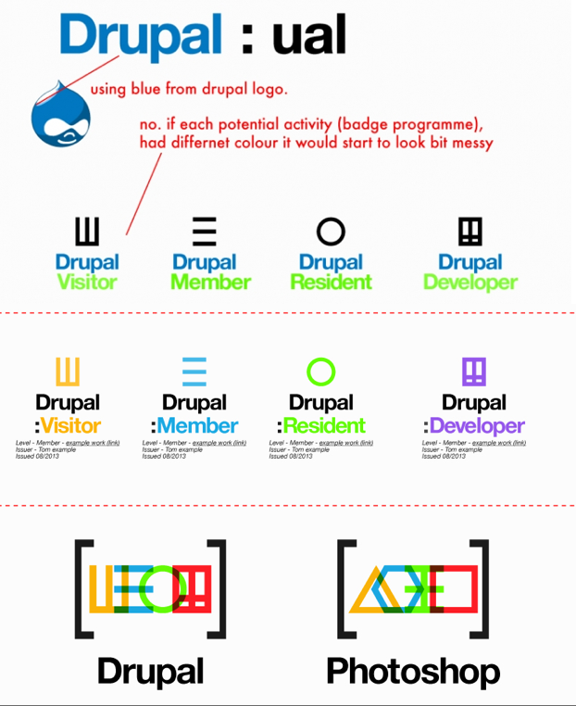
What next? Drupal UAL: Badges

Slide 19
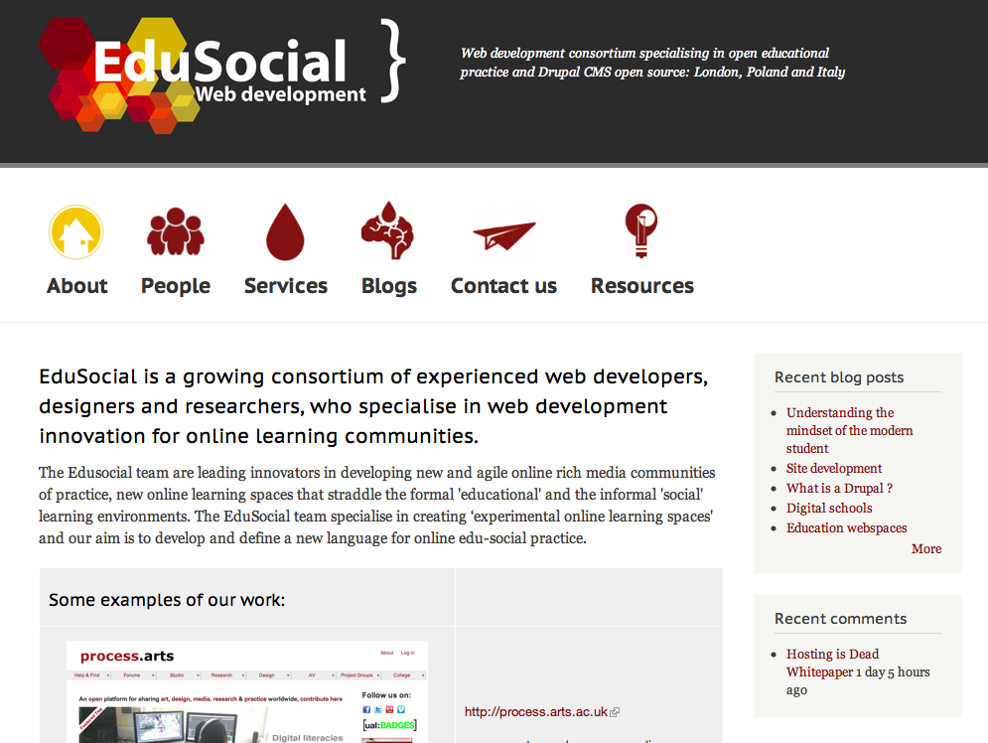
Web developers/Drupal consortium
Staff and students contact us for support and advise with their Drupal web development freelance work
We also aim to build up a team of experienced Drupal developers to work with us on large projects and commissions in the future

Slide 20
Thank You
Please contact: c.follows@arts.ac.uk

